Slide 1


The Rendering Pipeline -
Challenges & Next Steps
Johan Andersson
Electronic Arts

Slide 2
Intro
What does an advanced game engine real-time rendering pipeline look like?
What are some of the key challenges & open problems?
What are some of the next steps to improve on?
From both software & hardware perspectives

Slide 3

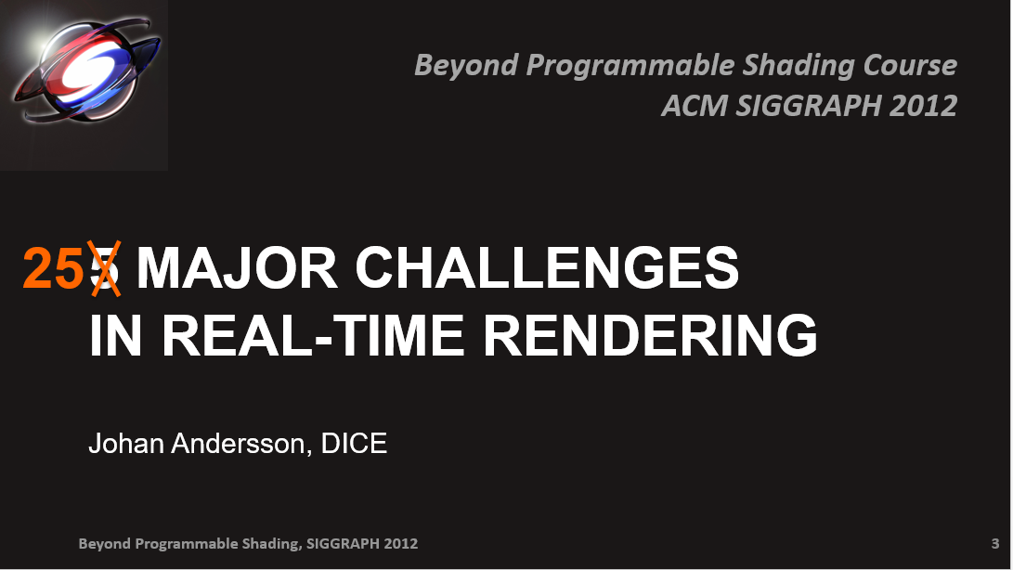
Previous talks
Notes:
But before that…. I did 2 talks around major challenges in real-time rendering in 2010 and 2012 as well.

Slide 4

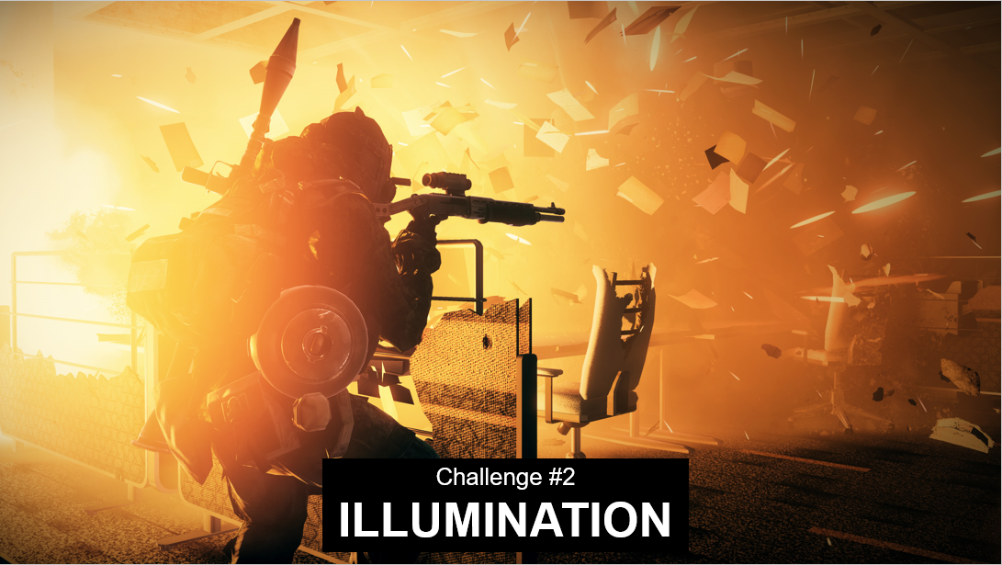
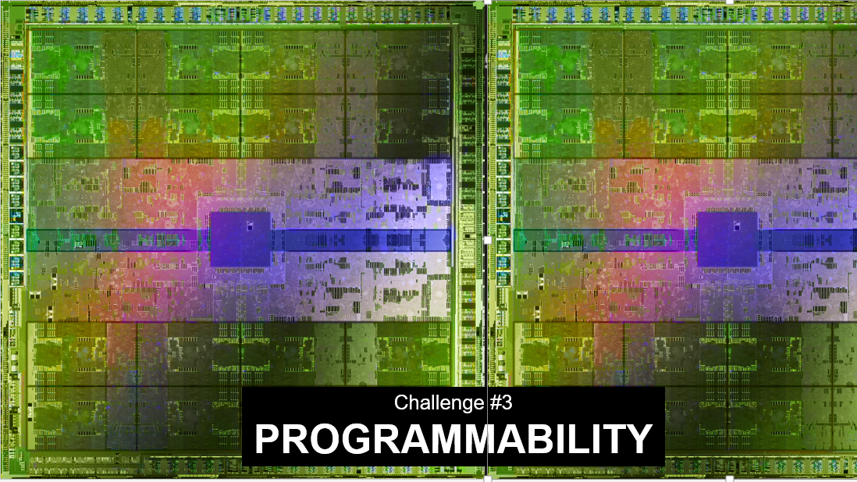
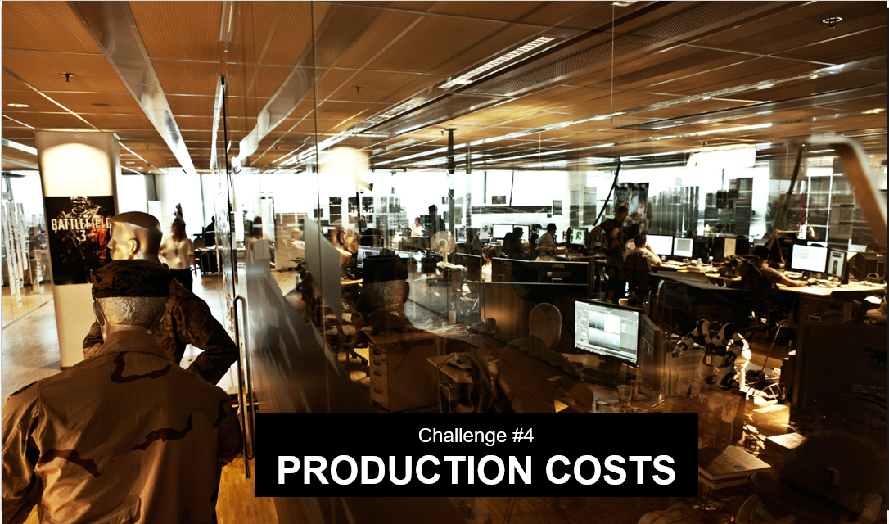
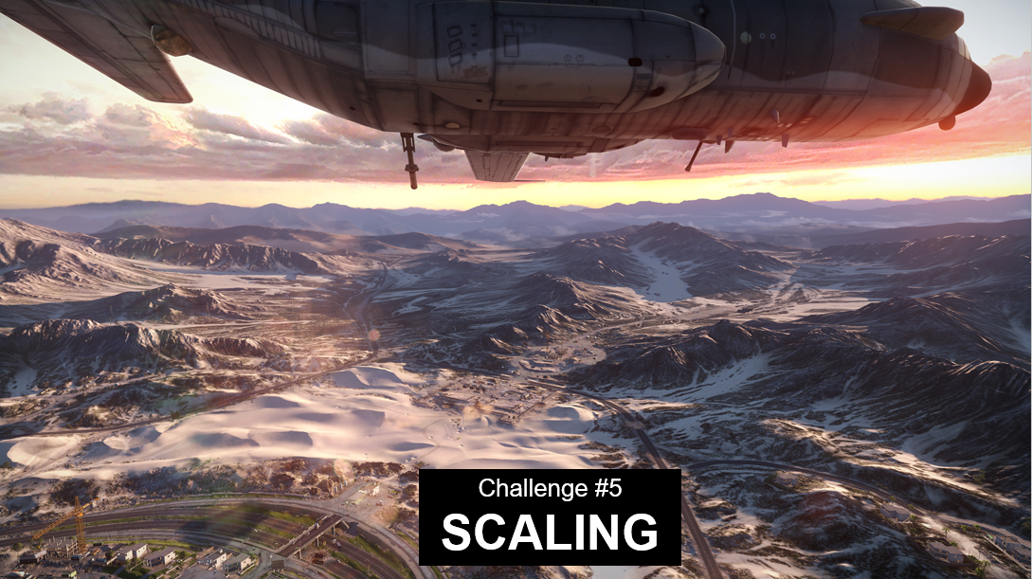
2010 & 2012 challenges

Slide 5
Photo-realistic rendering at 1W
Long term goal:

Slide 6
Improvements since 2010 & 2012
Image quality & authoring: massive transition to PBR
Reflections: SSR and perspective-correct IBLs
Antialiasing: TAA instead of MSAA
Gen4 consoles (PS4 & XB1) as new minspec
Compute shader use prevalent – create your own pipelines!

Slide 7
Improvements since 2010 & 2012 (cont.)
New explicit control APIs
  Mantle, Metal, DX12, Vulkan
  Well needed change & major step forward
  Not much improvements on compute & shaders
Programmability
  Conservative raster, min/max texture filter
  "Need a virtual data-parallel ISA" -> SPIR-V!
  "Render target read/modify/write" -> Raster Ordered Views
  Sparse resources
Notes:
The industry spent a lot of effort & energy (and still is) on the transition to low-level explicit graphics APIs
Haven't been that many other changes in the rendering pipeline
Esp. compute hasn't improved much

Slide 8
Pipeline of today – key themes
Non-orthogonality gets in the way – can we get to a more unified pipeline?
Complexity is continuing to increase
Increasing quality in a scalable way
Notes:
But let’s go back to the rendering pipeline of today

Slide 9
Getting to a more unified pipeline

Slide 10

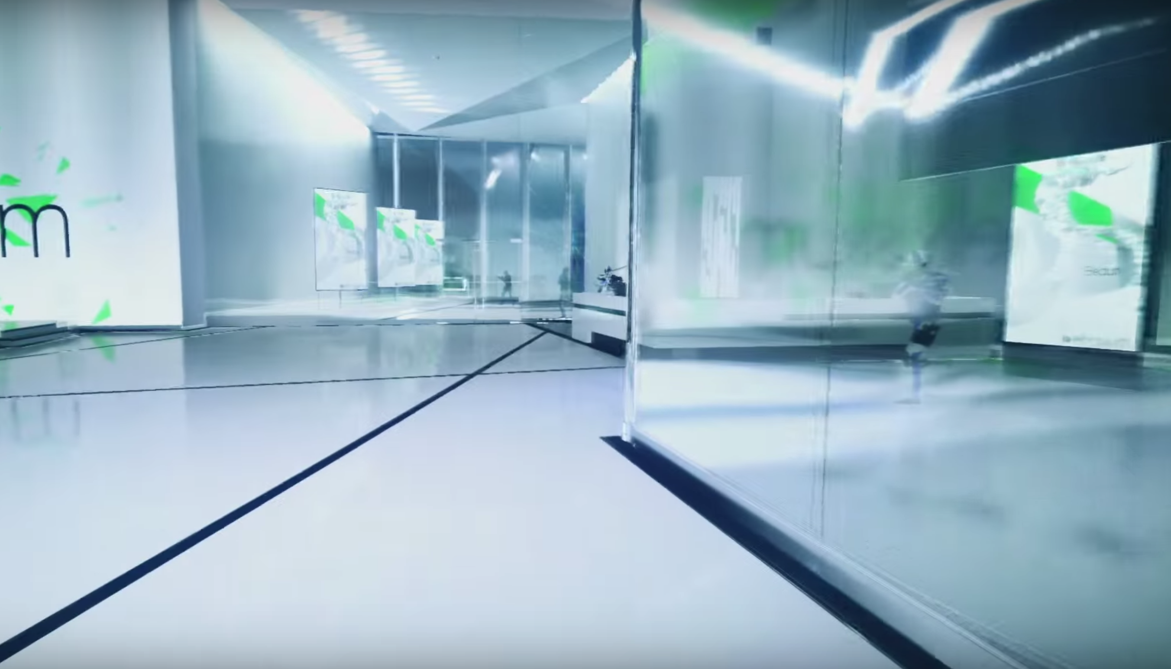
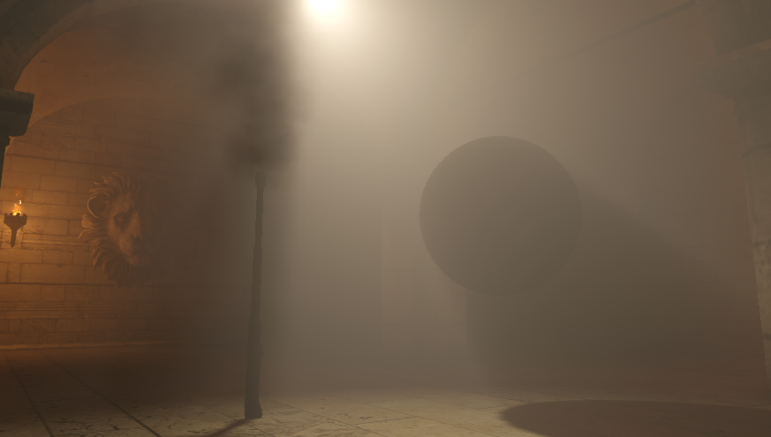
Transparencies – sorting
particles
Can’t mix different transparent surfaces & volumes
  Particles, meshes, participating media, raymarching
  Can’t render strict front to back to get correct sorting
  Most particles can be sorted, have to use uber shaders
Contrains game environments
Restricts games from using more volumetric rendering
meshes
volumetric

Slide 11
Transparencies – sorting solution
Render everything with Order-Independent Transparency (OIT)
  Use Raster Ordered Views (DX12 FL: Haswell & Maxwell)
  Not available on consoles = most games stuck with no OIT
Scalable to mix all types of transparencies with high quality?
  Transparent meshes (windows, foliage): 1-50x overdraw
  Particles: 10-200x overdraw
  Volume rendering (ray-marched)
Able to combine with variable resolution rendering?
  Most particles & participating do not need to be shaded at full resolution

Slide 12

Defocus & motion blur - opaque
Works okay in-game on opaque surfaces
  Render out velocity vectors
  Calc CoC from z
  Apply post-process
But not correct or ideal
  Leakage
  Disocclusion

Slide 13

Defocus & motion blur - transparencies
Transparent surfaces are even more problematic
  Esp. motion blur
  Typically simulated with stretched geometry (works mostly for sparks)
  Can only skip or smear everything with standard post-processes
  Fast moving particles should also have internal motion blur

Slide 14
Defocus & motion blur - transparencies
Blend velocity vectors & CoC for transparencies?
  Feed into the post-process passes
  Post-processes should also be depth-aware - use OIT approx. transmittance function
  Still not correct, but could prevent the biggest artifacts
Ideal: directly sample defocus & motion blur in rendering
  But how? Stochastic raster? Raytracing?
  Pre-filtered volumetric representations?
Notes:
Arbitrary ellipsoid / anisotropic filtering

Slide 15
Forward vs deferred
Most high-end games & engines use deferred shading for opaque geometry
  Better quad utilization
  Separation of material property laydown & lighting shaders
Would like to render more as transparent, which has to use forward
  Thin geometry: hair & fur
  Proxy geometry (foliage) with alpha-blending for antialiasing
But forward rendering is much more limiting in compositing
  No SSAO
  No screen-space reflections
  No decal blending of individual channels (e.g. albedo)
  No screen-space sub-surface scattering

Slide 16
Forward vs deferred (cont.)
Can we extend either forward or deferred to be more orthogonal?
Use world-space data structures instead of screen-space
  Be able to query & calc AO, reflections, decals while forward shading
  Texture shader to convolve SSS lighting
  Massive forward uber shaders that can do everything
Render opaque & transparent with deep deferred shading?
  Store all layers of a pixel, including transparents, in a deep gbuffer
  Unbounded memory
  Be able to query neighbors (AO)
  Be able to render into with blending (decals)

Slide 17
Rendering pipeline complexity

Slide 18
Rendering pipeline complexity
Recent improvements that reduce complexity ☺
  New APIs are more explicit – less of a black box
  DX11 hardware & compute shaders now minspec
  Hardware trend towards DX12 feature level

Slide 19
Rendering pipeline complexity
Challenges:
  Sheer amount of rendering systems & passes
  Making architectural choices of what techniques & pipeline to use
  Shader permutations & uber shaders
  Compute shaders still very limiting – no nested dynamic parallelism & pipes
  Mobile: TBDR vs immediate mode

Slide 20
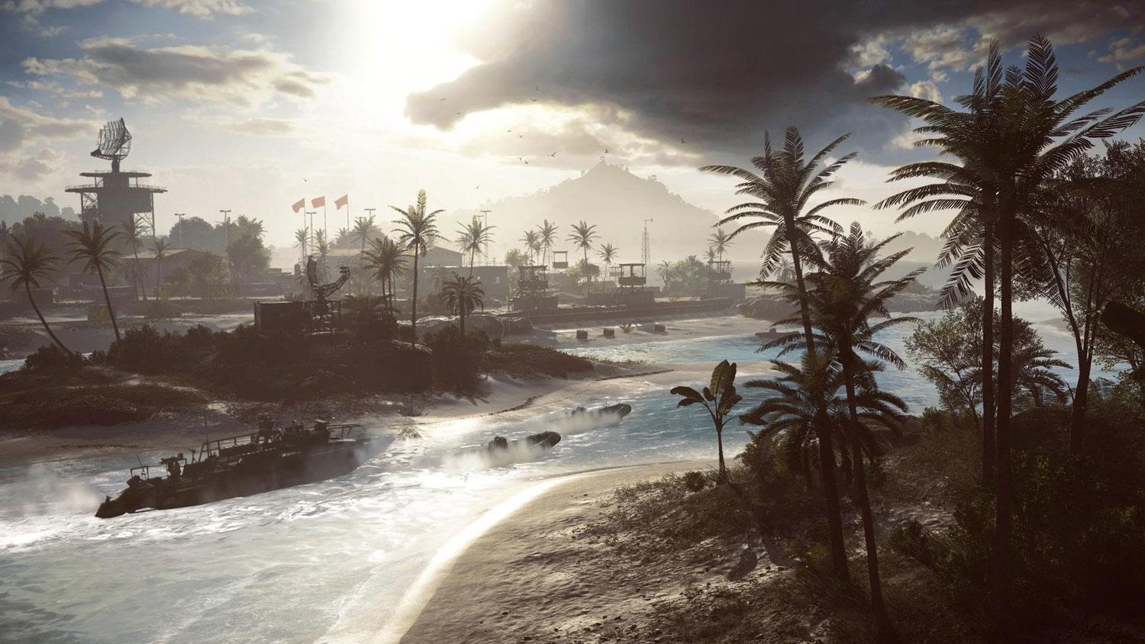
Battlefield 4 rendering passes
Battlefield 4

Slide 21
Battlefield 4 rendering passes
reflectionCapture
planarReflections
dynamicEnvmap
mainZPass
mainGBuffer
mainGBufferSimple
mainGBufferDecal
decalVolumes
mainGBufferFixup
msaaZDown
msaaClassify
lensFlareOcclusionQueries
lightPassBegin
cascadedShadowmaps
spotlightShadowmaps
downsampleZ
linearizeZ
ssao
hbaoHalfZ
hbao
ssr
halfResZPass
halfResTransp
mainDistort
lightPassEnd
mainOpaque
linearizeZ
mainOpaqueEmissive
mainTransDecal
fgOpaqueEmissive
subsurfaceScattering
skyAndFog
hairCoverage
mainTransDepth
linerarizeZ
mainTransparent
halfResUpsample
motionBlurDerive
motionBlurVelocity
motionBlurFilter
filmicEffectsEdge
spriteDof
fgTransparent
lensScope
filmicEffects
bloom
luminanceAvg
finalPost
overlay
fxaa
smaa
resample
screenEffect
hmdDistortion
Notes:
This is the rendering passes we had in Frostbite 2 years ago for Battlefield 4.
Our pipeline now with PBR has even more passes and complexity

Slide 22
Architectural decisions
Selecting which techniques to develop & invest in is a challenge
  Critical to create visual look of a game
  Non-orthogonal choices and tradeoffs
  Difficult to predict the moving future of hardware, games and authoring
Can be paralyzing with a big advanced engine rendering pipeline
  Exponential scaling with amount of systems & techniques interacting
  Difficult to redesign and move large passes
  Can result in a lot of refactoring & cascading effects to the overall pipeline
  Backwards compatibility with existing content
  Easier if passes & systems can be made more decoupled

Slide 23
What can we do to reduce complexity?
A more unified pipeline would certainly help!
  Such as with OIT
  Or in the long term: native handling of defocus & motion blur
Improve GPU performance – simplify rendering systems
  Much of the complexity comes from optimizations for performance
  Could sacrifice a bit of performance for increased orthogonality, but not much
  We have real-time constrain = get the most out of our 16 ms/f (VR: 4 ms/f!)
Raytrace & raymarch more
  Easier to express complex rendering
  Warning: moves to complexity to data structures and the GPU execution instead
  Not practical overall replacement / unification
  Use as complement – more & more common (SSR, volume rendering, shadows?)

Slide 24
What can we do to reduce complexity?
Make it easier to drive the graphics & compute
  CPU/GPU communication – C++ on both sides (and more languages)
  Device enqueue & nested data parallelism
  Increase flexibility, expressiveness & modularity of building pipelines
Build a specialized renderer
  Focus in on very specific rendering techniques & look
  Typically tied to a single game
  E.g. The Tomorrow Children, Dreams
Build engines, tools & infrastructure to build general renderers
  Handle wide set of environments, content and techniques
  Modular layers to easily have all the passes & techniques interoperate
  Shader authoring is also key

Slide 25
Uber shaders
Example cases:
  Forward shaders (lights, fog, skinning, etc)
  Particles (to be able to sort without OIT) – want to use individual shaders instead
  Terrain layers [Andersson07] – want to use massive uber shaders
Why they can be a problem:
  Authoring: Massive shaders with all possible paths in it, no separate shader linker
  Performance: Large GPR pressure affects entire shader
  Performance: Flow control overhead
Classic approach: break out into separate shader permutations
  Static CPU selection of shader/PSO to use – limited flexibility
  Can end up creating huge amount of permutations = long compile/load times.
  Worse with new APIs! PSO explosion

Slide 26
Uber shaders – potential improvements
Shader function pointers
  Define individual functions as own kernels
  Select pointers to use per draw call
    Part of ExecuteIndirect params
  Ideal: Select pointers inside shader – not possible today
    Optimization: VS selects pointers PS will use?
  What would the consequences be for the GPU?
    I$ stalls, register allocation, coherency, more?
More efficient GPU execution of uber shaders?
  Shaders with highly divergent flow & sections with very different GPR usage
  Hardware & execution model that enables resorting & building coherency?

Slide 27
Scalable quality

Slide 28
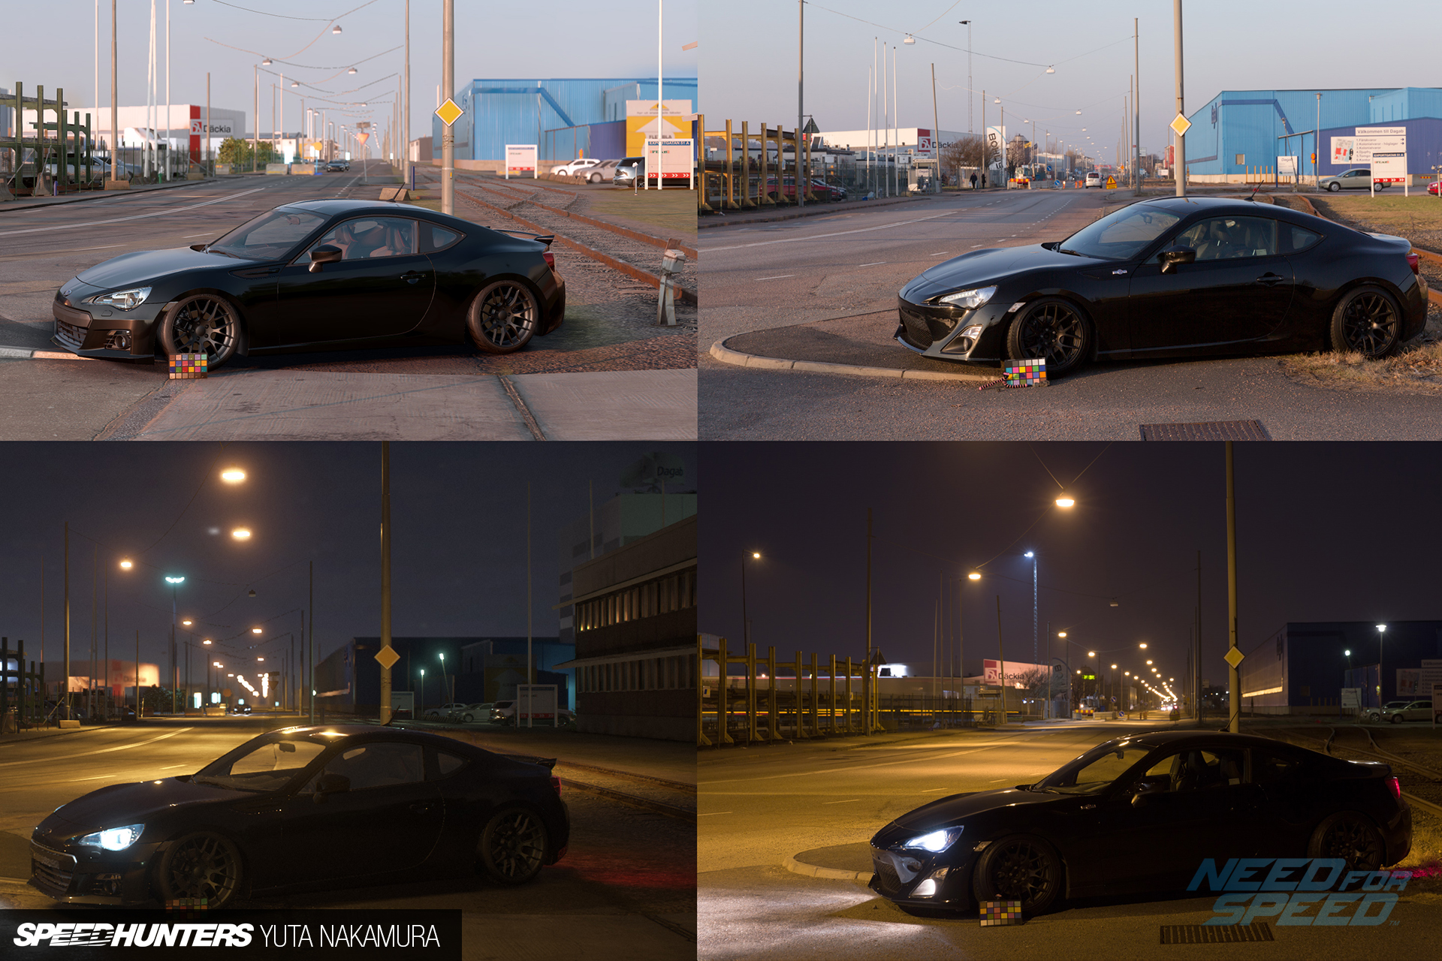
Notes:
We’ve gotten really far with our real-time rendering results. Here is 2 screenshots and 2 photos of the same area from the new Need for Speed game. And it is getting quite difficult to tell which one is the photo and which one is the real-time render!

Slide 29

Real-time rendering have gotten quite far!
In order to get further, want to:
  Get that last 5-10% quality in our environments to reach photorealism
NFS photo reference
Notes:
But what is left to do, what are we missing to get that last 5-10%?
It is also important to note that this is specifically created scene and as with all game development and real-time rendering we select & craft our worlds & visuals based on the limitations we know about. We avoid creating environments that we know we can’t create or won’t have the performance for or that doesn’t fit in together with the gameplay or other aspects.

Slide 30
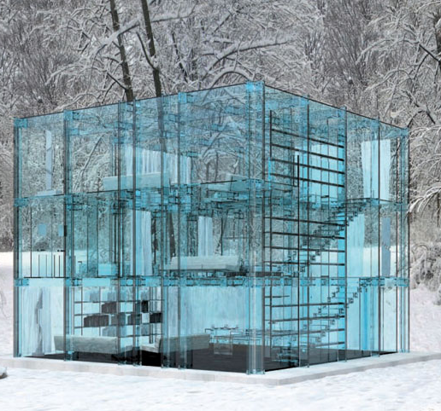
Real-time rendering have gotten quite far!
In order to get further, want to:
  Get that last 5-10% quality in our environments to reach photorealism
  Be able to build & render new environments that we haven’t been able to before
Glass houses!
Notes:
But what is left to do, what are we missing to get that last 5-10%?
It is also important to note that this is specifically created scene and as with all game development and real-time rendering we select & craft our worlds & visuals based on the limitations we know about. We avoid creating environments that we know we can’t create or won’t have the performance for or that doesn’t fit in together with the gameplay or other aspects.

Slide 31

Real-time rendering have gotten quite far!
In order to get further, want to:
  Get that last 5-10% quality in our environments to reach photorealism
  Be able to build & render new environments that we haven’t been able to before
Dreams (MediaMolecule)
Notes:
But what is left to do, what are we missing to get that last 5-10%?
It is also important to note that this is specifically created scene and as with all game development and real-time rendering we select & craft our worlds & visuals based on the limitations we know about. We avoid creating environments that we know we can’t create or won’t have the performance for or that doesn’t fit in together with the gameplay or other aspects.

Slide 32

Difficult areas
Hair & fur
  OIT, overdraw, LOD, quad overshading, deep shadows
Foliage
  OIT, overdraw, LOD, geometry throughput,
  Lighting, translucency, AO
Fluids
  LOD & scalability, simulation, overall rendering
VFX
  Need volumetric representation & lighting
  Related to [Hillaire15]

Slide 33

Difficult areas
Hair & fur
  OIT, overdraw, LOD, quad overshading, deep shadows
Foliage
  OIT, overdraw, LOD, geometry throughput,
  Lighting, translucency, AO
Fluids
  LOD & scalability, simulation, overall rendering
VFX
  Need volumetric representation & lighting
  Related to [Hillaire15]

Slide 34
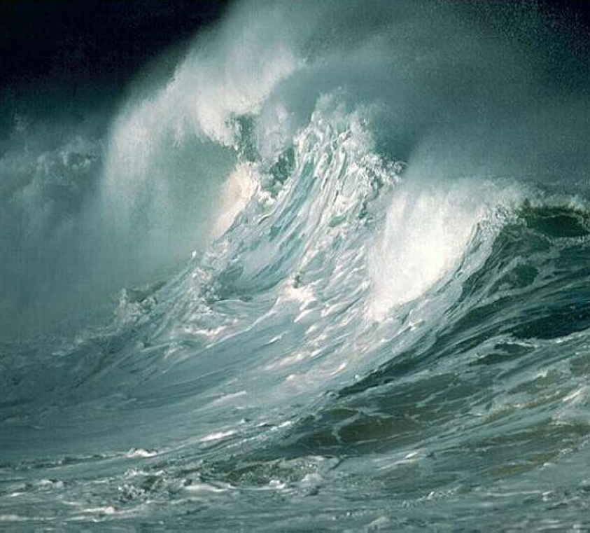
Difficult areas
Hair & fur
  OIT, overdraw, LOD, quad overshading, deep shadows
Foliage
  OIT, overdraw, LOD, geometry throughput,
  Lighting, translucency, AO
Fluids
  LOD & scalability, simulation, overall rendering
VFX
  Need volumetric representation & lighting
  Related to [Hillaire15]

Slide 35
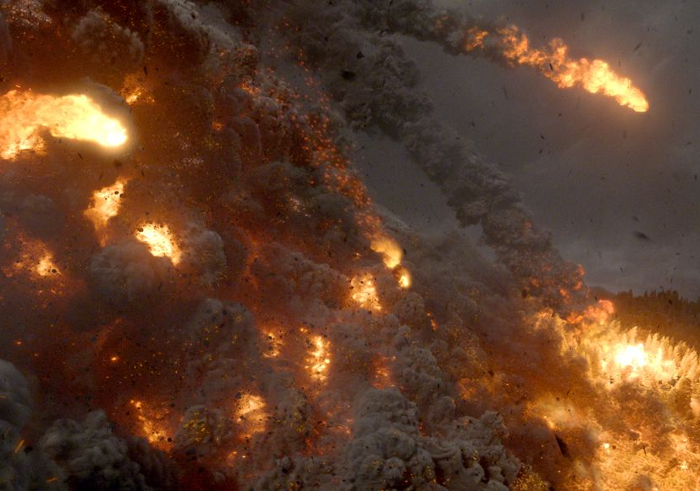
Difficult areas
Hair & fur
  OIT, overdraw, LOD, quad overshading, deep shadows
Foliage
  OIT, overdraw, LOD, geometry throughput,
  Lighting, translucency, AO
Fluids
  LOD & scalability, simulation, overall rendering
VFX
  Need volumetric representation & lighting
  Related to [Hillaire15]
Pompeii movie

Slide 36
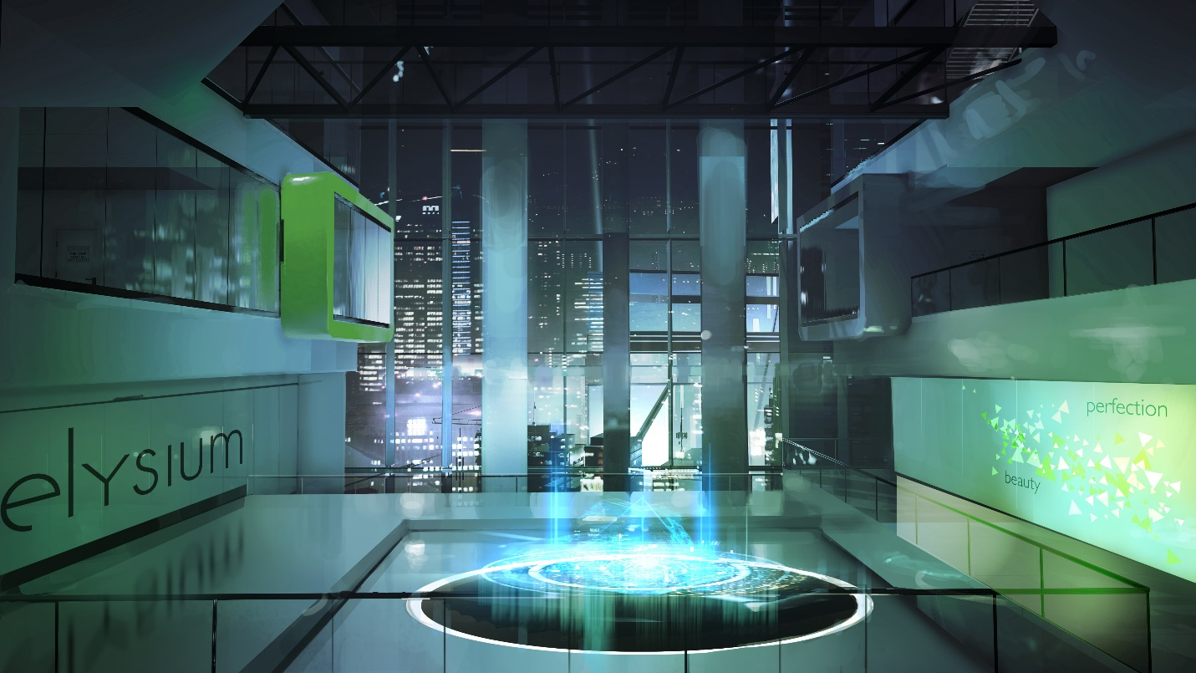
Difficult areas (cont.)
Correct shadows on everything
  Including area lights & shadows!
  Extra important with PBR to prevent leakage
  Geometry throughput, CPU overhead, filtering, LOD
Reflections
  Hodgepodge of techniques today
  Occlusion of specular critical
  See Mirror’s Edge talk [Johansson15]
Antialiasing
  See [Salvi15] next
Mirror’s Edge: Catalyst concept

Slide 37
Quality challenges
Getting the last 5-10% quality can be very expensive
  While covering a relatively small portion of the screen
  Example: hair & fur rendering
  Improving GPUs in some of these areas may not benefit “ordinary” rendering
How to build truly scalable solutions
  Example: Rendering, lighting and shadowing a full forest
  Level-of-detail is a key challenge for most techniques to make them practical
Notes:
Avoid perf cliffs, prefer linear scaling cost of systems

Slide 38
Scalable solutions – screen-space
Sub-surface scattering went from texture- to screen-space
  Orders of magnitude faster
  Implicitly scalable + no per-object tracking
  Not perfect, but made it practical & mainstream
Volumetric rendering to view frustum 3d texture
  Froxels! See [Wronski14] and [Hillaire15]

Slide 39
Scalable solutions – screen-space
Can one extend screen-space techniques further?
Render multiple depth layers to solve occlusion
  Multi-layer deep gbuffers [Mara14]
Render cubemap to reach outside of frustum
  Render lower resolution separate cubemap, slow
  Render main view as cubemap with variable resolution?
    Single geometry pass
    Also for fovated rendering

Slide 40
Scalable solutions – pre-compute
Traditionally a strong cut off between pre-computed & runtime solutions
Believe this is going away more – techniques and systems have to scale & cover more of the spectrum:
  Offline pre-compute: Highest-quality
  Load-time pre-compute: High-quality
  Background compute: Medium-quality
  Runtime
Want flexible tradeoffs depending on contexts
  Artist live editing lighting
  Gamer customizing in-game content
  Background gameplay changes to the game environment

Slide 41
Scalable solutions – hierarchical geometry
Want to avoid wasteful brute force geometry rendering
Do your own culling, occlusion & LOD directly on the GPU
  Finer granularity than CPU code
  Engine can have more context and own spatial data structures
  Combined with GPU information (for example HiZ)
  Opportunities to extend the GPU pipeline?
Compute as frontend for graphics pipeline to accelerate
  Avoid writing geometry out to memory
  Good fit with procedural geometry systems as well

Slide 42
Takeaways
We’ve gotten very far in the last few years!
  Big transitions: PBR, Gen4, Compute, explicit APIs
We are at the cusp of a beautiful future!
Build your own rendering pipelines & data structures
  But which ones? All of them! ☺
Need reduce coupling & further evolve GPU execution models

Slide 43
Thanks to everyone who provided feedback!
Sébastien Hillaire (@sebhillaire)
Christina Coffin (@christinacoffin)
John White (@zedcull)
Aaron Lefohn (@aaronlefohn)
Colin Barré-Brisebois (@zigguratvertigo)
Sébastién Lagarde (@seblagarde)
Tomasz Stachowiak (@h3r2tic)
Andrew Lauritzen (@andrewlauritzen)
Jasper Bekkers (@jasperbekkers)
Yuiry O’Donnell (@yuriyodonnell)
Kenneth Brown
Natasha Tatarchuk (@mirror2mask)
Angelo Pesce (@kenpex)
David Reinig (@d13_dreinig)
Promit Roy (@promit_roy)
Rich Forster (@dickyjimforster)
Niklas Nummelin (@niklasnummelin)
Tobias Berghoff (@tobiasberghoff)
Morgan McGuire (@casualeffects)
Tom Forsyth (@tom_forsyth)
Eric Smolikowski (@esmolikowski)
Nathan Reed (@reedbeta)
Christer Ericson (@christerericson)
Daniel Collin (@daniel_collin)
Matias Goldberg (@matiasgoldberg)
Arne Schober (@khipu_kamayuq)
Dan Olson (@olson_dan)
Joshua Barczak (@joshuabarczak)
Bart Wronski (@bartwronsk)
Krzysztof Narkowicz (@knarkowicz)
Julien Guertault (@zavie)
Sander van Rossen (@logicalerror)
Lucas Hardi (@lhardi)
Tim Foley (@tangentvector)

Slide 44

Questions?
    Email: johan@ea.com
    Web: http://frostbite.com
    Twitter: @repi

Slide 45
References
[Andersson07] Terrain rendering in Frostbite using Procedural Shader Splatting
[Hillaire15] Physically Based and Unified Volumetric Rendering in Frostbite
[Wronski14] Volumetric fog: Unified, compute shader based solution to atmospheric scattering
[Salvi15] Anti-Aliasing: Are We There Yet?
[Mara14] Fast Global Illumination Approximations on Deep G-Buffer
[Johansson15] Leap of Faith: The World of Mirror’s Edge Catalyst

