Slide 1
Anti-Aliasing: Are We There Yet?
Marco Salvi
NVIDIA Research
Notes:
Games

Slide 2
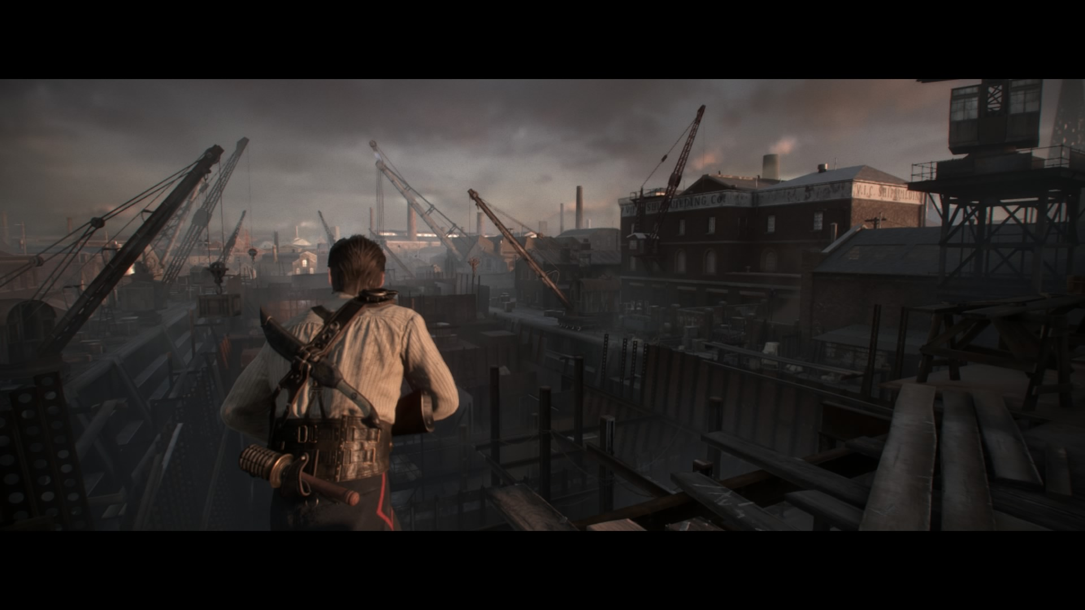
“The Order: 1866” © Sony Computer Entertainment
Notes:
As an industry we made some tremendous progress in the last few years.

Slide 3
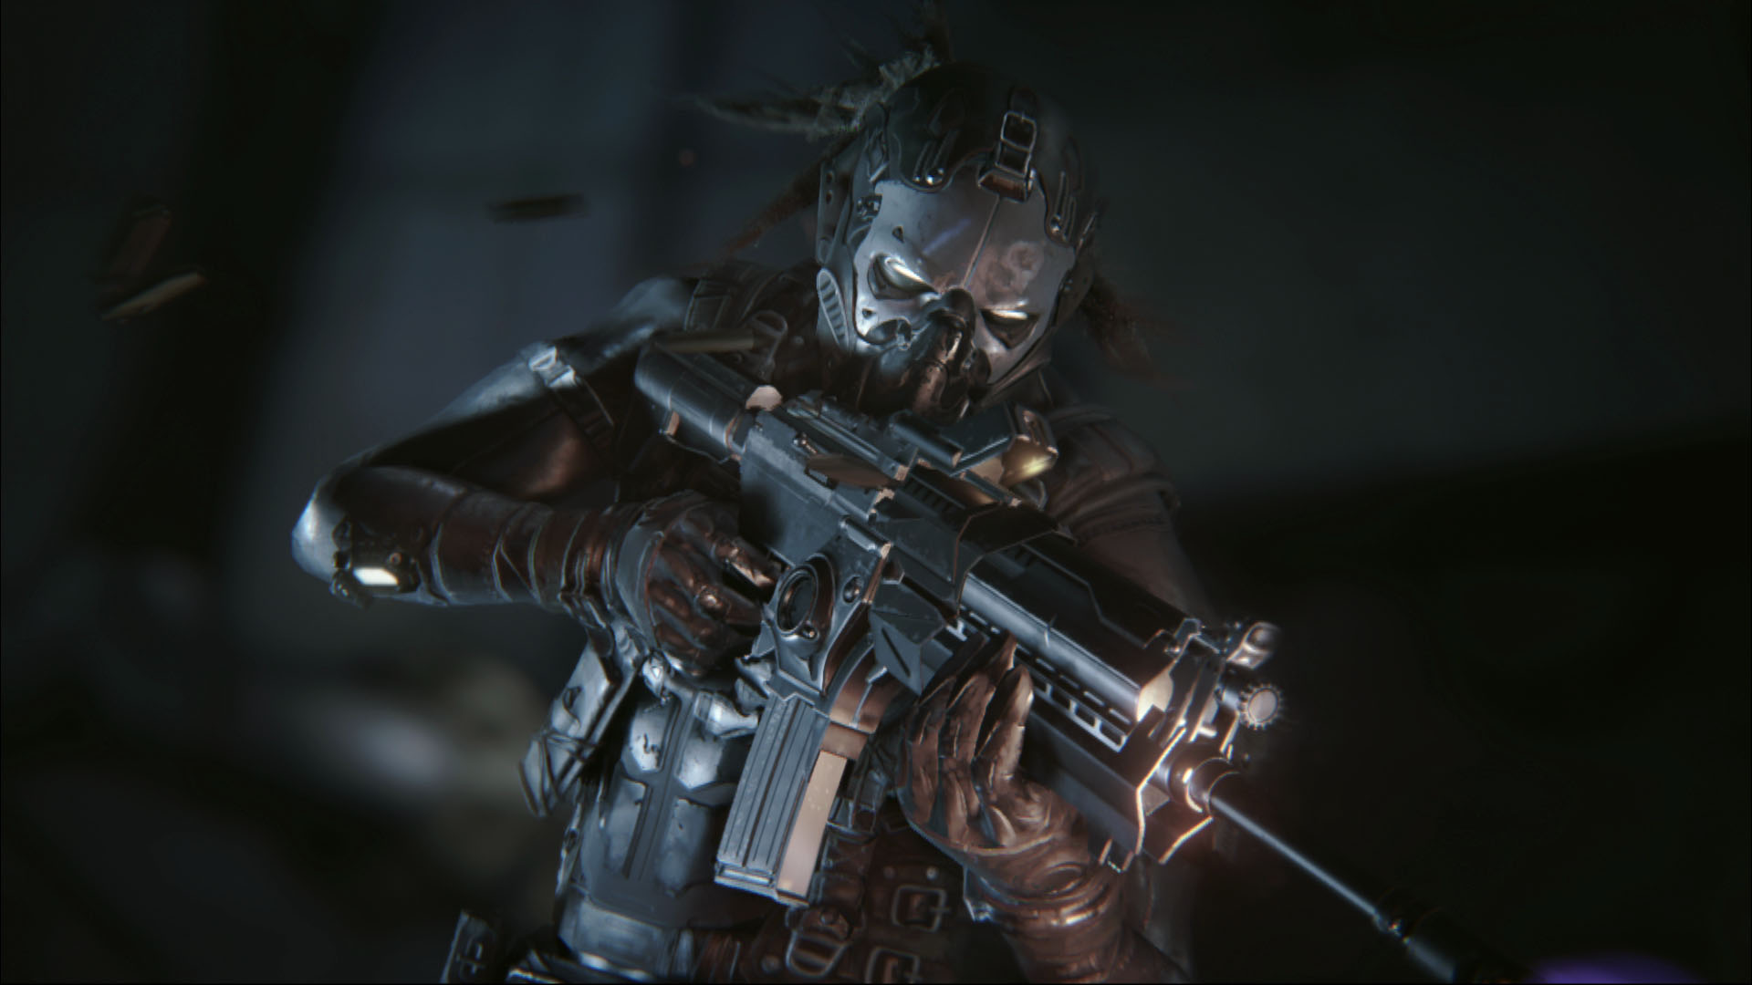
“Infiltrator” Unreal Engine 4 demo © Epic Games
Notes:
Modern games look absolutely amazing.

Slide 4
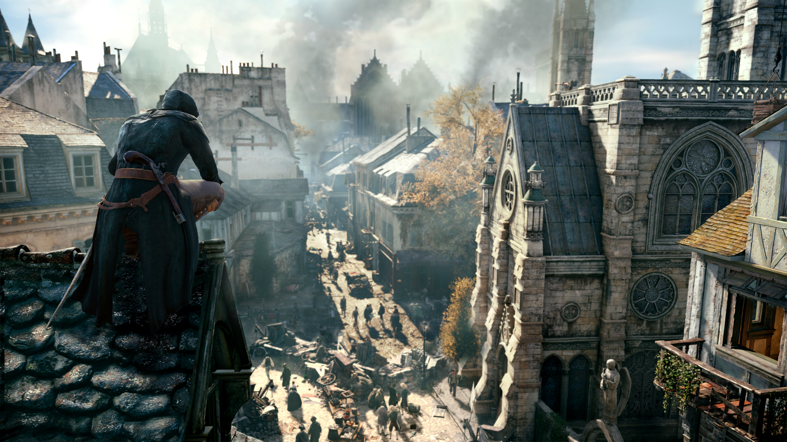
“Assassin’s Creed Unity” © Ubisoft
Notes:
A few years ago it would have been hard to believe these images are rendered in real-time on consumer-grade HW.

Slide 5
Not even close ☺
Notes:
Despite all this progress “solving” aliasing in real-time applications still remains a distant and elusive goal.

Slide 6
What Is Aliasing?

Slide 7
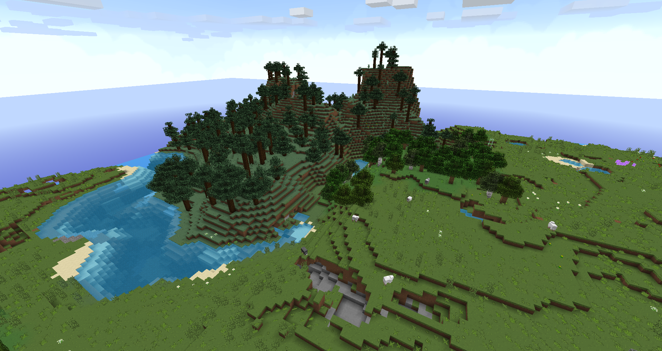
Notes:
When I first heard about the term aliasing it was in association with jagged and staircase-like features in an image.
This is an innacurate definition. For instance in this image we have jagged structures at all scales but only some of them are a manifestation of “aliasing”.
A more accurate definition is needed..

Slide 8
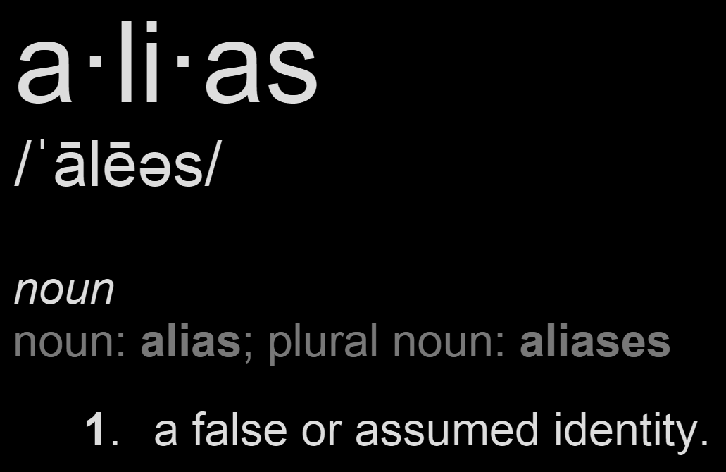
What is aliasing?
high frequency information
disguised
as low frequency information
Notes:
Aliasing is high frequency information disguising itself as low frequency information → Aliasing is “identify theft” for signals
Although, even the standard technical definition of aliasing, while being more accurate, is not of much help because it does not tell us how this “identify theft” process takes place.

Slide 9
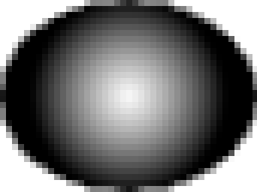
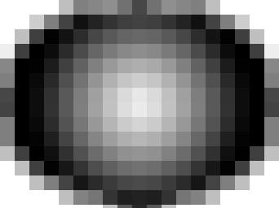
Aliasing can be caused by an insufficient sampling rate
A
f
aliasing
Notes:
The Fourier transform of a Gaussian blob yields another Gaussian, which we visualize here as 1D slice in frequency space.
The process of sampling the Gaussian blog, that is going from a continuous to discrete domain, generates copies of its spectrum (everything is good so far).
If the sampling rate is too low the spectrum of the discretized signal contains overlapping copies of the original signal → aliasing
Every time we perform a conversion from continuous to discrete domain (i.e. we take a sample) we can introduce aliasing.
Theoretically speaking to avoid aliasing one has to match the Nyquist limit, that is the sampling frequency has to be 2X the max siginal frequence. In practice we need to go higher than that..

Slide 10
Two main strategies to attack aliasing
more samples
aliasing
pre-filtering

Slide 11
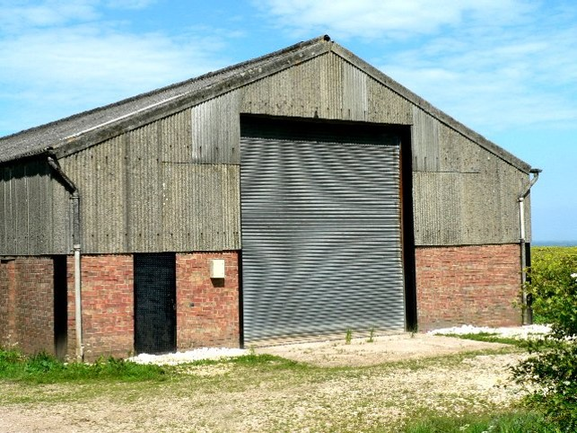

Aliasing can also be caused by poor reconstruction
A
f
aliasing
aliasing
aliasing
aliasing
Roger Gilbertson
Notes:
Aliasing can also be introduced when performing the opposite process as we convert from a discrete to a continuous domain.
We must make sure that our reconstruction filter spectrum won’t erroneously include unwanted copies of the original signal spectrum.

Slide 12
How Does Nature Solve Aliasing?

Slide 13
60 cycles/degree is a magic number
It is the Nyquist limit set by the spacing of photoreceptors in the eye
It is also the spatial cutoff of the optics of the eye
Unlikely to be a coincidence
  Photoreceptors density is thought to be a physical limit
  Species with better optics use “tricks” to increase photoreceptors density
Evolution gave us optics to filter out high freq that could lead to aliasing!
  Is sampling at the Nyquist limit even good enough? (e.g. HMD with 10K x 10K res per eye)
  Pre-filtering is the only substitute for the eye optics

Slide 14
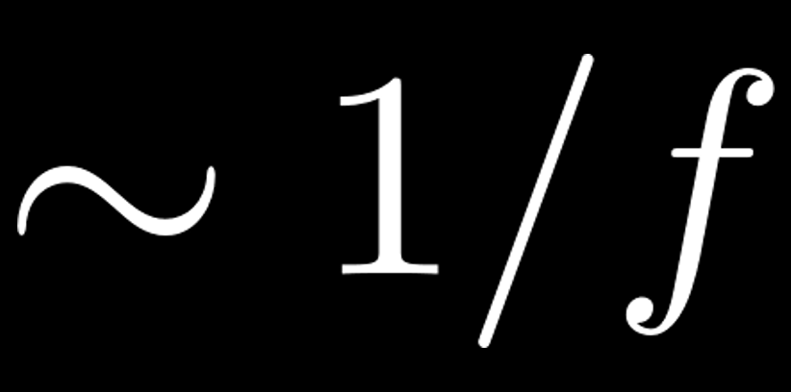
Why do we perceive aliasing as something bad?
A few hypotheses..
  No (or little?) aliasing in the fovea region
  The amplitude of natural images spectrum is
    Does aliasing make CG images even more “unnatural”?
  Brain might find difficult to stereo-fuse some parts of the image (VR/AR)
    Fine features seen from left eye are different from ones seen from right eye
    Could cause vergence/accommodation conflicts → “something is wrong” feeling

Slide 15
How Does Our Industry Solve Aliasing?

Slide 16
Real-time is harder than off-line
Per-shot tuning → great image quality
  More samples
    Just throw more samples until the problem goes away, otherwise..
  Pre-filtering → assets specialization
    Code, models, textures, lighting, etc.
Much harder to apply the same model to real-time rendering
  Can’t use as many samples
    Limited time, memory, compute, power, etc.
  Assets specialization cannot be used as extensively

Slide 17

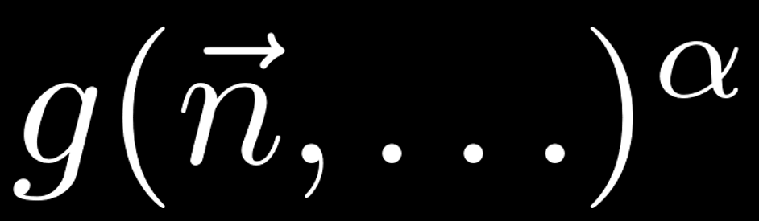
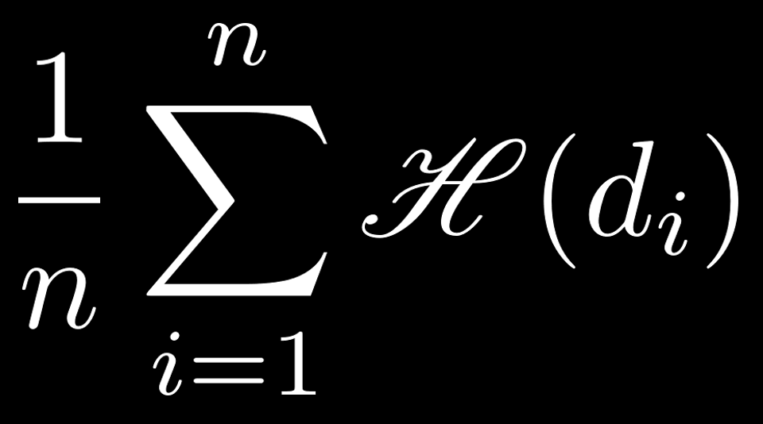
Pre-filtering data is hard
data
Mip mapping is great for color but..
  Only works with linear transformations →
  Pre-filtering of normals and visibility are still open problems
Specular highlights →
  Alternative NDF representations
    Toksgiv, (C)LEA(DR)(N) mapping
Shadows → PCF →
non-linear
linear
visibility test
non-linear
Notes:
Mip mapping is a hugely successful method for pre-filtering data but it can only be used when the data transforms linearly.
For instance mip mapping normals is incorrect since lighting (especially specular lighting) is typically a non-linear function of many variables, including normals.
The same is true for shadows/visibility.
One way to work around this issue is to switch to a different representation under which our data transforms linearly.

Slide 18
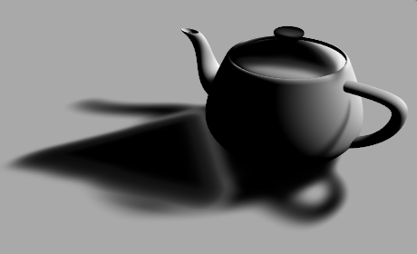
Pre-filtering visibility really is hard
Represent depth distribution via first N moments (aka the Hausdorff problem)
  N = 2 → variance shadow maps [Donnelly and Lauritzen 2006]
  N = 1 → exponential shadow maps [Salvi 2008] [Annen et al. 2008]
  N = [-2, 2] → exponential variance shadow maps [Lauritzen et al. 2011]
  …
[spoiler alert] The Hausdorff problem is ill defined!
Notes:
A popular method is to think as some data we want to pre-filter as a statistical distribution and use the first N moments of such distribution as an approximate representation of the original data.
Raw moments transform linearly, which allows us to put them in a mipmap, as long as we can perform computations on the distribution itself, without recovering the original data.
For instance the visibility test of a shadow map filter is equivalent to computing a cumulative distribution function that can be evaluated implicitly, even without having a model for the distribution, using various inequalities (Chebyshev, Markov, etc..).
A lot of work has been published on shadow pre-filtering but none of it is really robust since recovering a distributing from its moment is inherently an ill defined problem. For instance it is easy to build completely different distributions that generate the very same first N moments.
The same methodology applied to normal distributions (e.g. LEAN mapping) suffer from the same type of problems.

Slide 19

Pre-filtering code is even harder
Analytical anti-aliasing
  Symbolic integration
  Approximate function with hyperplane and integrate
  Convolve function with filter
  …
Multi-scale representations with a scale cutoff (aka frequency clamping)
  E.g. truncated Fourier expansion →
    Impractical to use on sharp functions due to slow convergence (e.g. convolution shadow maps)

Slide 20
Supersampling is often impractical
Shade N samples per pixel
  Image quality can be great, but highly dependent on content
  Performance impact can be significant
  Older apps on new GPUs benefit the most
The number of pixels continues to grow
  4K+ displays are becoming the norm
  Current VR headsets need ~500M pixels/s and likely to need more in the near future
    Foveated rendering techniques tend to increase aliasing!

Slide 21
The cost of samples can be high, alternatives abound
Samples consume compute, memory and bandwidth resources
  Taking more samples scale well on large GPUs
  Hardly ideal on mobile devices
There are many ways of getting new samples
  Direct evaluation (pre and post-shading)
  Re-use
  Recover \ Hallucinate

Slide 22
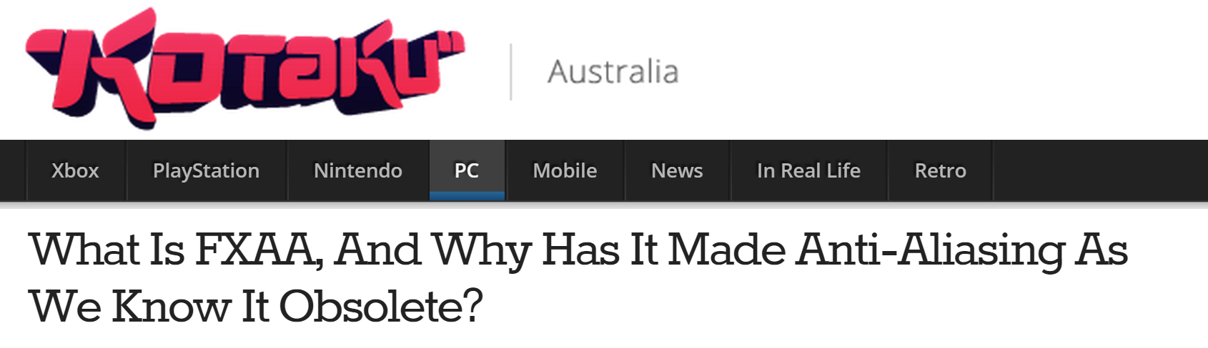
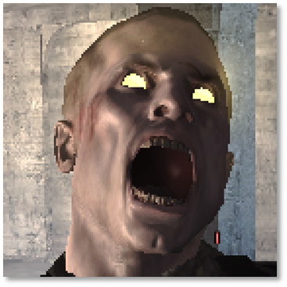
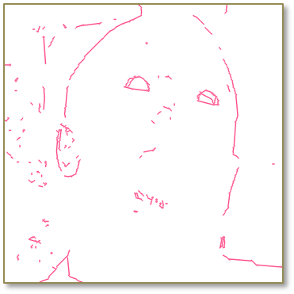
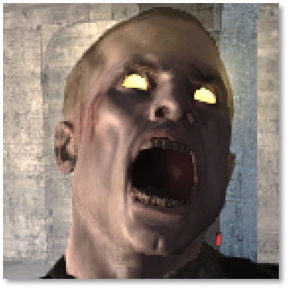
Hallucinating new samples is fun
Find silhouettes and blend color of surrounding pixels (MLAA) [Reshetov 2009]
  Blur along direction orthogonal to local contrast gradient (FXAA) [Lottes 2009]
  High performance & easy to integrate → very popular techniques
Notes:
At some point many thought FXAA was the solution to all of our aliasing problems..

Slide 23
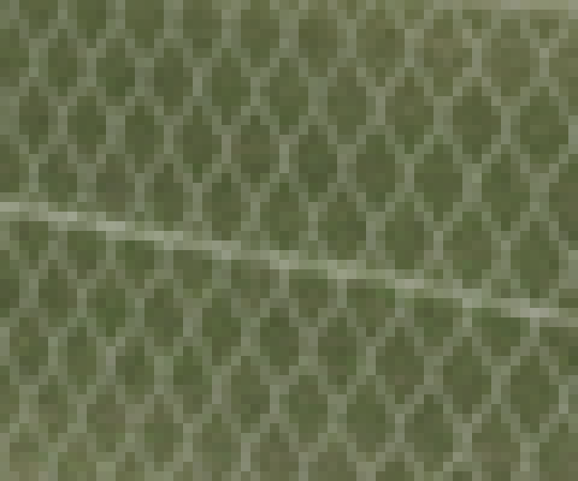
SSAA

Slide 24
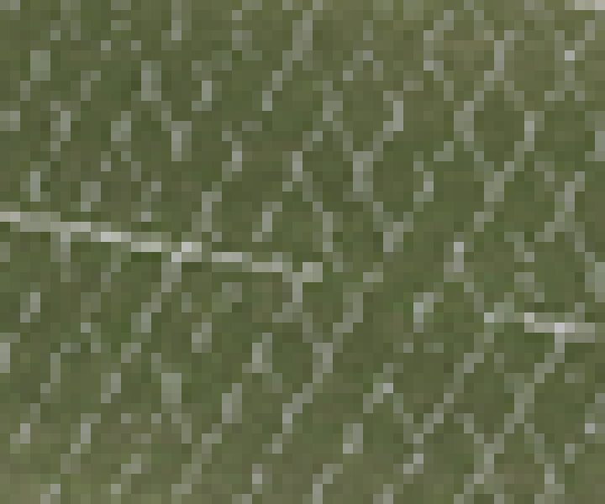
No AA

Slide 25
No AA
Notes:
It is impossible to hallucinate the missing samples → spatial and temporal aliasing

Slide 26
Hallucinating new samples is fun (when it works)
Pixel color can change abruptly → temporal artifacts
  Missing sub-pixel data
  Dynamic content and camera
It is impossible to generate a coherently “anti-aliased” image
  Can we remove short-lived & high-contrast image features by filtering in space AND time?

Slide 27
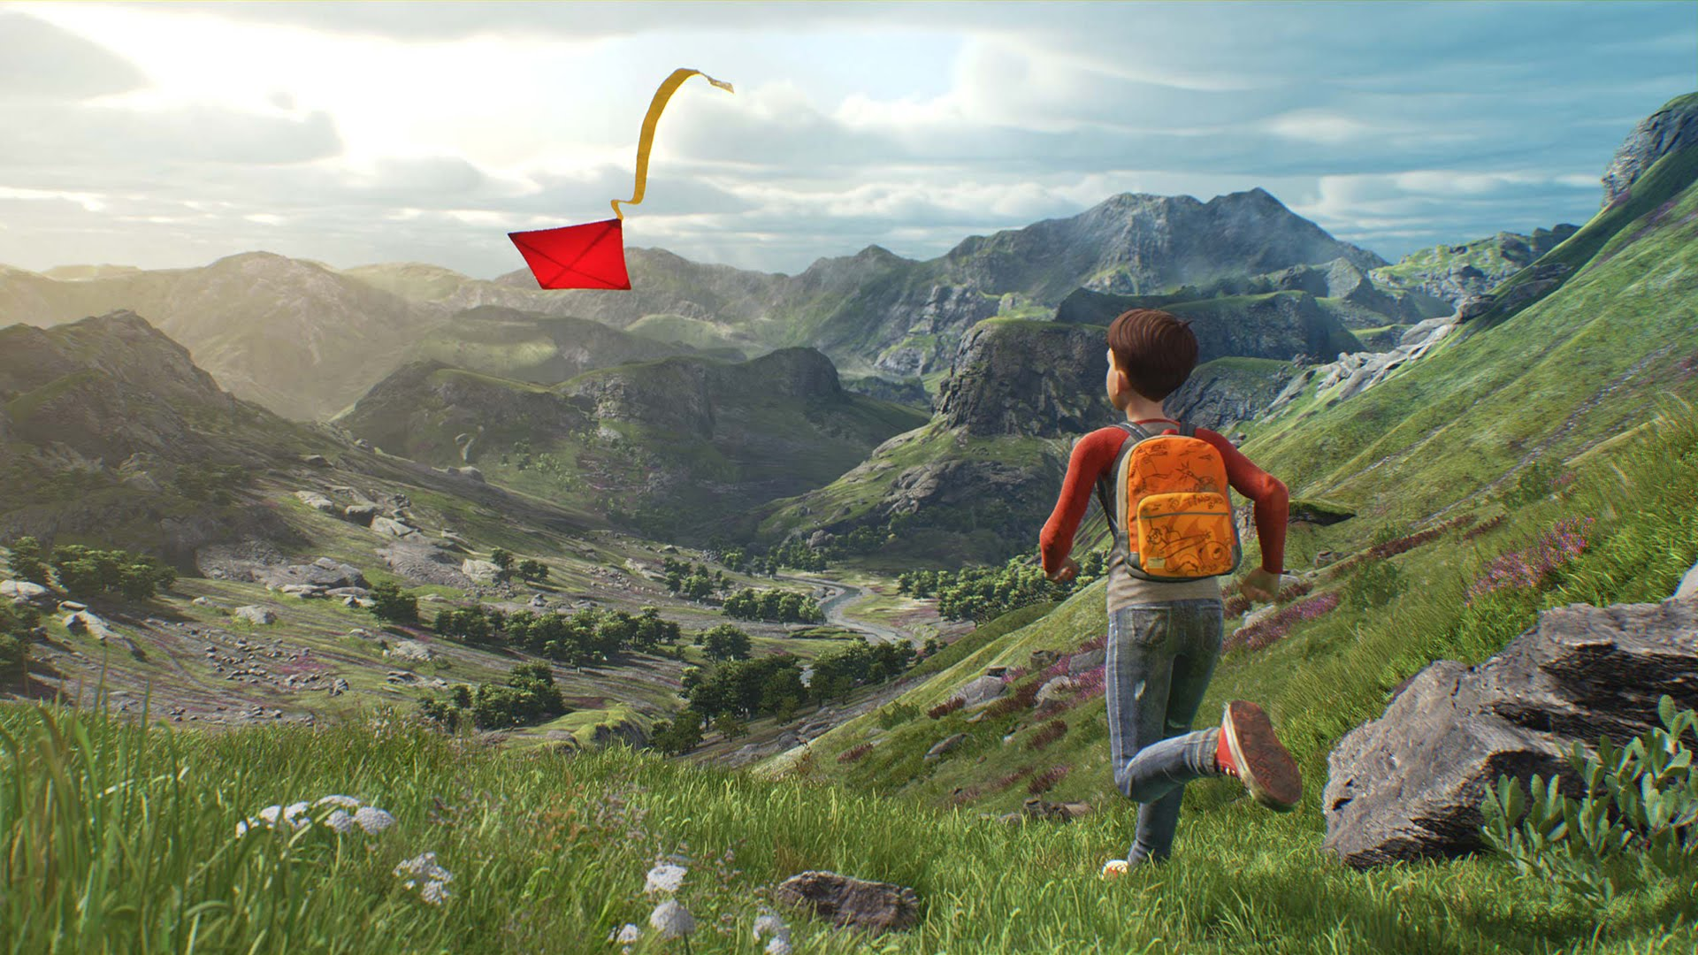
“A boy and his kite” Unreal Engine 4 demo © Epic Games
Notes:
This demo is fully of very high frequency/thin details such as grass blades and other foliage.
One would normally expect to see a lot of aliasing issues but temporal AA is able to significantly reduce image “instability” and makes for an incredibly looking demo.

Slide 28
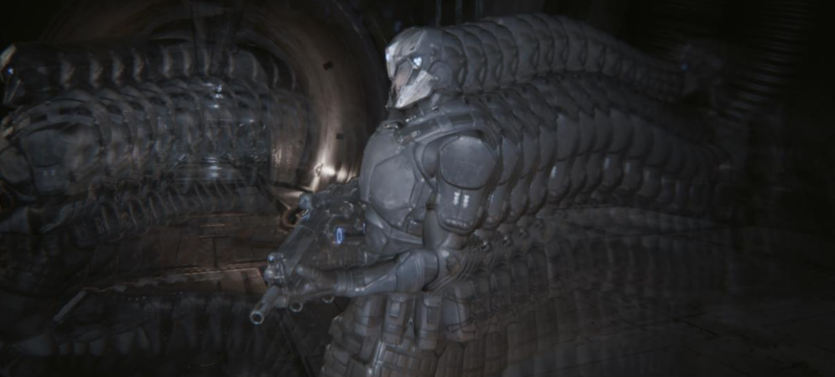
Temporal anti-aliasing generates more stable images
Re-use samples from previous frames
  Camera jitter + exponential averaging + static scene → super sampling
  Motion vectors help recovering fragment position in the past
B. Karis, 2014, “High Quality Temporal Anti-Aliasing” in “Advances In Real-Time Rendering for Games” Course, SIGGRAPH
Notes:
Reprojecting samples from past frame is easy but not every sample can be used.
In this case the background is re-using samples from the walking character, which leads to ghosting artifacts.
We must understand when we can or we cannot re-use a sample from a previous frame.

Slide 29
Temporal anti-aliasing generates more stable images
Re-use samples from previous frames
  Camera jitter + exponential averaging + static scene → super sampling
  Motion vectors help recovering fragment position in the past
?

Slide 30
Temporal anti-aliasing generates more stable images
Re-use samples from previous frames
  Camera jitter + exponential averaging + static scene → super sampling
  Motion vectors help recovering fragment position in the past
I found a sample from the previous frame! can I re-use it?
  Does it come from the right surface?
    Sample could be from a different object or a mix of objects (e.g. edge → background + foreground)
    Sample comes from the right object but it has drastically different properties
      e.g. don’t want to re-use samples across the faces of a cube
  Did the current fragment even exist in the previous frame?
    Was partially or completely occluded?
    POV change?
    Were we even rendering it? (i.e. popped into existence in the current frame)
  …

Slide 31
To re-use or to not re-use?
Re-projected sample test types
  Test data: depth, normals, post-shading color, ...
  Test type: distance, variance, extent, …
Color extent tests are (currently) the best choice
  Find color BBOX in re-projection area (e.g. 3x3 pixel)
  Accept re-projected sample if current sample color is inside BBOX
  It’s indistinguishable from magic ☺

Slide 32
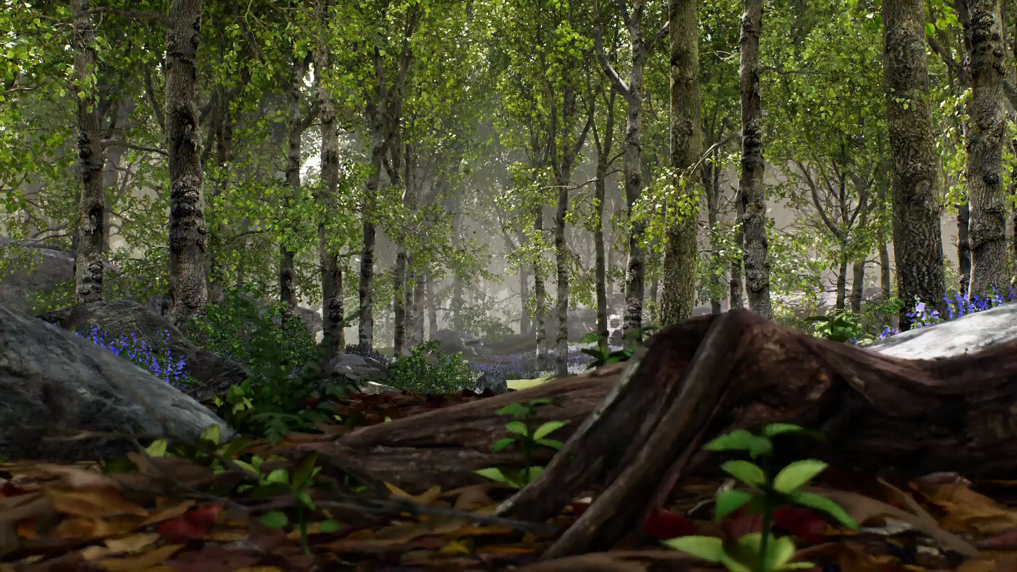
“A boy and his kite” Unreal Engine 4 demo © Epic Games
Notes:
I don’t fully understand the color extent test but it is currently is the de factor standard accept/reject test for TAA-like approaches.

Slide 33
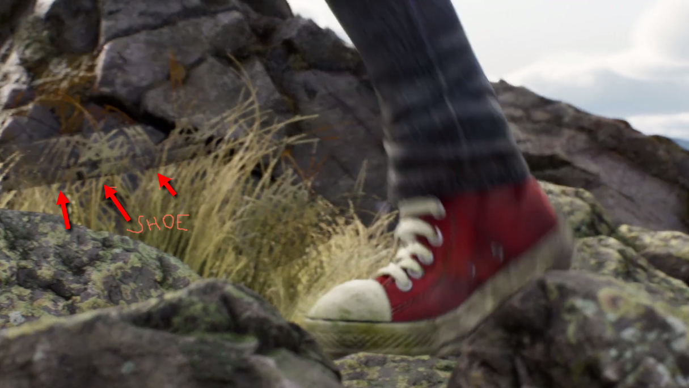
We don’t have a fully robust way of temporally re-using samples yet
“A boy and his kite” Unreal Engine 4 demo © Epic Games
Notes:
Sometime it fails (especially when the images tends to be noisy) and we can observe ghosting artifacts.
It is incredibly hard to determine whether a sample can be re-used or not in a robust way. More work needs to be done to fully understand this problem and possibly invent new solutions.

Slide 34
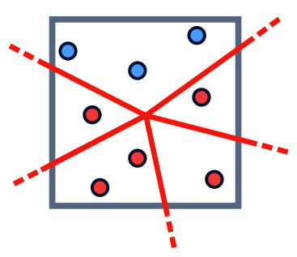
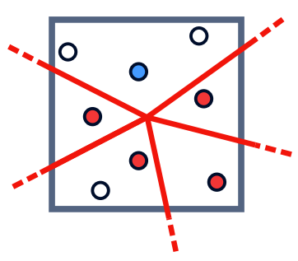
Multi-sampling decouples visibility from shading
Shade only one sample per-primitive per-pixel
  Reduce number of samples to shade → save compute, reduce bandwidth
Only geometry edges are anti-aliased
  No AA for specular highlights, alpha-testing, shadows, reflections, etc.

Slide 35
Decoupling samples opens many possibilities
Sample types
  Visibility
  Coverage
  Pre-shading attributes
  Post-shading attributes
  …
We decouple samples to divert resources where needed most
  MSAA, CSAA/EQAA, etc.
  Sample type conversions help trading off image quality vs. performance

Slide 36
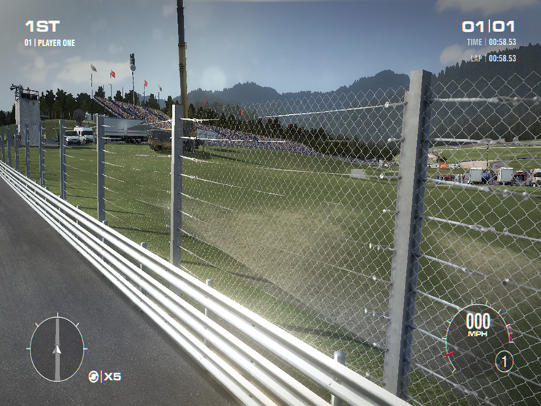
Alpha-test
“Grid 2” © Codemasters, Feral interactive

Slide 37
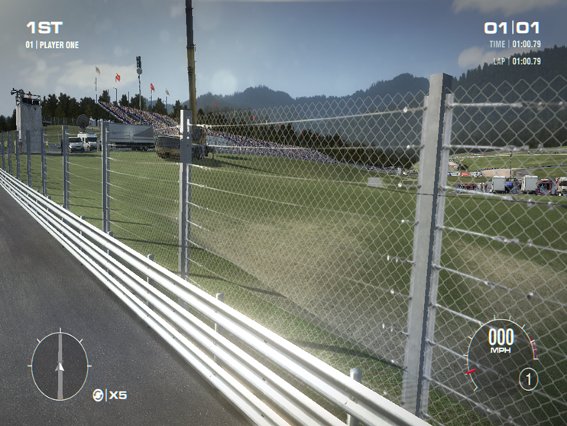
Coverage-to-alpha with OIT [Salvi et al. 2011, 2014]
“Grid 2” © Codemasters, Feral interactive
Notes:
At 1 spp we can still get high quality AA by converting coverage into alpha and composite using an OIT method

Slide 38
Advanced decoupled samples methods
Deferred rendering + MSAA → trouble
  GPU-owned decoupling function is lost → shade every sample ☹
  G-buffers simply take too much memory / bandwidth
Cluster G-buffer samples into aggregates (or surfaces)
  Store and shade a few aggregates per pixel → save compute, memory and bandwidth
    Software defined decoupling function enables re-using shades across primitives!
  SBAA [Salvi et al. 2012]
  Streaming G-Buffer Compression [Kerzner et al. 2014]
  AGAA [Crassin et al. 2015]

Slide 39
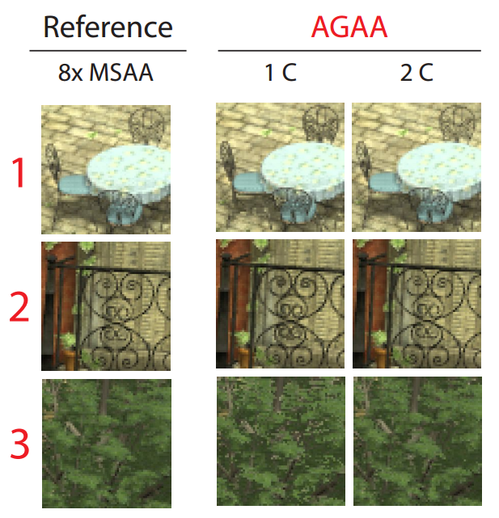
Aggregate G-Buffer Anti-Aliasing
Accumulate and filter samples in screen space before shading
  Aggregate G-Buffer statistics for NDF, albedo, metal coefficient, etc. → pre-filtering!

Slide 40
So many algorithms, so little time…
Exercise for the SIGGRAPH attendee
  Given the number of sample types, decoupling configs, pre-filtering methods, …
  … calculate combinations without repetition of all possible AA techniques
2205 possible papers
  ~100 so far, we have material until SIGGRAPH 2415!
Is (at least) one of these papers going to solve all our aliasing problems?
  [hint] not a chance

Slide 41
Now What?

Slide 42
Trade off more spatial aliasing for less temporal aliasing
The shading space matters (a lot)
  Screen space shading is inherently unstable under motion
A lesson from PIXAR’s Reyes
  Shading on vertices yields stable shading locations
  Not so practical for real-time rendering
Alternative shading spaces for real-time rendering?
  Texture space [Baker 2005]
  Object space [Cook et al. 1987] [Burns et al. 2010] [Clarberg et al. 2014]
  …

Slide 43
Develop new data structures to enable better AA
Decoupling data is a double-edged sword
  e.g. how to properly re-construct curvature at all scales?
    Curvature information is spread across normal maps, displacement maps, triangles, patches, etc.
    Require developing an anti-aliasing algorithm for each type of data → aliasing ☹
Need to query any scene property in a region of space at any scale
  Query should return a compact and pre-filtered representation of the space region
    e.g. sparse voxel octrees [Crassin 2008]
LoD done right → anti-aliasing

Slide 44
Conclusion
Anti-aliasing in real-time applications has never been so important
  VR/AR experiences significantly impacted by aliasing
Anti-aliasing is not an algorithm, is a process
  It begins in the content creation pipeline and it ends on your retina

Slide 45
Acknowledgments
Aaron Lefohn
Anjul Patney
Anton Kaplanyan
Alex Keller
Brian Karis
Chris Wyman
Cyril Crassin
David Luebke
Eric Enderton
Fu-Chung Huang
Henry Moreton
Johan Andersson
Joohwan Kim
Matt Pettineo
Morgan McGuire
Natasha Tatarchuck
Nir Benty
Stephen Hill
Tim Foley
Twitter: @marcosalvi
E-mail: msalvi@nvidia.com

Slide 46
Bibliography
ANNEN T., MERTENS T., SEIDEL H.-P., FLERACKERS E., KAUTZ J.: Exponential shadow maps. In Proceedings of graphics interface 2008 (2008), pp. 155–161. 2
BAKER, D., Advanced Lighting Techniques, Meltdown 2005
BURNS, C., FATAHALIAN, K., AND MARK, W., 2010. A lazy object-space shading architecture with decoupled sampling. In Proceedings of the Conference on High Performance Graphics (HPG '10). Eurographics Association, Aire-la-Ville, Switzerland, Switzerland, 19-28.
CLARBERG, P., TOTH, R., HASSELGREN, J., NILSSON, J., and AKENINE-MOELLER, T., AMFS: adaptive multi-frequency shading for future graphics processors. ;In Proceedings of ACM Trans. Graph.. 2014, 141-141.
COOK, R., CARPENTER, L., AND CATMULL, E. 1987. The Reyes image rendering architecture. SIGGRAPH Comput. Graph. 21, 4 (August 1987), 95-102.
CRASSIN, C., MCGUIRE, M., FATAHALIAN, K., and LEFOHN, A. 2015. Aggregate G-buffer anti-aliasing. In Proceedings of the 19th Symposium on Interactive 3D Graphics and Games (i3D '15). ACM, New York, NY, USA, 109-119
DONNELLY, W., AND LAURITZEN, A. 2006. Variance shadow maps. In Proceedings of the 2006 Symposium on Interactive 3D Graphics and Games, ACM, New York, NY, USA, I3D ’06, 161–165.
KERZNER, E., AND SALVI, M. 2014. Streaming g-buffer compression for multi-sample anti-aliasing. In HPG2014, Eurographics Association.
LAURITZEN, A., AND SALVI, M., AND LEFOHN, A.. 2011. Sample distribution shadow maps. In Proceedings of ACM SIGGRAPH Symposium on Interactive 3D Graphics and Games 2011, pages 97–102.
RESHETOV A., 2009. Morphological antialiasing. In Proceedings of the Conference on High Performance Graphics 2009. pp. 109–116
SALVI, M. 2008. Rendering filtered shadows with exponential shadow maps. In ShaderX 6.0 – Advanced Rendering Techniques. Charles River Media
SALVI, M., MONTGOMERY, J., AND LEFOHN, A. 2011. Adaptive transparency. In Proceedings of the ACM SIGGRAPH Symposium on High Performance Graphics, ACM, New York, NY, USA, HPG ’11, 119–126.
SALVI, M., VAIDYANATHAN, K. 2014, Multi-layer Alpha Blending, Symposium on Interactive 3D Graphics and Games.
SALVI, M., AND VIDIMCEˇ , K. 2012. Surface based anti-aliasing. In I3D’12, ACM, 159–164.

