Slide 1

A Certain Slant of Light:
Past, Present and Future Challenges of Global Illumination in Games
Colin Barré-Brisebois
Senior Rendering Engineer, SEED – Electronic Arts
@ZigguratVertigo
Notes:
Hello everyone, my name is Colin Barré-Brisebois, and welcome to a certain slant of light. During this talk we’ll take a look at the past, present and future challenges of global illumination in games.

Slide 2















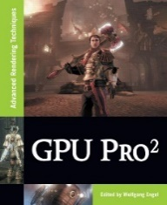
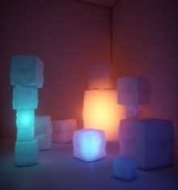
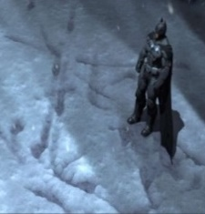
Who Am I?
Senior Rendering Engineer at SEED – Electronic Arts
  Cross-disciplinary team working on cutting-edge,
  future graphics technologies and creative experiences
  Offices in Stockholm, Los Angeles and Montréal
  www.ea.com/SEED
  @SEED
Previously
  Technical Director at WB Games' Montréal
  Rendering Engineer at EA Montréal and DICE
…
Notes:
Briefly, who am I…

Slide 3
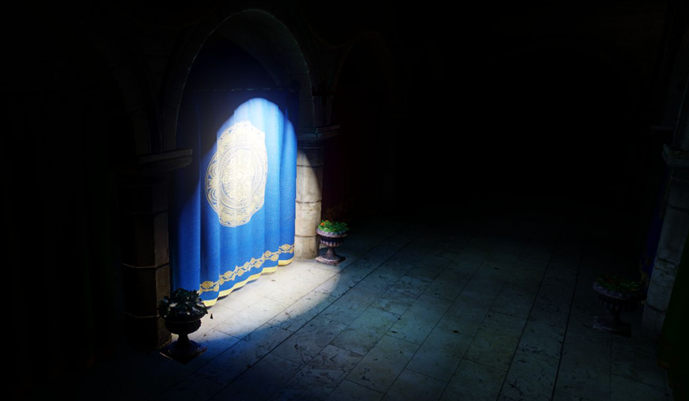
Agenda
State of The Union
Current Challenges
The Future
Questions

Slide 4

What’s In It For You?
Because you want to know about…
For Researchers:
How GI in academia compares to the state of the art in games
Latest art, engineering, pipelines and production challenges in games
Fundamental issues that artists & programmers have with current approaches
Unsolved GI problems in the games industry, and how it can orient future research
For Gamedevs:
The state of GI in your field! ☺
How academia can help you achieve your goals
What you can do to improve & create collaboration opportunities
Where is GI heading for future games
Notes:
If you’re attending this course, it’s because you’re either part of academia or the gamedev community.

Slide 5

Before We Begin
Thanks to everyone who contacted me and helped me gather content!
I’ve done my best to summarize the state of the art of GI in shipped games
Feel like I’ve missed a thing or two? Please contact me!
All references at the end of the talk
Notes:
We can talk about GI for hours, so I apologize in advance as might have to go fast on some points.

Slide 6
Disclaimer - Storage vs Data
Storage can be independent of format & encoding
2D Storage | 3D Storage | 4D Storage
Per-Texel | Probes | Time
Per-Vertex | Voxels (Point/Aniso) | States
Per-Face | Surfels | Story Chapters
Per-Object | Cubemaps | …
… | Polycube maps | …
… | … | …
Encoding
Spherical Harmonics
Spherical Gaussians
Octahedron
Ambient Dice
Custom Basis (RNM, H, …)
…
Format
Raw
Compressed
Quantized
Palletized
Chroma Subsampled
…
Can often be mixed-and-matched
Notes:
As a quick disclaimer, I might mix and match some terms during the presentation. Actually, it’s because many of the terms here can be mixed and matched. If I don’t cover all cases when talking about a specific technique, it’s simply for the sake of time. I’ll also focus on the common use cases.

Slide 7
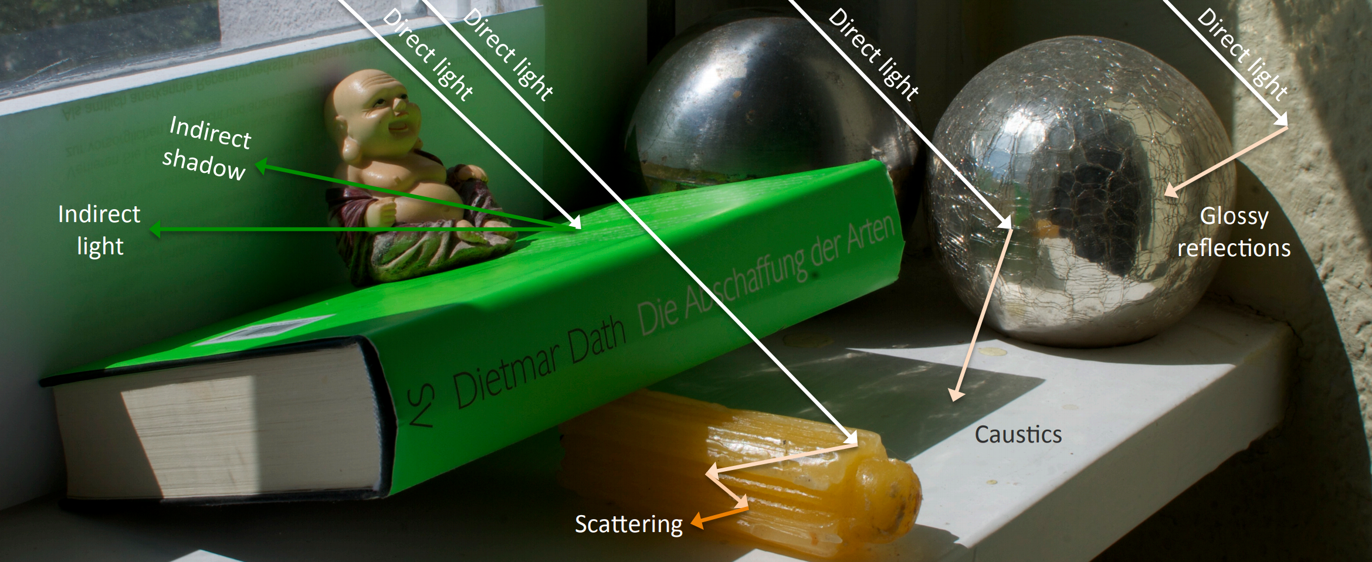
Games’ Global Illumination (GI)?
[Ritschel11]
BSDF = BRDF + BTDF…
Notes:
As we all know, Global illumination (GI) is a family of algorithms that simulate how light interacts and transfers between objects in a scene. In gamedev, we tend to keep it simple and focus on the BRDF aspect of GI, but in fact it’s quite more complex than that. One thing that’s for sure is that the ability to increase the visual quality of a scene by convincing light transport (through math) is really appealing for gamedev, because it makes it so that artists don’t have to try and emulate such behaviour “by hand”. To be honest, nothing beats simulation. With this in mind...

Slide 8
State of the Union

Slide 9
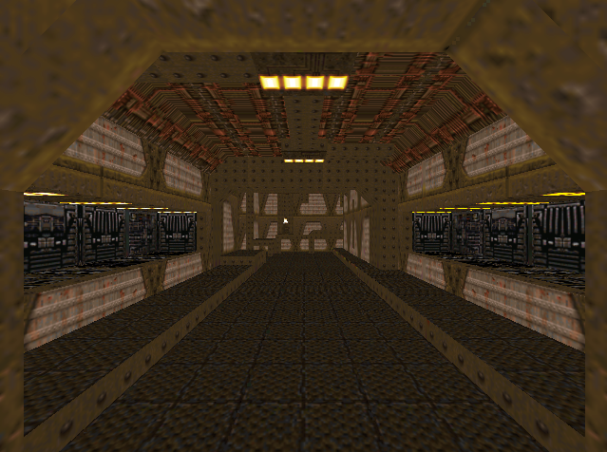
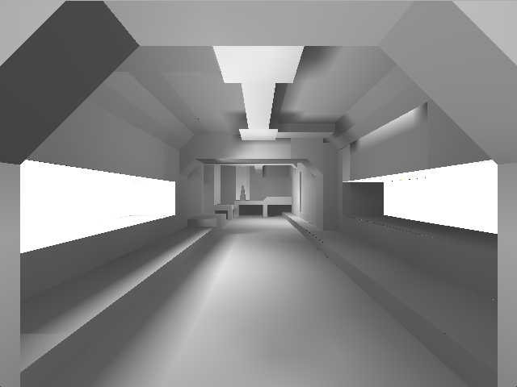
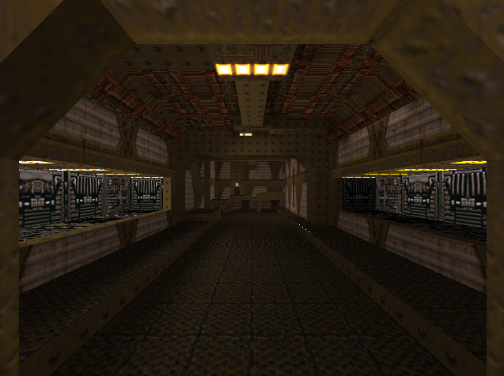

Surface Caching
Quake [Abrash2000]
The beginning of global illumination in games…
One of the first games to store precomputed irradiance
Better sense of space, volume, and tension!
Single 8-bit value for all lights affecting a vertex/texel
Later colored (Quake2)
[Images from Bush15]
Notes:
It all began with Quake’s surface caching.

Slide 10
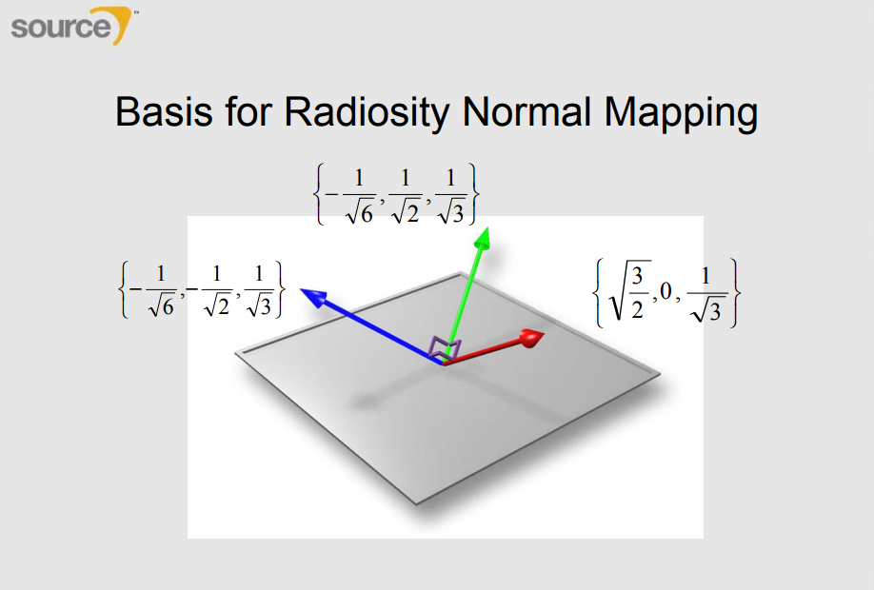
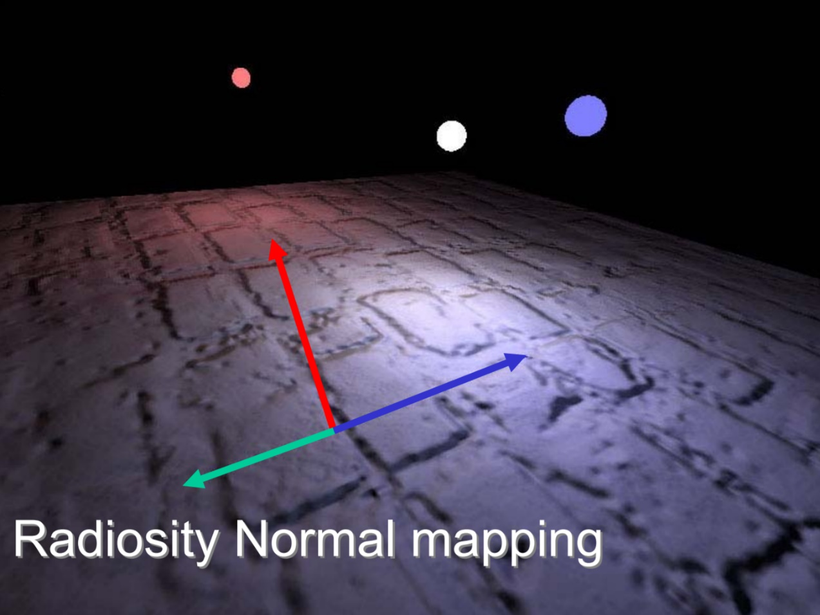

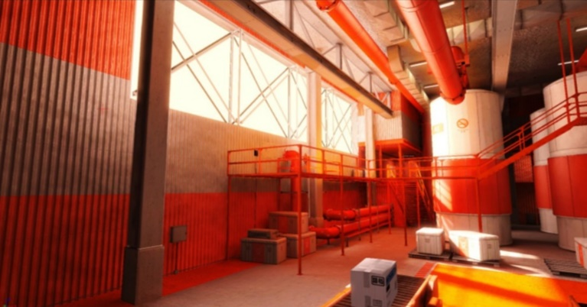
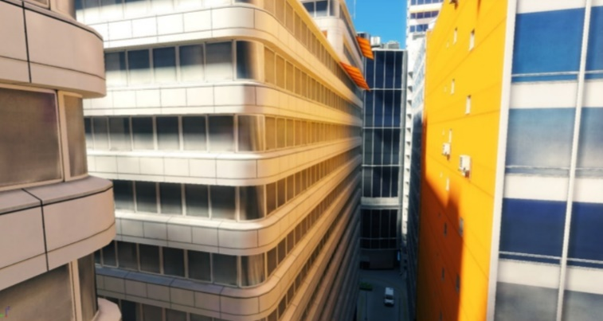
Radiosity Normal Mapping
[McTaggart04]
As seen in Half-Life 2 [McTaggart04]
Avoids flat ambient
Three full RGB lighting values, in three directions in TS
Blending based on the cos(NormalMap, BasisDirections)
Can approximate specular
  When view direction aligns with basis
  “okay” with rough specular, not with low roughness
Used in many games/engines!
[Halén09]
Notes:
An improvement over single value lightmaps is radiosity normal mapping…

Slide 11
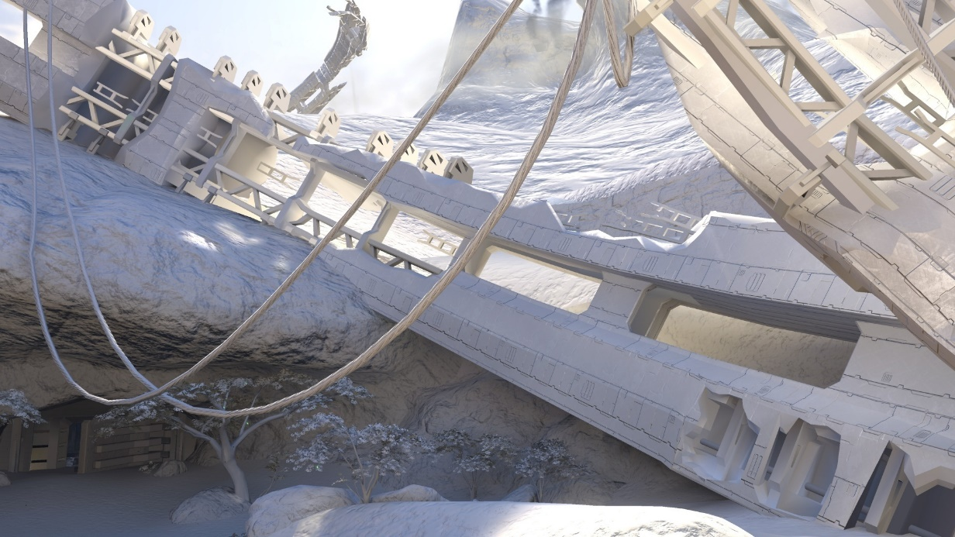
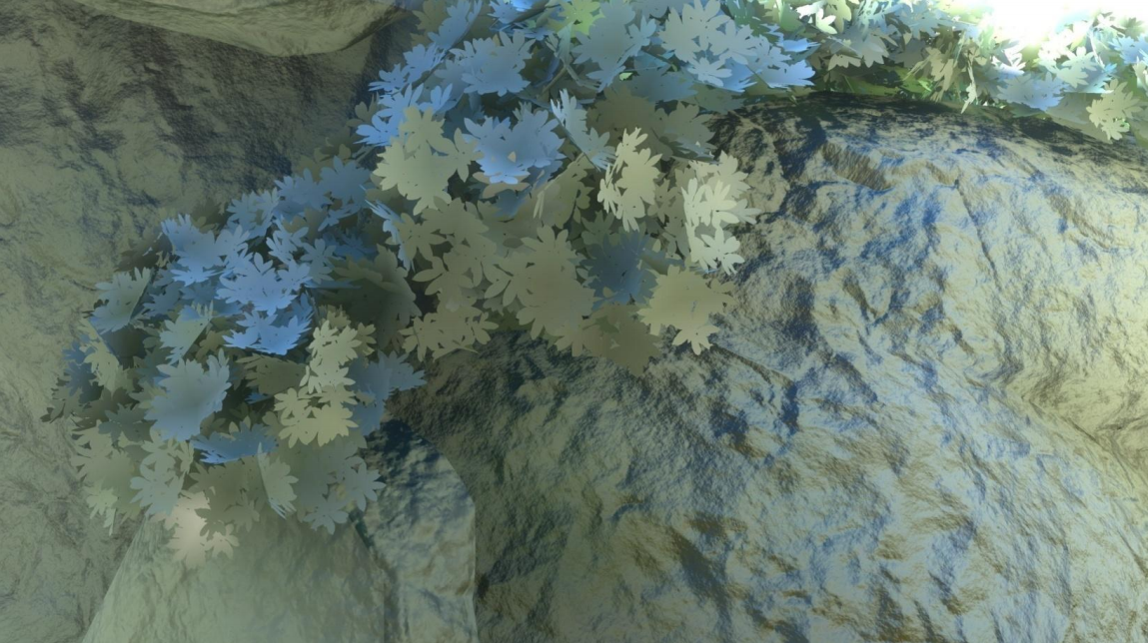
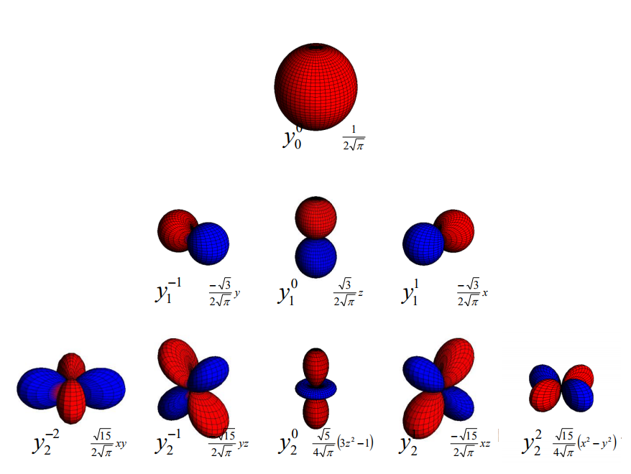

Spherical Harmonics Lightmaps
[Sloan08]
[Chen08]
[Chen08]
Another step towards “global” improved fidelity
Spherical harmonics from offline photon mapper
Texel has irradiance at surface point, as a continuous function on a sphere
Probes for dynamic objects also stored as SHs
SH: Great for diffuse, but specular…
Notes:
Another step towards improved global fidelity is to encode irradiance as a spherical harmonic.
Lower order SH are great for diffuse, but not so much for specular. Specular can be approximated if you extract the dominant color direction in the SH, but for higher fidelity it definitely requires more coefficients. And with higher order, it gets big fast. Also SH have potential ringing issues, that can be mitigated as explained yesterday by Peter-Pike Sloan in the Advances course. [Iwanicki17]

Slide 12
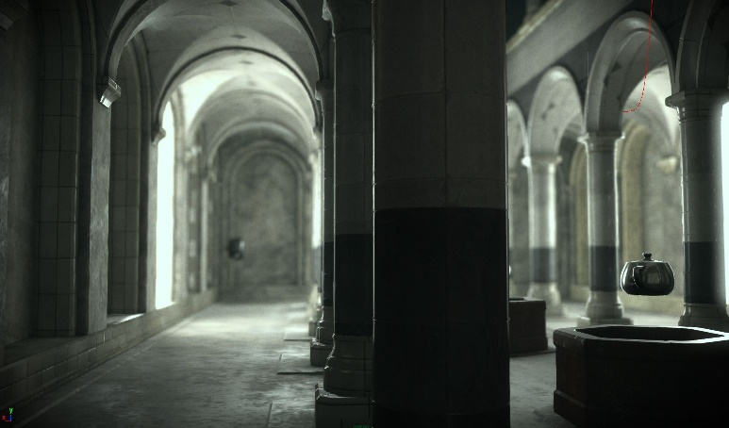
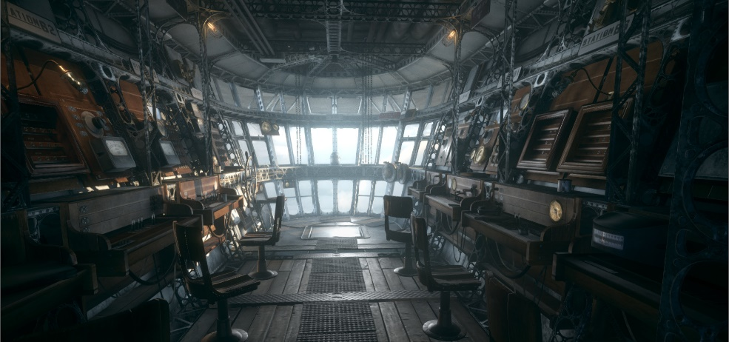
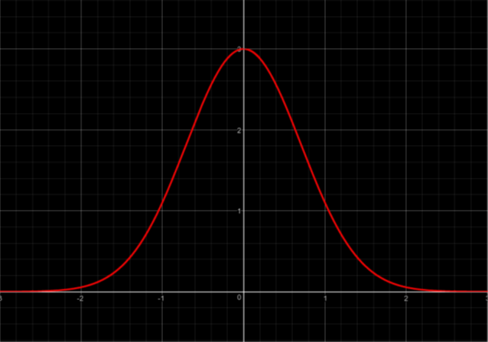

Spherical Gaussians Lightmaps
[Neubelt14]
[Pettineo16]
The Order: 1886 [Neubelt14]
Approximate incoming radiance using spherical gaussians
Intuitive & compact representation for diffuse and specular
Probes for dynamic objects also stored as SGs
Extensive implementation details on Matt’s blog [Pettineo16]
Notes:
Another approach is to encode incoming radiance as spherical gaussians. What’s really cool about this approach is how it’s both intuitive and compact for both diffuse and specular, being a gaussian distribution.
Key here: significant improvement on specular over HL2 basis without the weight of spherical harmonics

Slide 13
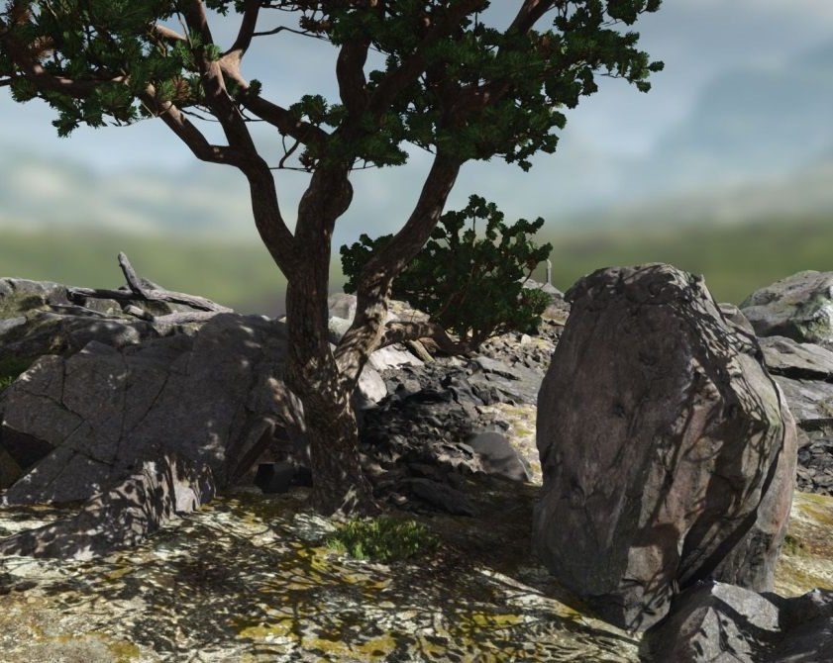
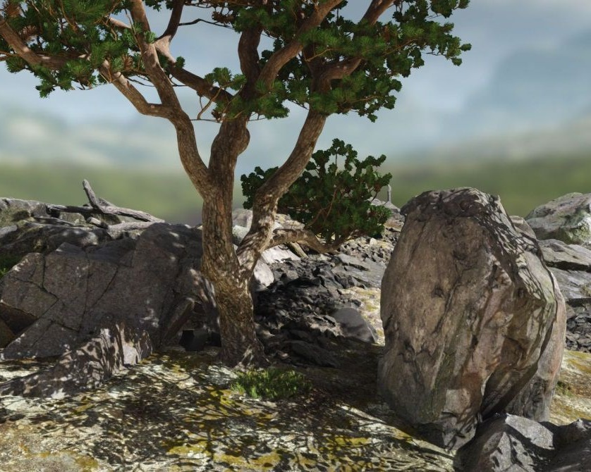
Heightfield GI
UE4 Kite Demo – Without (Left) and With Heightfield GI (Right) [Seymour15]
Static Terrain Radiosity Maps in MotoGP [Hargreaves03]
For large area and environmental lights on height fields. Can be dynamic [Nowrouzezahrai09]
Many improvements since MotoGP’s precomputed radiosity map (2003) [Hargreaves03] [Oat07]
Pros: Neat solution for height-based worlds
Cons: Height-field only. Doesn’t work for interiors
Notes:
Another approach people have used is to compute GI using a heightfield. This was featured in the UE4 kit demo, but before that in the MotoGP games.

Slide 14
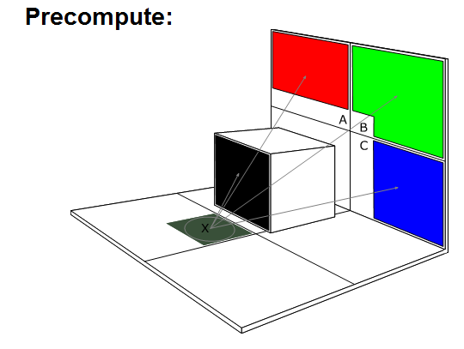
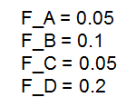



Precomputed Form Factors
[Enlighten]
Subdivide scene into finite elements
Precompute visibility between elements
Transfer function used at run-time for diffuse GI, for many dynamic lights
Stored in lightmaps & probes
Has to be recomputed if geometry (visibility) changes
Notes:
Another idea is to use precomputed form factors. Form factors represents an finite element-to-element visibility function, and basically how “much” elements can see each other. Key thing here: as many dynamic lights as you want

Slide 15
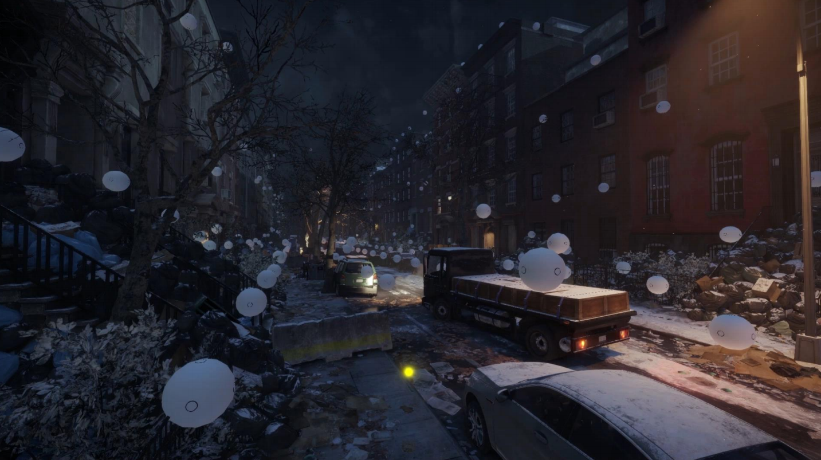
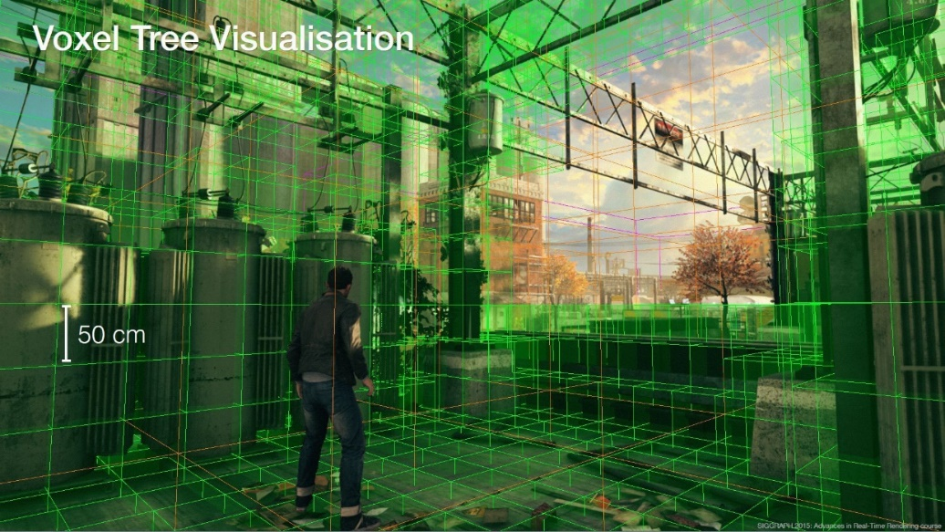
Probe-only* Approaches
[Gilabert12]
Tom Clancy’s The Division [Stefanov15]
Quantum Break [Silvennoinen15]
PRT (Farcry / Division), irradiance volumes ([Tatarchuk05], Quantum Break) in probes
Various unified, CPU/GPU, console friendly approximations to global illumination:
  FC4: CPU probes cells streaming to GPU page table (radiance xfer, clipmap injection and sampling) [McAuley15]
  The Division: Surfels-to-probe, with surfel sharing (G-Buffer Cubemaps) [Stefanov15]
  Quantum Break: Adaptive Irradiance Volume via octree [Silvennoinen15]
*Can also be used in combination with lightmaps. Lately, split lighting and visibility [Iwanicki17]
Pros: Dynamic and static objects lit by same data. Volumetric!
Cons: No HQ indirect specular. Specular from IBL & SSR
Notes:
While you can definitely combine lightmaps and probes for your GI solution, some games have relied on a probe-only approach to store their GI, either as Precomputed Radiance Transfer (PRT) for real-time relighting, or as irradiance volumes. Relying only on probes is often the case with open world games, where unwrapping unique UVs for all objects in the world doesn’t always scale. Split lighting and visibility [Iwanicki17]

Slide 16
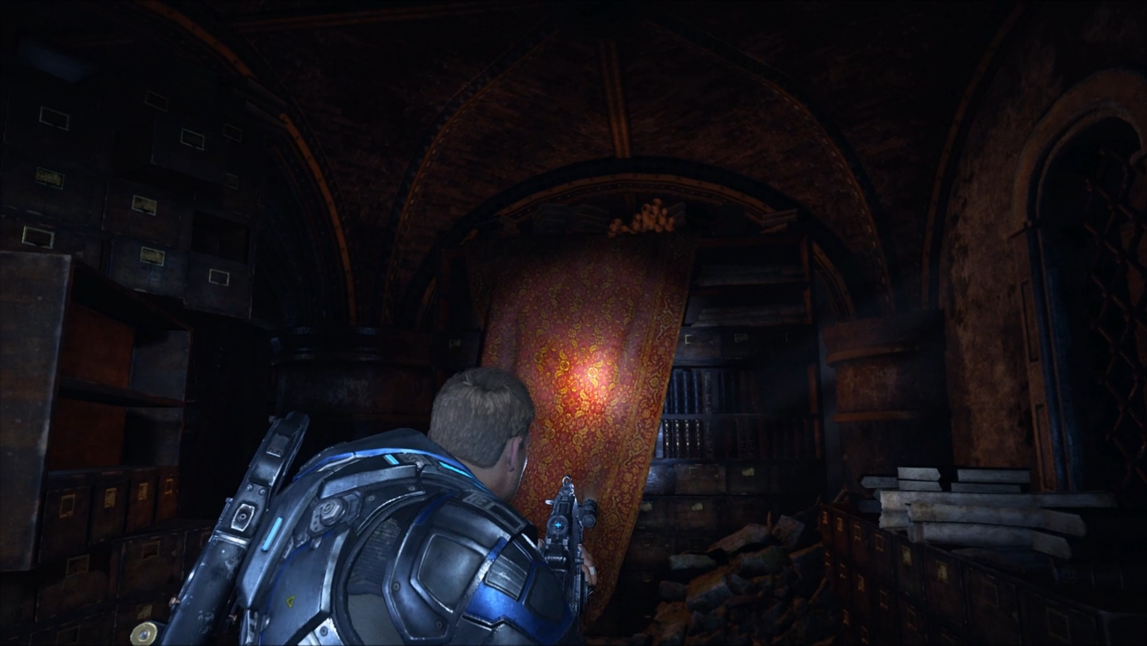
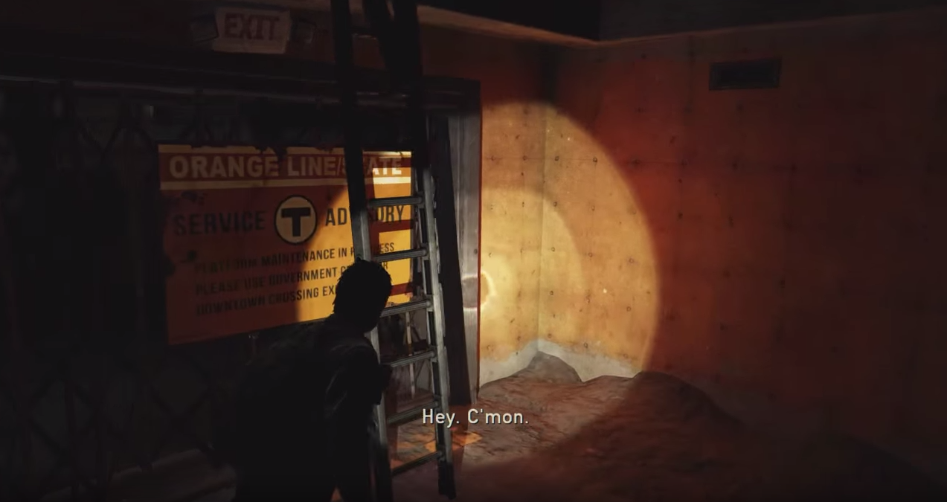
Virtual Point Lights
Gears of War 4 [Malmros17]
The Last of Us
Generate Virtual Point Lights (VPLs) from Reflective Shadow Maps (RSMs) [Dachsbacher04]
For the player’s flashlight, but also for other spotlights of interest
Pros: Cheap point lights that approximate bounce. Can be quite convincing!
Cons: Can be unstable (VPL selection). Localized solution. Precision can be a concern
Notes:
Another approach that was featured in Gears of War 4 and The Last of Us is virtual point lights. This was used in more constrained corridor areas, such as the subway system and old abandoned buildings, often tied to player’s flashlight. It’s a localized solution that’s pretty cheap, in the last of us this was done first on PS3, not really global but it can be quite convincing! But just like any technique with VPLs, stability can be an issue especially if the number of VPLs is low.

Slide 17
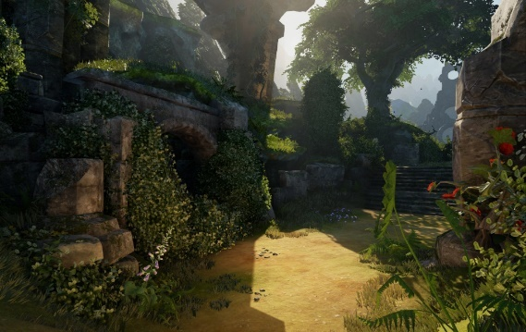
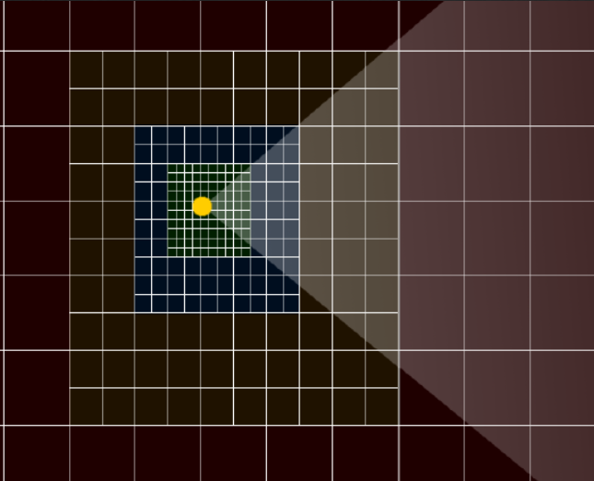
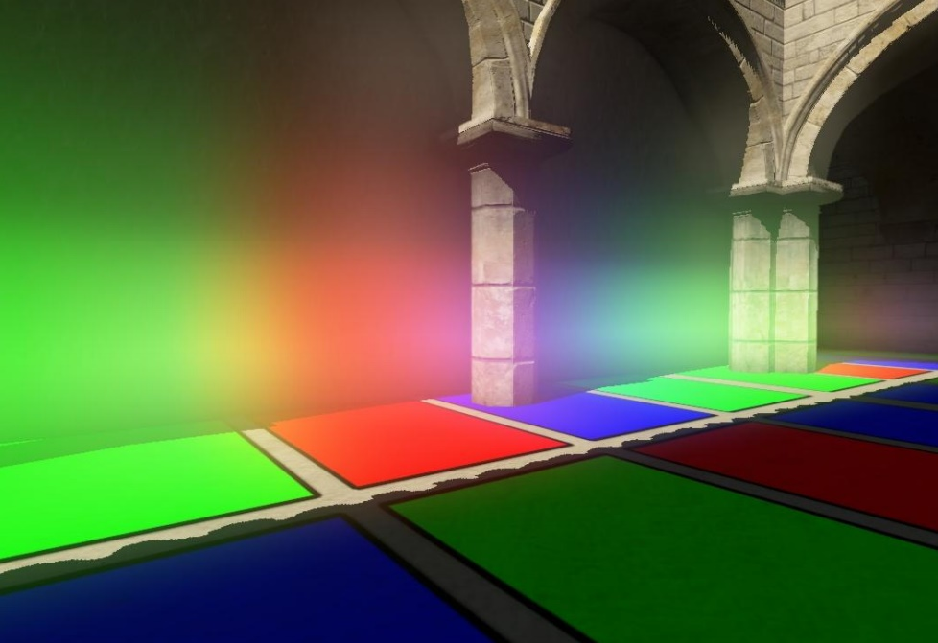
Light Propagation Volumes
Cascaded Light Propagation Volumes in Fable [Woodhouse14]
Clipmap
Crytek’s Light Propagation Volumes [Kaplanyan09]
Render scene into RSMs, inject VPLs in volume, propagate and apply [Kaplanyan09]
Cascaded with clipmap: detail up close, consistent in the distance
Pros: No preprocessing. Console hardware friendly, and volumetric!
Cons: Grid misalignment can lead to bleeding. Stability issues because of VPL aliasing
Notes:
Another approach that’s volumetric that builds on VPL and RSMs is Kaplanyan’s cascaded light propagation volumes.

Slide 18
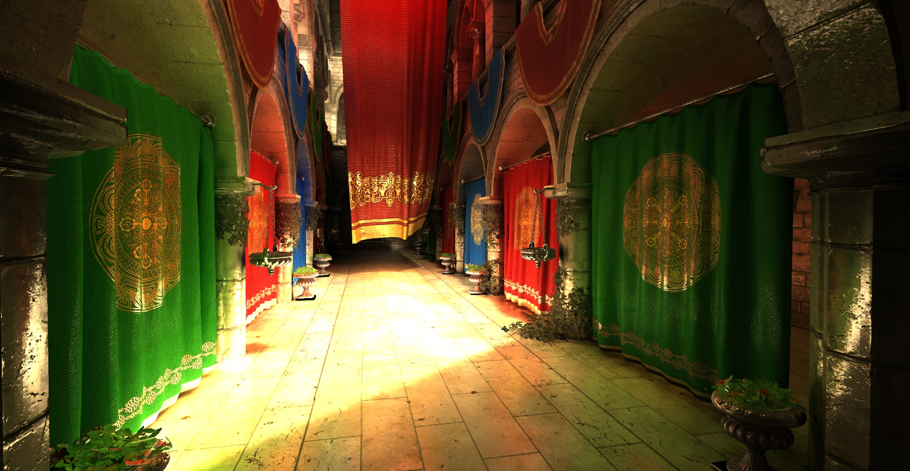
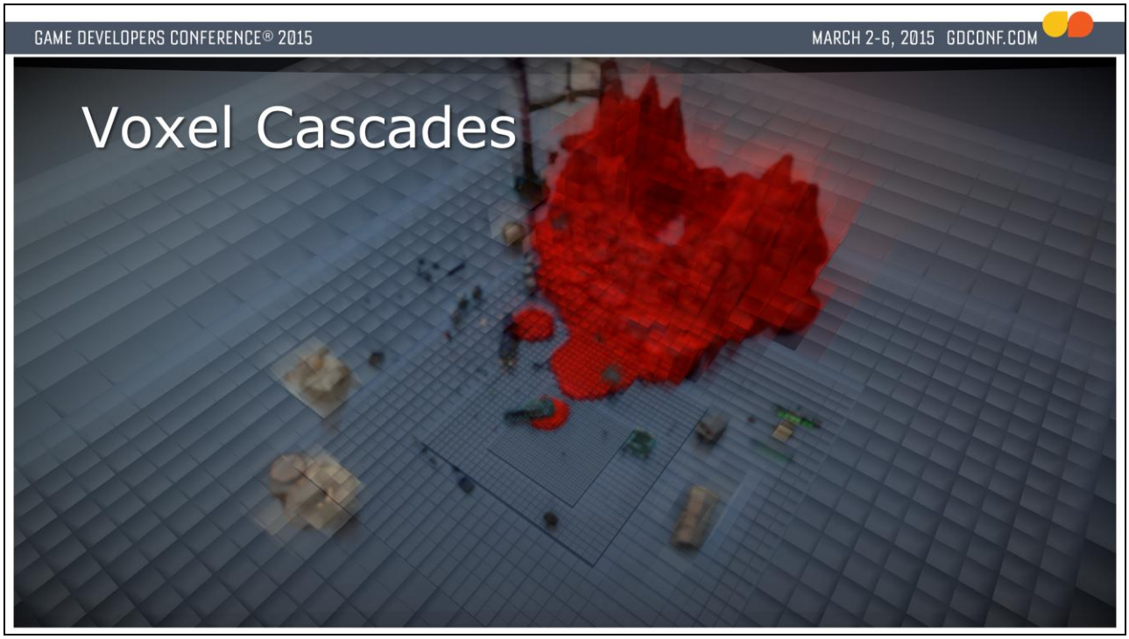
Voxel Cone Tracing
Sparse Voxel Octree Cone Tracing [Crassin11]
The Tomorrow Children’s Cascaded Voxel Cone Tracing [McLaren15]
Original idea from [Crassin11], with sparse voxel octree
Clipmap by [McLaren14] [Pantaleev15], more GPU-friendly compared to octree [Mittring12]
Pros: Diffuse and specular GI, and mid-to-large scale AO from voxels [Crytek16]
Cons: Some leaking of GI, low roughness specular cone cost is significant, clipmap transitions
Notes:
Following with another volumetric approach is voxel cone tracing. This was featured in The Tomorrow Children on PS4, but also available in Unreal 4 and Cryengine. The original idea from Crassin was augmented with a clipmap by McLaren and then by Pantaleev, and is more GPU-friendly compared to managing an octree. It is currently the highest quality solution for real-time diffuse and specular GI, where rough specular is actually cheaper because of the hierarchical structure. You also get mid-to-large scale AO from voxels.

Slide 19
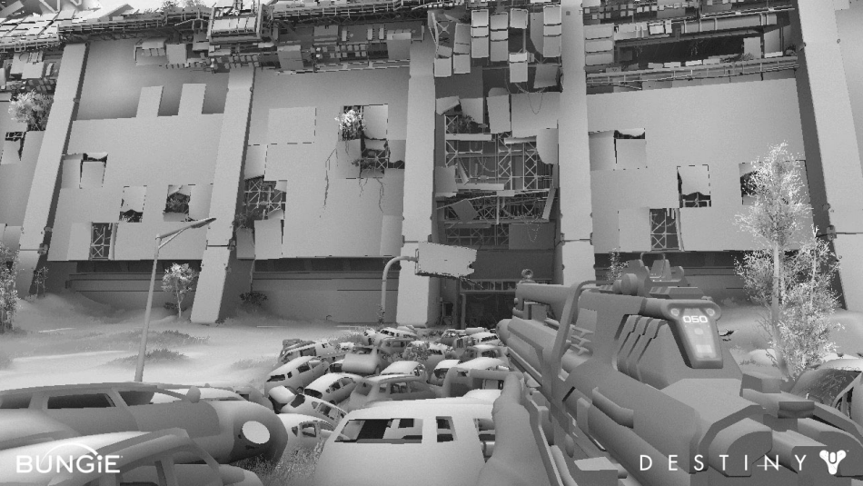
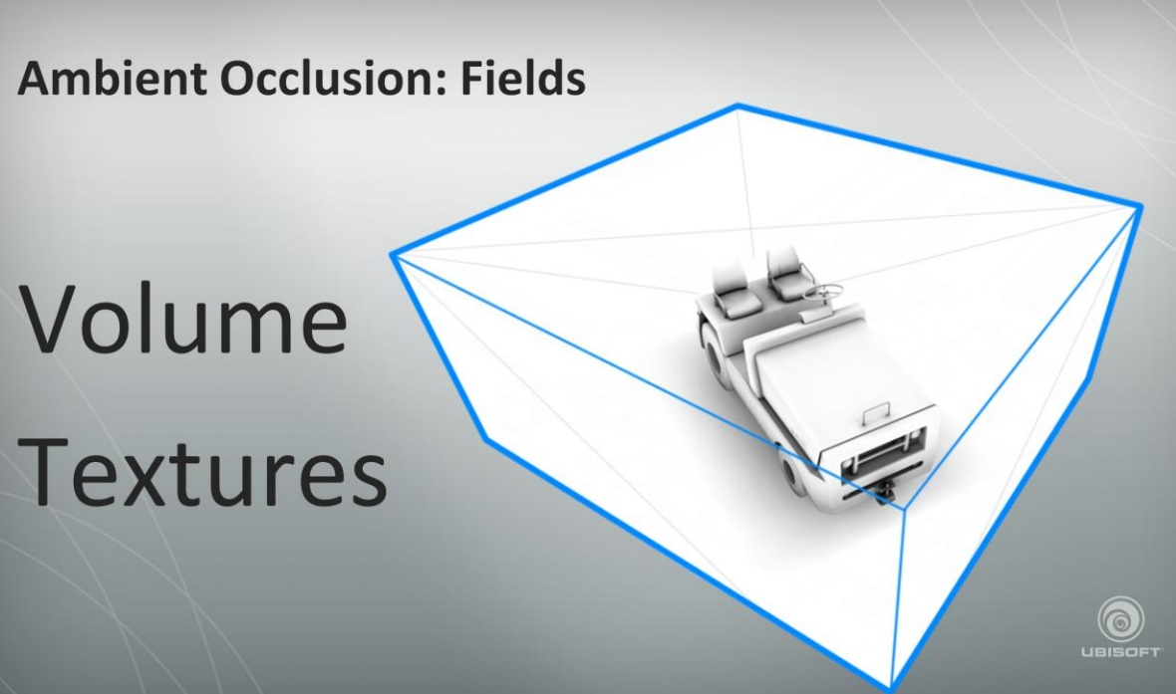
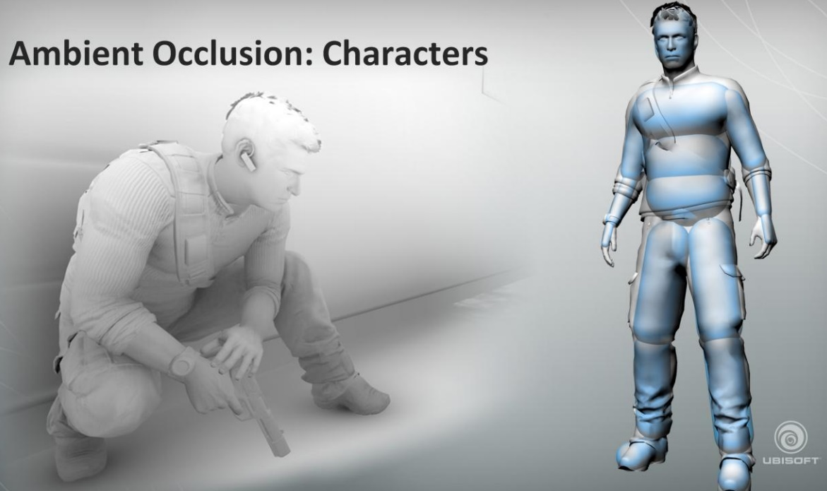
Ambient Occlusion?
Multiple frequencies
Near-field: vertex/lightmap, cavity or screen space (SSAO) [Mittring07]
Mid-field: vertex/lightmap, SSAO, volumes or capsules [Hill10]
Far-field: [Sloan16], height-based [McAuley15],
distance-fields (UE4) [Wright15]
Ambient Obscurance Baking on the GPU [Sloan16]
SH Sky Occlusion [McAuley15]
AO Fields and AO Capsules [Hill10]
Notes:
In parallel, Ambient Occlusion is a coarse approximation of global illumination from ambient lighting. In games we try to handle this at multiple frequencies, often with different techniques.

Slide 20
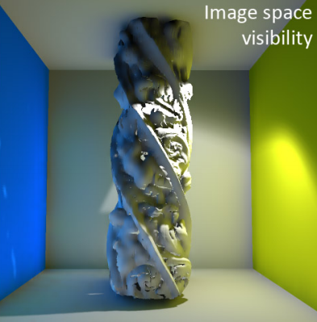
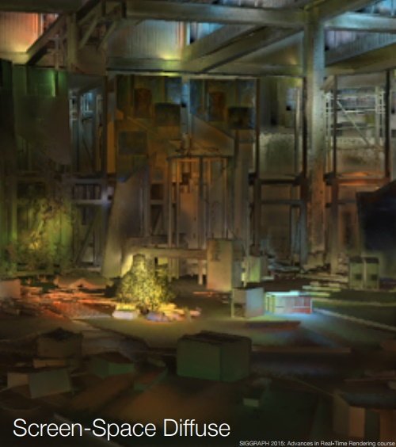
Screen Space GI?
SSDO [Ritschel09]
Quantum Break [Silvennoinen15]
Additional near-field local diffuse GI via screen-space
Screen-Space Diffuse Lighting [Silvennoinen15]
Inspired by first bounce approximation from SSDO [Ritschel09]
Notes:
Additionally it’s also possible to compute localized near field GI in screen space. This was recently featured in Quantum Break, and greatly inspired by the work of Screen Space Directional Occlusion from Ritschel.

Slide 21
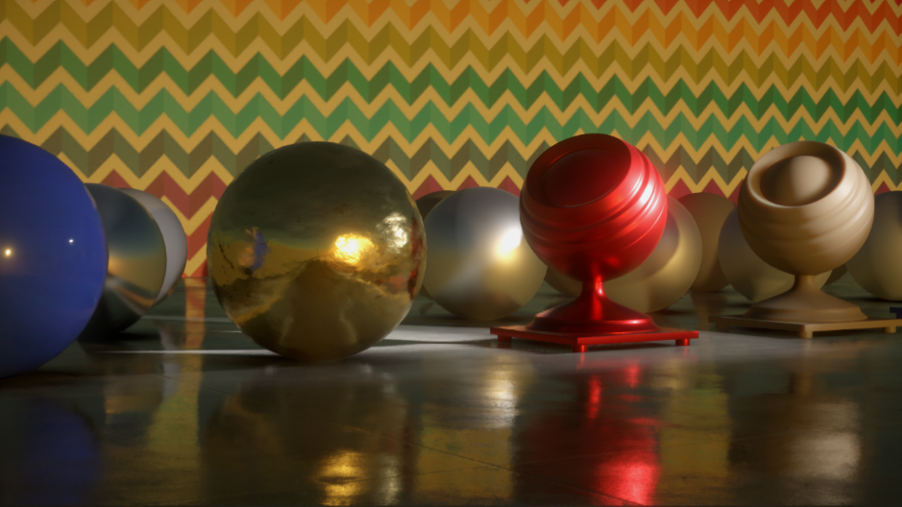
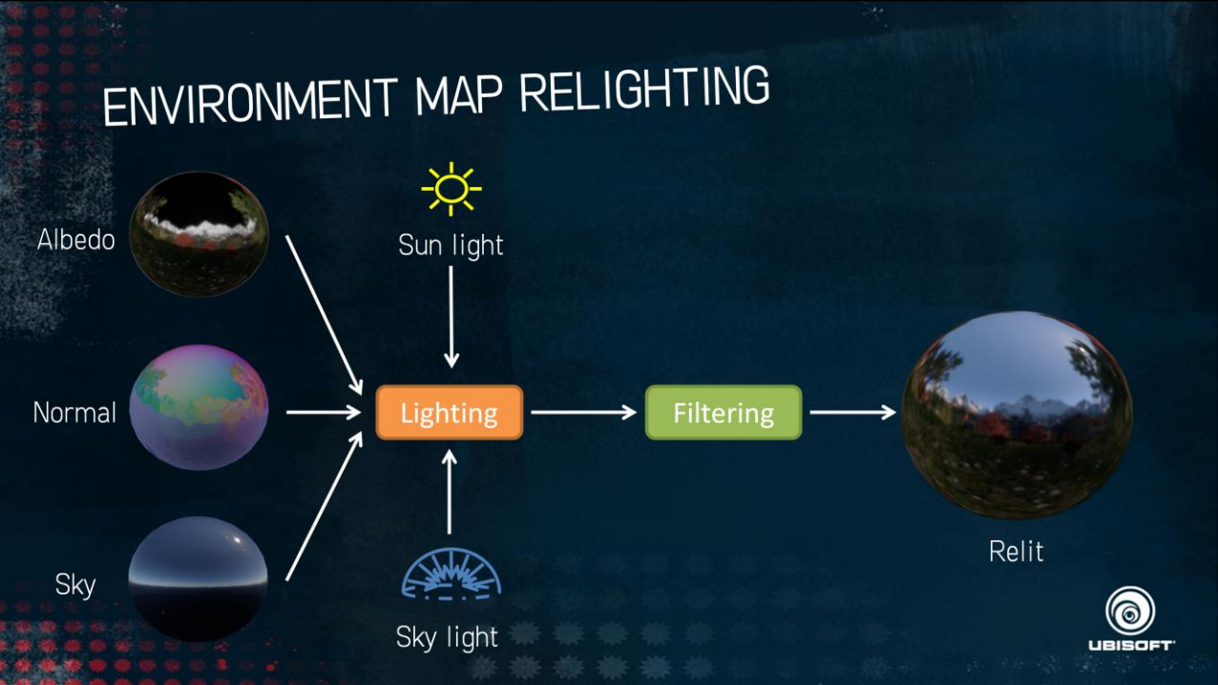
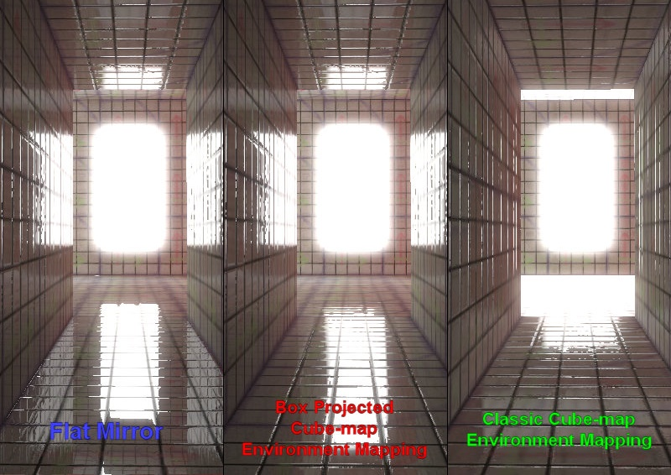
Specular GI?
Stochastic SSR [Stachowiak14]
Cubemap Relighting [McAuley15]
Box Projected Cube Maps [Bech10]
Mostly approximated via:
Parallax-Corrected Cubemaps [Bech10] [Lagarde12]
Screen-Space Reflections (SSR) [Sousa11] [Stachowiak14]
Cubemap relighting [Stachowiak14] [McAuley15]
Extract dominant color from 2nd order SH
Specular for SG [Neubelt14]
Most games don’t do specular to specular light transport
Notes:
What about specular GI? In games this is mostly approximated by IBLs such as parallax corrected cubemaps, screen space reflections and Cubemap relighting. It’s also possible to extract a dominant specular color if you’re using spherical harmonics, or from a spherical gaussian as shown by Neubelt and Pettineo. Also most games don’t do specular to specular light transport.
SSR especially favoring first-person views, doesn’t work so well in top-down views.

Slide 22

Art, Engineering, Pipeline & Production Challenges
aka Gamedev Table Flipping… (╯°□°）╯︵ ┻━┻

Slide 23
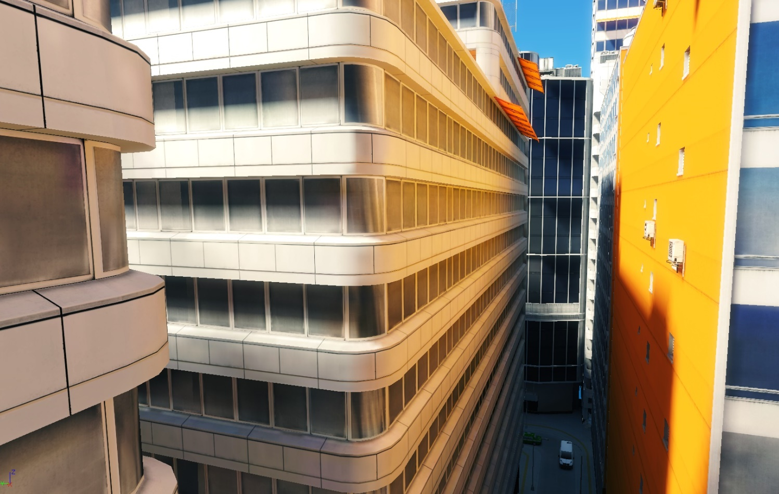
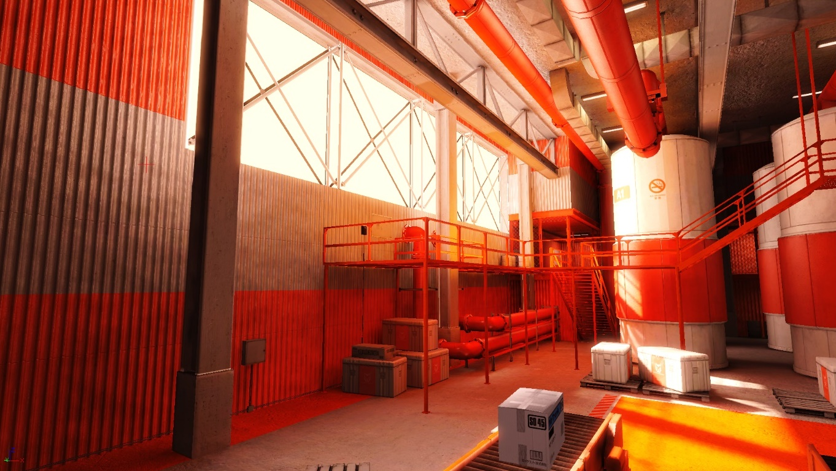
Visual Consistency
[Halén09]
Visually-plausible representation of light transport (8 years ago)
Color bleeding, global shadows, colored transparency, …
Clever combination of art direction and technology to maximize visual consistency
Notes:
When it comes to visual consistency, what makes it so that images like this from Mirror’s Edge can stand the test of time is because it showcases a visually-plausible representation of light transport.

Slide 24
When Visual Consistency Fails
Various points in the process where visual consistency can break
Simplified representation ≠ visual representation
  Hand-authored mesh proxies [Martin10]
Over-simplified representation of PBR parameters for GI
  Simplified albedo color
  Not handling metallic surfaces
  Not handling roughness properly
  Not storing enough post-computation info to reconstruct view-dependent results
Resolution issues
  Vertex/surface/detail normal to texel/voxel/probe ratio
Not properly handling shadow casting lights for GI and custom filters (Gobos / Gels / Cookies)
Per-object / per-light custom parameters
Lighting channels and negative lights…
(╯°□°）╯︵ ┻━┻
Notes:
And so there are several cases in the process where visual consistency can break.

Slide 25
When Iteration Fails
Long precompute that requires whole game world re-evaluated is a huge problem!
Lighting is always “wrong" during development
Destroys iteration, can create serious dependencies in review & approval process, and ultimately ruin reviews
  i.e.: Build made two revisions before lighting was “generated”, hard to judge art!
  i.e.: Lighting done late in the level authoring process, after sign-off
“Global” = move a pillar, have to relight the whole level instead of proximity
Preview modes that take 5+ minutes where one can’t use their computer
Example Scenario: Nightly build of GI for open world map (8+ hours)
Artist submits everything in time for automated process to start
Process runs all night
Artist arrives at work in the morning, syncs and opens editor, notices something is visually broken
Fixes it, submits, waits (next day, or several hours)
Rinse-and-repeat
Such process leads to very static game worlds
(╯°□°）╯︵ ┻━┻

Slide 26
When Authoring Fails
Relying on hand-tweaks to compensate for lack of robustness
GI-only lights for when lack of convincing propagation
Per-object GI parameters, hand-tweaked to make objects artificially “pop”
Fixing leaks with override volumes & planes (interiors/exteriors)
Negative lights to remove GI
Grunt Work: I doubt any artist out there likes doing the following tasks
Unwrapping lightmap UVs
Building simplified geometry for GI
Any other task imposed on artists that was “a-ok” to do back then, but that doesn’t scale today
(╯°□°）╯︵ ┻━┻
Notes:
Artist time spent on such tasks instead of actual game art is expensive and to be honest a waste of time. Some artists are actually doing this sort of work all day, and if you ask them how they feel about it, they’ll most likely politely tell you it… they don’t like it.

Slide 27

The (<n) ms Threshold
Game & platform-specific cut-off at which a technique can make it into game
We tend to keep our frames pretty busy
Unless significant change to aesthetics, something else will have to go
Has to be implemented early in production
30hz Games: [0 – 10%] → [0…3.0 ms]
60hz Games: [0 – 10%] → [0…1.5 ms]
0-frame-drop-allowed-60hz Competitive Games & VR:
16ms @ 60hz… but really it’s less than that
MK / Injustice: 12-13 ms frame times [Greenberg05], FIFA
Consider non highest-end GPUs (TFLOPS) [Wikipedia]
PS4: 1.8, PS4Pro: 4.2, XB1: 1.3, XB1X: 6
TitanX: 11, Vega: 13.1
Graphics vs. Aesthetics
Notes:
When thinking about implementing a new GI technique in a game, and the feasibility of such techniques, many factors need to be taken into account. One of them is the <n ms threshold.

Slide 28
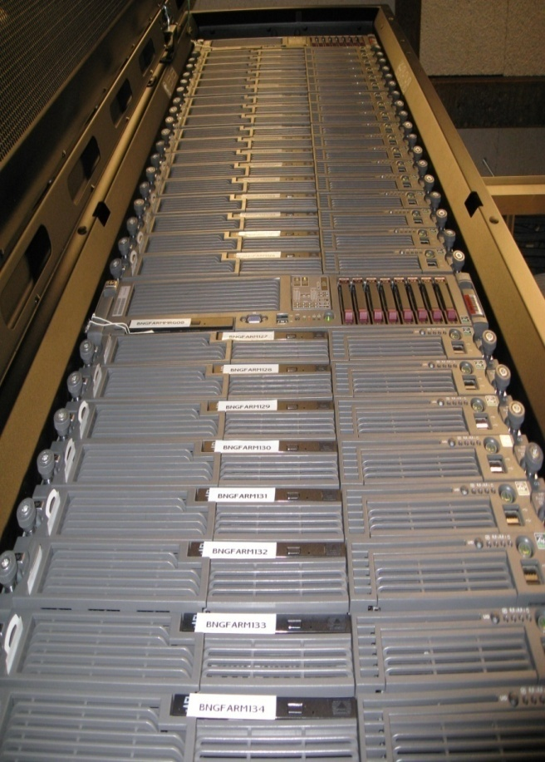

The Power Cost ($)
[Chen08]
The cost of power for precomputing (parts/full) lighting for a modern large world might be non-trivial
Beefy Machines / Server Setups
  Halo 3: 256 servers, 456 Processors, 1GB memory [Chen08][Villegas08]
  CoD: 48 GB RAM and 12 GB VRAM machines [Hooker16]
  Destiny: Farm with tens of servers to bake AO [Sloan16]
  SNDBS/Incredibuild: pool of GPUs running all night (650W+ PSUs)
  Consider additional costs (i.e.: cooling, hardware failure, …)
Cloud computing might be cheaper in the long run
  Even with reduced cost of electricity (Industrial vs Household)
Notes:
Not talked about much, but if a GI technique requires a significant amount of precomputation to work, the cost of that power might be non-trivial.

Slide 29
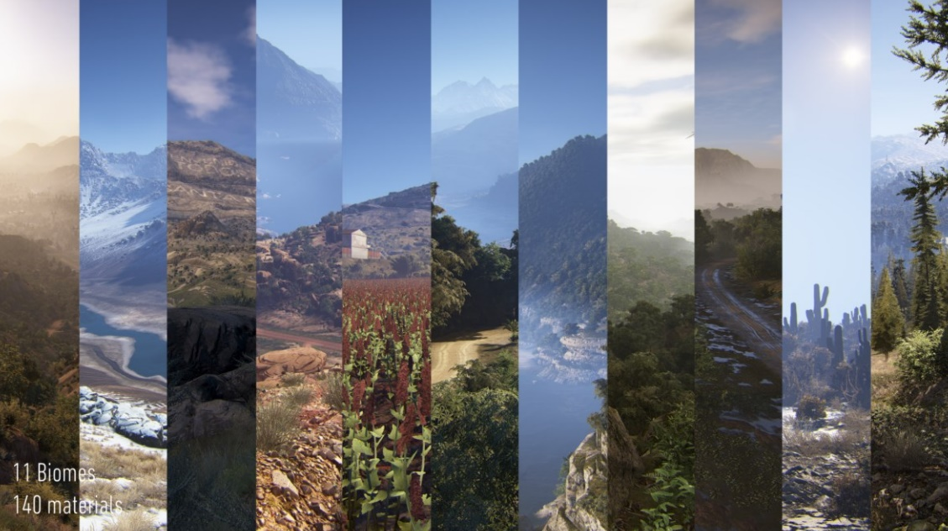
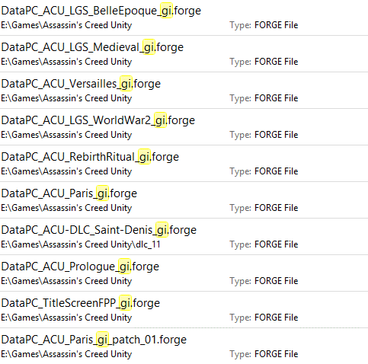

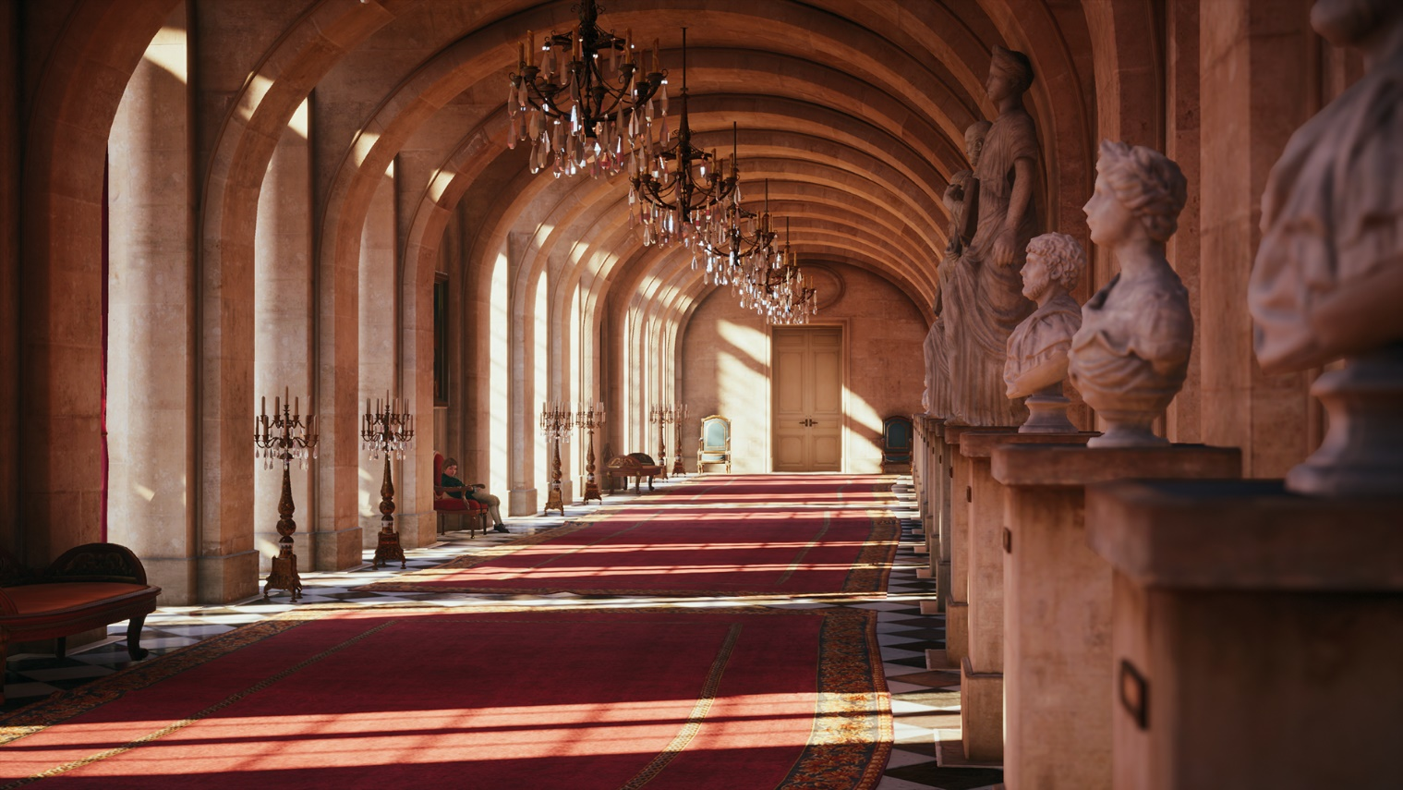

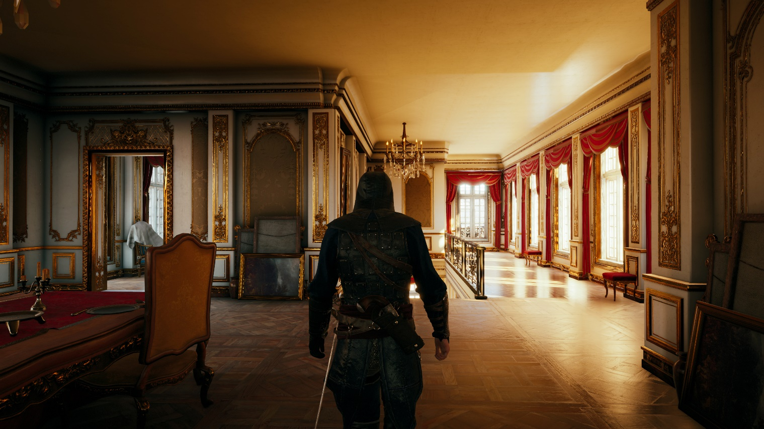
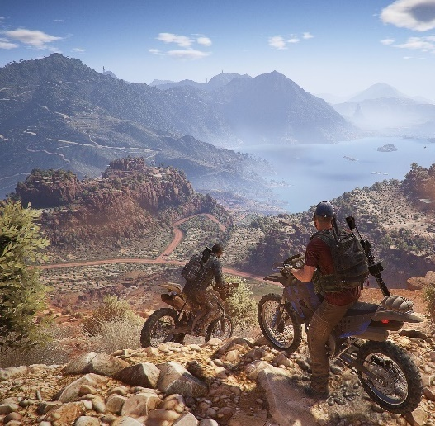
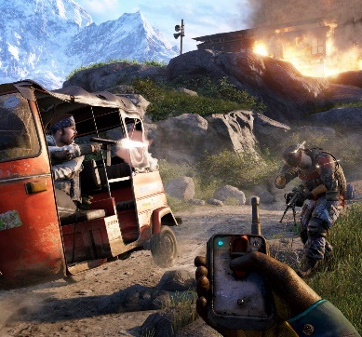

The Open World Beast
GI solutions for open world games is non-trivial
Handles scale
Massive world dimensions, at quality
  ACU: scalable quality (DVD space), up to 21+ GB of GI on PC
  Significant team decision, and it was worth it!
High entity count
  Wildlands [Werle2017]: 839 862 trees, 3 449 638 bushes, 775 288 rocks
Holds on console memory, handles streaming
Handles interiors & exteriors (without leaks)
Often handles time-of-day, weather
Authoring content as such scale requires:
Robust and distributed process
Easy of authoring/updating, production-manageable
Ghost Recon Wildlands [Werle17]
Just Cause 3 (≈1000 km²)
Just Cause 3 (≈1000 km²)
Ghost Recon Wildlands (≈256 km²)
Ghost Recon Wildlands (≈256 km²)
Far Cry (≈100 km²)
Far Cry (≈100 km²)
PUBG (≈64km² )
PUBG (≈64km² )
Assassin’s Creed Unity

Slide 30
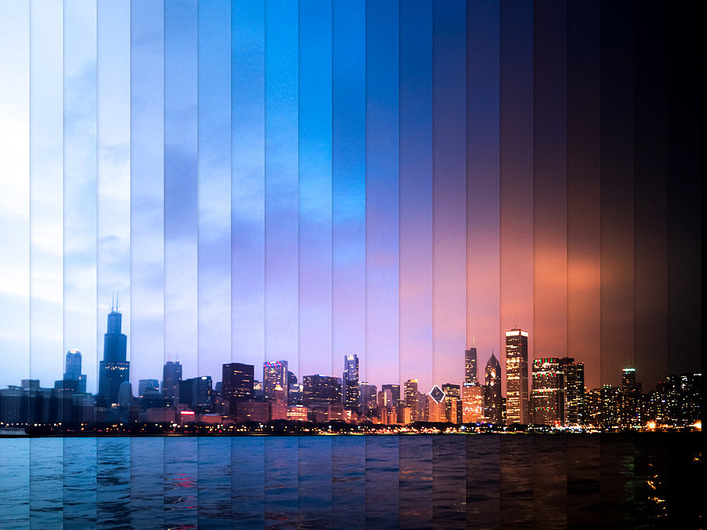
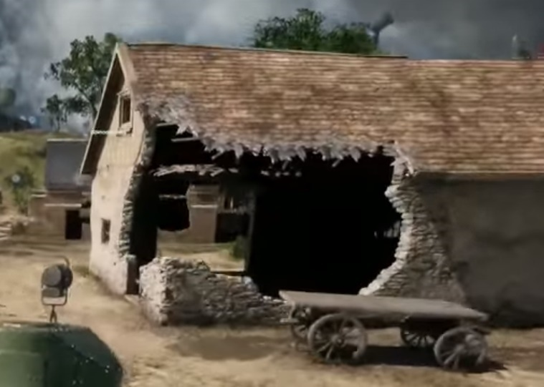


Game Features
Several features that can make/break GI:
Wear, tear, destruction
  A hole in the wall can drastically break GI
  Handle arbitrary malleable worlds
Time-of-Day
  Art-direct key hours, but what about in-betweens?
  Interpolation doesn’t always give best results
Weather
User-Generated/Assembled Environments
  Can’t guarantee AAA gamedev artist authoring here, for composition, performance, etc.
Stuff-that-moves, lights on/off, volumetrics

Slide 31
The Future
Notes:
Now that we’ve admitted our challenges, let’s paint a picture of a potential future we want to have with regards to GI

Slide 32

GI for Games of The Future
Crafted
Procedural
Player Generated
From Left to Right: BF1, Tom Clancy’s Ghost Recon Wildlands, Minecraft
Notes:
In the future, near or far, we will have a combination of games that fall into these categories.

Slide 33




GI as a First-Class Citizen
Artists can rely on shadows for gameplay, but not GI
FPS scenario where the firefight actually sets things on fire:
Continuously burn, affecting lighting and GI
Lighting from incidental fire could have a big and striking effect on gameplay
Corridor shooter, where another player is around a corner:
But you can see the bounce of their muzzle flashes
Audio gives queues of what's ahead. So can GI
Use GI to create better games and experiences
Die Hard 2
Bioshock
Notes:
Alien Isolation actually uses this to its advantage.

Slide 34



Mixed Environments
Inconsistent representation for different geometries
Organic: GI for forests / vegetation is non-trivial
Trunk / big branches: lightmaps? (maybe…)
Branches: probes? vertex color?
Leaves (cards): …
Need a unified solution for organics and artificially-made environments
Coexist in the same environment
Hard edges
Don’t want leaks

Slide 35

Participating Media
GI for complex participating media is definitely unsolved in games
Lighting the world with physically-based pyroclastic simulations!
Notes:
360 fly around and look convincing. We also can’t have games without sweet explosions!

Slide 36

The Importance of Specular GI
Indirect Specular with SVOGI [Crassin12]
Notes:
Super compelling to have great looking specular GI. Enable new types of environments and art direction.

Slide 37

Player Generated Content
Can’t assume AAA gamedev art & composition from user-generated content
Reconcile (potential) weird assemblage of player made worlds:
Players can do whatever they want and system has to deal with it
Handle weird ratios (geometry/materials) and weird composition
Without offline processing
Alternative runtime representations as a true equalizer?
Voxelization?
Spherical representations?
Or transform to a common/uniform/compact representation
Need robust solutions that just work ™ (on millions of arbitrary assets)
Notes:
Without offline processing

Slide 38
The Artist Perspective
Design GI with our main client in mind: artists and designers!
Big Picture vs Details
Solve “big picture” GI rapidly, and refine details over time
Progressive feedback with refinement
Algorithms that support for quick previz, able to slice work over n-frames
Refinement zones (user, camera-driven) works: progressive lightmapper [Unity16]
Runtime approximation of final quality to unblock people (art reviews, playtest, bugs)
Drastically improves iteration times, iteration → quality
Less downtime, and bakes always mean downtime

Slide 39


Towards a Zero Grunt Work™
Pipeline
Automatic parametrization & good interfaces!
Let’s get rid of the tedious “non-art” manual steps:
Unwrapping lightmap UVs
Building simplified geometry for GI
Manually placing GI & reflection volumes
Any other non-artistic step that could be automated
Interface & Tweakables
Exposing everything doesn't mean the best results
  Horrible PBR: 75% metals
Simple and clear, artist and art director friendly params
  People test stuff by trying extremes: 0-1 mappings
  Complex behaviours: slider driving 4 sliders. Presets!
Notes:
Basically, and what artists have signed up for in the first place: making art

Slide 40



Future Light Types
Area lighting is becoming more and more common
Blade Runner
Used in several areas in games [Drobot13] [Lagarde14] [Heitz16]
Runtime (windows, ad panels, light enclosures)
In-game cinematics (photo-studio lighting, 3+ point lighting)
Need to build GI systems that work for such light types, in real-time
With diffusers, textured & animated
Even direct area light shadows are still unfortunately challenging

Slide 41

Denoising / Reconstruction
Denoising becomes relevant when considering path tracing as a solution
[Mara17]
[Schied17]
The denoisers in these papers are still too heavy for games today (1-2 spp, 10ms @ TITAN X), but they are much faster than film denoisers (100+ spp, seconds-to-minutes). Huge progress! ☺
Notes:
Where we compute GI sparsely and reconstruct or denoise the missing information.
5 orders of magnitude improvement in the past months
Still lots of research to be done, but it’s looking great!

Slide 42



Deep Learning
Deep learning is making its way into rendering as well!
[Holden16]
[AllaChaitanya17]
More info about DL and rendering in Marco’s Talk
“Deep Learning: The Future of Real-Time Rendering?” @ 4:25PM

Slide 43
Open Questions
What is the next big step in a completely unified real-time GI solution?
Need a unified “solve all BSDF” approach (organics, human-made, volumetrics)
Need to solve for fully malleable, deformable and interactive worlds!
Are engines architectures and current art methods preventing us from moving forward with high-quality real-time GI?
What if we weren’t using triangles anymore…
What if the data representation used for GI was completely different from authoring?
Real-time denoised path-tracers for future rendering architectures?
How do we go about solving real-time GI for mobile and VR?
Mid-to-far-field on the cloud, near-field on the device?
Notes:
Path tracing just went through a major leap with denoising! Is this it?

Slide 44


Gamedev vs Research
So many academic sources:
SIGGRAPH / SIGGRAPH ASIA
I3D
HPG
EGSR
JCGT
GDC
But also:
  (╯°□°)╯︵ ┻━┻
Finding what works for your game may sometimes feel like finding a needle in a haystack

Slide 45


Gamedev vs Research
And once we’ve found it, we might have to duct tape it in the engine…

Slide 46

Tug-of-War
I want to know where it fails!
I want demo and source!
I want game relevant assets!
I want more publications!
Gamedev
Academia
We need to challenge our respective organizations to align for the greater good
Gamedevs:
Contact academia when you have questions!
Consider finding different ways to work with them, and share some assets!
Cite and give credit to academia in your GDC/SIGGRAPH presentations!
Academia:
When a gamedev contacts you, it means they’re interested and want to hear back from you!
It’s not just “implementation details”. Consider practicality in addition to citations [Hecker11] [Baker11], augmenting artists [McGuire13]
You think your technique belongs in a game? Cool! More info in the next slide.
Middle ground: JCGT
Notes:
More industry gap bridging initiatives like JCGT are needed
Many success stories too!

Slide 47








Getting Your Technique in Games
If you want your stuff in games, here’s how to achieve maximal visibility:
HLSL / GLSL / Code in your paper (i.e.: appendix)
  While many gfx programmers have an extensive math background, yours is most likely more complete
  Learning from source is easier, and trying out stuff rapidly is great
Working Demo with Source
  Github
Use Social Media
  Twitter: lots of devs hang-out there, and retweet papers they find interesting
  Blog Post to summarize and add extra content (i.e.: summary, where it breaks, etc.)
Relevant Art Assets
  Check out Morgan McGuire’s Mesh Database [McGuire17-2]
  Want something different? Ping artists on art forums!
Use ms instead of fps [Hecker11] [Baker11]
Try on non highest-end GPUs ;) (slide 26)
Team up with us and other R&D groups!
Notes:
You should also try to implement your techniques in a framework or engine that is larger than your personal sandbox, in an open source game engine or even Falcor. This will allow you to combine your technique with the other rendering techniques in the infrastructure, allowing you to evaluate some of the scaling-up and interop issues. If you want your technique to be productized in a game, be a consultant to those who are interested in trying your idea in production. Also, be ready to change your algorithm when it fails the first time it comes in contact with production requirements, as those iterations are part of the birthing process.

Slide 48


Summary
Still have lots of work to do!
Need to work towards a unified GI solution for games of the future
Need more/strong collaborations between academia and gamedevs, with a model where both parties win!
With the latest advances in both academia and gamedev GI, the future is looking promising!
Notes:
Challenges to the right still apply!

Slide 49




















Special Thanks
Tomasz Stachowiak
Jon Greenberg
Aaron Lefohn
Natalya Tatarchuk
Sébastien Lagarde
Yuriy O’Donnell
Jasper Bekkers
Andrew Lauritzen
Paul Greveson
Henrik Halén
Diede Apers
Oscar Carlén
Alan Wolfe
Johan Andersson
Steve McAuley
Dave Barrett
Francesco Cifariello
Guillaume Werle
John White
Cyril Crassin
Nicolas Lopez
Graham Wihlidal
Sandra Jensen
Sébastien Hillaire
Michal Iwanicki

Slide 50
References (1/2)
[AllaChaitanya17] ALLA CHAITANYA, C.R. et Al. Interactive Reconstruction of Monte Carlo Image Sequences using a Recurrent Denoising Autoencoder, SIGGRAPH 2017, Link
[Abrash2000] ABRASH, Michael. Quake's Lighting Model: Surface Caching, Graphics Programming Black Book, Special Ed., Chapt. 68, 2000, Link
[Baker11] BAKER, Daniel. From Papers to Pixels: how Research Finds (or Often Doesn’t) its Way into Games, I3D 2011, Report by Naty Hoffman
[BarréBrisebois14] BARRÉ-BRISEBOIS, Colin. DirectX 11 Rendering and NVIDIA GameWorks in Batman: Arkham Origins, GTC 2014, Link
[Bech10] BECH, Box projected cubemap environment mapping, GameDev.net Forums, Link
[Bush15] BUSH, Jeff. Project Log - Quake Lightmaps, Blog Post, 2015, Link
[Chen08] CHEN, Hao. Lighting and Material of HALO 3, GDC 2008, Link
[Crassin11] CRASSIN, Cyril Et. Al. Interactive Indirect Illumination and Ambient Occlusion Using Voxel Cone Tracing, Pacific Graphics 2011, Link
[Crassin12] CRASSIN, Cyril. GTC 2012 Talk: "Octree-Based Sparse Voxelization for Real-Time Global Illumination, GTC 2012, Link
[Crassin15] CRASSIN, Cyril Et. Al. CloudLight: A System for Amortizing Indirect Lighting in Real-Time Rendering, JCGT 2015, Link
[Crytek16] CRYTEK. Voxel-Based Global Illumination, Link
[Dachsbacher04] DACHSBACHER, Carsten and Stamminger, Marc. Reflective Shadow-Maps, Link
[Drobot13] DROBOT, Michal. Lighting of Killzone Shadow Fall, Digital Dragons 2013, Link
[Enlighten] ENLIGHTEN. Demystifying the Enlighten Precompute Process, Blog, Link
[Seymour15] SEYMOUR, Mike. EPIC’s Unreal Engine Open World: behind the scenes, Blog, Link
[Gilabert12] GILABERT, Mickael and STEFANOV, Nikolay. Deferred Radiance Transfer Volumes, GDC 2012, Link
[Good05] GOOD, Otavio. Optimized photon tracing using spherical harmonic light maps, SIGGRAPH 2005, Link
[Greenberg05] GREENBERG, Jon. Hitting 60Hz with the Unreal Engine: Inside the Tech of Mortal Kombat vs DC Universe, GDC 2009, Link
[Habel10] HABEL, Ralf and WIMMER, Michael. Efficient Irradiance Normal Mapping, I3D 2010, Link
[Halén09] HALÉN, Henrik and LARSSON, David. The Unique Lighting of Mirror’s Edge, GDC 2009, Link
[Hargreaves03] HARGREAVES, Sean. Hemisphere Lighting with Radiosity Maps, GamaSutra, 2003, Link
[Hecker11] HECKER, Chris. A Game Developer’s Wish List for Researchers, I3D 2011, Link
[Heitz16] HEITZ, Eric et. Al. Real-Time Polygonal-Light Shading with Linearly Transformed Cosines, SIGGRAPH 2016, Link
[Hill10] HILL, Stephen. Rendering with Conviction, GDC 2010, Link
[Holden16] HOLDEN, Daniel et. Al. Neural Network Ambient Occlusion, SIGGRAPH ASIA 2016, Link
[Hooker16] HOOKER, JT. Volumetric Global Illumination At Treyarch, SIGGRAPH 2016, Link
[Iwanicki16] IWANICKI, Michal. Precomputed Lighting in Call of Duty: Infinite Warfare, SIGGRAPH 2017
[Kaplanyan09] KAPLANYAN, Anton. Light Propagation Volumes in CryEngine 3, SIGGRAPH 2009, Link
[Lagarde12] LAGARDE, Sébastien. Local image-based lighting with parallax-corrected cubemaps, SIGGRAPH 2012, Link
[Lagarde14] LAGARDE, Sébastien and DE ROUSIER, Charles. Moving Frostbite to PBR, SIGGRAPH 2014, Link
[Lauritzen17] LAURITZEN, Andrew. Future Directions for Compute-for-Graphics, SIGGRAPH 2017
[Malmros17] MALMROS, Jim. Gears of War 4 : Custom Graphics Features and Optimization Techniques, SIGGRAPH 2017
[Martin10] MARTIN, Sam and EINARSSON, Per. A Real Time Radiosity Architecture for Video Games, SIGGRAPH 2010, Link
[Mara17] MARA, Michael et. Al. An Efficient Denoising Algorithm for Global Illumination, HPG 2017, Link

Slide 51
References (2/3)
[McAuley15] McAULEY, Stephen. Rendering the World of Far Cry 4, GDC 2015, Link
[McGuire13] McGUIRE, Morgan. The Augmented Artist: Computation & Content Creation, I3D 2015, Link
[McGuire17] McGUIRE, Morgan. Real-Time Global Illumination using Precomputed Light Field Probes, I3D 2017, Link
[McGuire17-2] McGUIRE, Morgan. Computer Graphics Archive, 2017, Link
[McLaren15] McLAREN, James. The Technology of The Tomorrow Children, GDC 2015, Link
[McTaggart04] McTAGGART, Gary. Half-Life 2 / Valve Source Shading, GDC 2004, Link
[Mittring07] MITTRING, Martin. Finding Next Gen – CryEngine 2. SIGGRAPH 2007, Link
[Mittring12] MITTRING, Martin. The Technology Behind “Unreal Engine 4 Elemental demo”. GDC 2012, Link
[Neubelt14] NEUBELT, David and PETTINEO, Matt. Crafting a Next-Gen Material Pipeline for The Order: 1886, GDC 2014, Link
[Nowrouzezahrai09] NOWROUZEZAHRAI, Derek and SNYDER, John. Fast Global Illumination on Dynamic Height Fields, EGSR 2009, Link
[Oat07] OAT, Christopher and SANDER, Pedro, Ambient Aperture, I3D 2007, Link
[Pantaleev15] PANTALEEV, Alexey. Practical Real-Time Voxel-Based Global Illumination for Current GPUs, GTC 2014, Link
[Pettineo15] PETTINEO, Matt. Step Into The Baking Lab, Blog Post, Link
[Ren06] REN, Zhong Et. Al. Real-time Soft Shadows in Dynamic Scenes using Spherical Harmonic Exponentiation, Microsoft Research 2006, Link
[Ritschel09] RITSCHEL, Tobias et. Al. Approximating Dynamic Global Illumination in Image Space, I3D 2009, Link
[Ritschel11] RITSCHEL, Tobias Et. Al. The State of the Art in Interactive Global Illumination, Computer Graphics Forum, 2001, Link
[Schied17] SCHIED, Christoph et. al. Spatiotemporal Variance-Guided Filtering: Real-Time Reconstruction for Path-Traced Global Illumination, HPG 2017, Link
[Schulz14] SCHULZ, Nicolas. The Rendering Technology of Ryse, GDC 2014, Link
[Silvennoinen15] SILVENNOINEN, Ari. Multi-Scale Global Illumination in Quantum Break, SIGGRAPH 2015, Link
[Sloan08] SLOAN, Peter Pike. Stupid Spherical Harmonics (SH) Tricks, GDC 2008 Lecture Notes, Link
[Sloan13] SLOAN, Peter Pike Et. Al. Ambient Obscurance Baking on the GPU, SIGGRAPH Asia 2013, Link
[Sousa11] SOUSA, Tiago et. Al. Secrets of CryENGINE 3 Graphics Technology, SIGGRAPH 2011, Link
[Stachowiak14] STACHOWIAK, Tomasz. SGSSR + run-time filtered cubemap, Demo, Link
[Stachowiak15] STACHOWIAK, Tomasz. Stochastic Screen Space Reflections, SIGGRAPH 2015, Link
[Stefanov15] STEFANOV, Nikolay. Global Illumination in Tom Clancy’s The Division, GDC 2016, Link
[Tabellion10] TABELLION, Eric. Ray Tracing vs. Point-Based GI for Animated Films, SIGGRAPH 2010, Link
[Tatarchuk05] TATARCHUK, Natalya. Irradiance Volumes for Games, GDCE 2005, Link
[Unity16] UNITY and IMAGINATION TECHNOLOGIES. Progressive Lightmapper, GDC 2016, Link
[Valient14] VALIENT, Michal. Taking Killzone Shadow Fall Image Quality Into The Next Generation, GDC 2014, Link
[Villegas08] VILLEGAS, Luis and SHYPULA, Sean. Life on the Bungie Farm: Fun Things to Do with 180 Servers, GDC 2008, Link
[Wang09] WANG, Jiaping Et. Al. All-Frequency Rendering of Dynamic, Spatially-Varying Reflectance, SIGGRAPH ASIA 2009, Link
[Werle17] WERLE, Guillaume and MARTINEZ, Benoit. Ghost Recon Wildlands Terrain Technology and Tools, GDC 2017, Link
[Woodhouse14] WOODHOUSE, Ben. Dynamic Global Illumination in Fable Legends, LionHead Blog (WebArchived), Link
[Wright15] WRIGHT, Daniel. Dynamic Occlusion With Signed Distance Fields, SIGGRAPH 2015, Link

Slide 52
Questions?
www.ea.com/seed We’re hiring! @SEED

