Slide 1

Future Directions for Compute-for-Graphics
Andrew Lauritzen
Senior Rendering Engineer, SEED
@AndrewLauritzen

Slide 2
Who am I?
Senior Rendering Engineer at SEED – Electronic Arts
  @SEED, https://www.ea.com/SEED
Previously
  Graphics Software Engineer at Intel (DX12, Vulkan, OpenCL 1.0, GPU architecture, R&D)
  Developer at RapidMind (“GPGPU”, Cell SPU, x86, ray tracing)
Notable research
  Deferred shading (Beyond Programmable Shading 2010 and 2012)
  Variance shadow maps, sample distribution shadow maps, etc.
Notes:
I just recently joined the SEED team at Electronic Arts.
Before that I worked at Intel for 8 years.
During my time there I was involved pretty heavily with the DirectX 12 and Vulkan specifications and prototypes, and before that with OpenCL’s initial specification.
I worked in the early “GPGPU” days at RapidMind on a variety of parallel processors.
It’s worth noting that I’m not a compiler expert, but I have experience with parallel languages and GPU architecture and design.

Slide 3
Renderer Complexity is Increasing Rapidly
Why?
  Demand for continued increases in quality on wide variety of hardware
  GPU fixed function not scaling as quickly as FLOPS
  Balance of GPU resources is rarely optimal for a given pass, game, etc.
  Power efficiency becoming a limiting factor in hardware/software design
Opportunity to render “smarter”
  Less brute force use of computation and memory bandwidth
  Algorithms tailored specifically for renderer needs and content
Notes:
To motivate this talk, let me point out a trend that most people here won’t find very surprising: the complexity of modern real-time renderers has been increasing rapidly over the past few years.
There’s a number of reasons why this trend has accelerated recently, but fundamentally while GPUs continue to get faster, simply scaling the same brute force algorithms up produces diminishing returns in terms of image quality.
Happily, GPUs are also becoming increasingly programmable, and thus we’ve seen a sharp increase in “smarter” renderers.

Slide 4
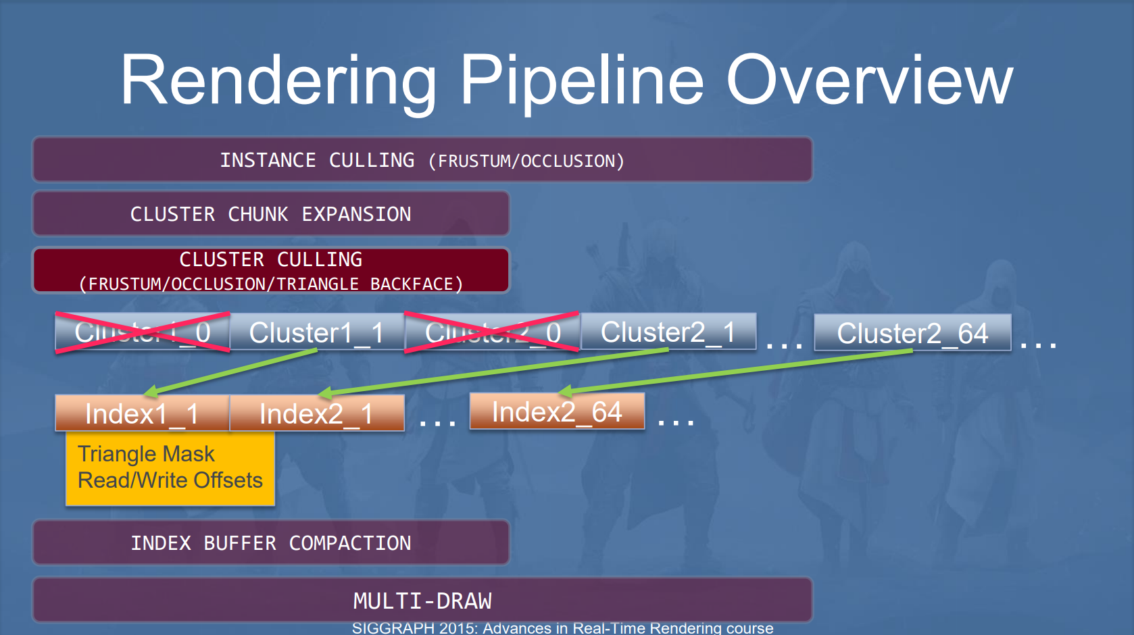
From “GPU-Driven Rendering Pipelines” by Ulrich Haar and Sebastian Aaltonen, SIGGRAPH 2015
Notes:
For instance, Ubisoft gave a talk a couple years ago wherein they described the geometry pipeline in Assassin's Creed Unity.
To improve the performance of rendering massive amounts of geometry, they implemented a variety of hierarchical clustering and culling steps in compute shaders to greatly cut down on the amount of geometry sent to the GPU rasterizer.
This allowed them to greatly increase the amount of detail in their large, open world games.

Slide 5
BF1 : PS4™Pro
1600x1800
Clear (IDs and Depth)
3200x1800
CB Resolve + Temporal AA
Foreground Transparency
Gaussian Pyramid
Final Post-Processing
Silhouette Outlines
3840x2160
Display Mapping + Resample
Velocity Vectors
Transparency
Sky
Emissive
Tiled Lighting + SSS
HBAO + Shadows
G-Buffer Decals
Resolve AA Depth
G-Buffer Laydown
Partial Z-Pass
Motion Blur
ish…
Dynamic resolution scaling
ish…
From “4K Checkerboard in Battlefield 1 and Mass Effect Andromeda” by Graham Wihlidal, GDC 2017
Notes:
At the other end of the pipeline, shading is getting increasingly decoupled from the conventional GPU rendering pipeline.
In a presentation earlier this year, Graham described how the Frostbite engine uses checkerboarding to add more perceived resolution by being more particular about the frequencies at which they evaluate various terms during rendering.
In reality it’s actually even more decoupled than this image shows, as the internal render resolutions are also driven by an adaptive scaling algorithm, and temporal anti-aliasing is itself an additional decoupling in time.
Of course all of these things significantly increase the complexity of the renderer, and that trend will continue.

Slide 6
GPU Compute Ecosystem
Complex algorithms and data structures are impractical to express
  End up micro-optimizing the simple algorithms into local optima
Significant language and hardware issues impede progress
  Writing portable, composable and efficient GPU code is often impossible
GPU compute for graphics has been mostly stagnant
  Most of the problems I will discuss were known ~7 years ago! [BPS 2010]
  CUDA and OpenCL have progressed somewhat, but not practical for game use
Notes:
Unfortunately, we are rapidly approaching a complexity wall past which it becomes impractical for us to express the algorithms and data structures we need to advance the state of the art.
Thus instead of pursuing fundamentally more efficient algorithms, we often fall back on low level optimization of the simpler algorithms at the expense of the scaling we really desire.
At the root of the problem is a variety of language and hardware issues that I’ll describe in this talk.
It’s worth noting that none of the problems I’ll talk about are particularly new.
Unfortunately, GPU compute in graphics APIs has seen very few changes since its initial introduction.
While CUDA and OpenCL have made a little progress, they are not targeted at games.

Slide 7
Case Study: Lighting and Shading
Notes:
Let’s go through a couple case studies to support these claims.

Slide 8
Lighting and Shading
Deferred shading gives us more control over scheduling shading work
  … but still a chunk of it lives in the G-buffer pass
  Per pixel state is large enough to inhibit multi-layer G-buffers
  Want better control over shading rates, scheduling, etc.
Visibility Buffers [Burns and Hunt 2013]
  Follow-up work by Tomasz Stachowiak on GCN [Stachowiak 2015]
  Store minimal outputs from rasterization, defer attribute interpolation
  Possibly even defer full vertex shading
  Use the rasterizer just to intersect primary rays, rest in compute
Notes:
Deferred shading is a great tool that lets us decouple a good chunk of the shading cost so that we can schedule it in a more efficient manner.
That said, the per-pixel cost of storing surface data makes things like multi-layer G-buffers fairly expensive.
We also want even more control over how we position and shade samples in the future, so a light representation of the rays to shade would be ideal.
So why not defer even more of the shading work?
Visibility buffers do that by performing the minimal amount of rasterization up front and deferring attribute interpolation and surface shading to the later pass.

Slide 9
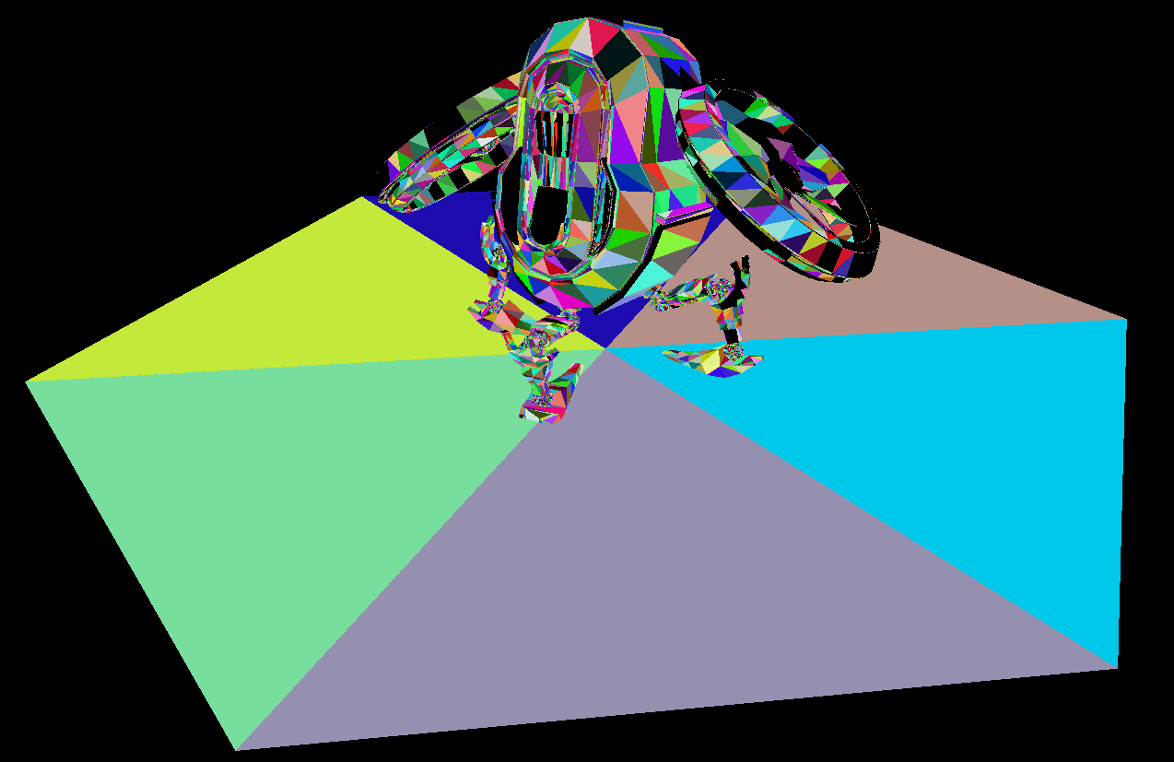
Notes:
Rendering a visibility buffer is pretty straightforward.
We just need a unique mapping from a given pixel to the nearest triangle covering that pixel.
The easiest way to do this is to render depth and primitive IDs to a slim visibility buffer.
We can also encode a material ID if convenient, or just have a mapping from primitive or instance ID to material.
On some platforms it also makes sense to render barycentric coordinates, but these can be computed in the deferred pass as well.

Slide 10

Visibility Buffer Shading
We want to run different shaders based on material/instance ID
  Similar need in deferred shading or ray tracing
Sounds like dynamic dispatch via function pointer or virtual
  Nice and coherent in screen space
struct Material {
Texture2D<float4> albedo;
float roughness;
...
virtual float4 shade(...) const;
};
Notes:
Now that we have a visibility buffer, we have a lot of flexibility in how to shade it.
In most cases we want some sort of dynamic dispatch of different shaders based on the material or instance ID in the buffer.
People who are familiar with conventional deferred shading will recognize this, but it comes up in ray tracing and a variety of other situations too.
Here’s one natural expression of what we’re trying to do here.
Now low level GPU folks are probably losing their minds, but don’t get tied up in details or implementation baggage of these notions in C++.
The point is that we need a clean, composable way to do dynamic dispatch on GPUs.

Slide 11
Übershader Dispatch
struct Material
{
int id;
Texture2D<float4> albedo;
float roughness;
...
};
float4 shade(Material* material)
{
switch (material->id)
{
case 0: return shaderA(material); // Entire function gets inlined
case 1: return shaderB(material); // Entire function gets inlined
case 2: return shaderC(material); // Entire function gets inlined
...
};
}
Notes:
Instead of that, here’s the code you actually have to write to do something like this on GPUs today.
This is a classic “ubershader”.

Slide 12
Shader Resource Allocation
Why are we forced to write code like this?
  GPUs have been fully capable of dynamic jumps/branches for some time now
  Why not just define a calling convention/ABI and be done with it?
Static resource allocation
  GPUs needs to know how many resources a shader uses before launch
  Can only launch a warp if all resources are available
  Will tie up those resources for entire duration of the shader
  Function calls either get inlined, or all potential targets must be known
“Occupancy” is a key metric for getting good GPU performance
  GPUs rely on switching between warps to hide latency (memory, instruction)
Notes:
It’s worth taking a second to consider why we have to write ubershaders instead of just function calls?
GPUs have been able to do dynamic dispatch for quite a while, so why not just define the appropriate calling convention and support it in the language?
The problem is that GPU hardware is still very reliant on static resource allocation.
Before launching a new warp, the scheduler must ensure that all resources that it might potentially need – such as registers and shared memory – are available.
Once the warp is in flight, all of those resources are tied up for the duration regardless of the actual dynamic use of those resources.
This is where we get the notion of “occupancy”.
Occupancy is a measure of how many warps are live on the GPU at a given time.
While occupancy does not equal performance, GPUs heavily rely on switching between live warps to hide various latencies and thus lower occupancy will generally lead to lower performance.
Let’s look at a quick example.

Slide 13
Shader Resource Allocation Example
return shaderA(material);
Registers (40)
Shared Memory (12)
Warp 0
Warp 1
Warp 2
Warp 3
Warp 4
=> “Occupancy 5”
Notes:
Here we have a single material shader that needs some number of registers, and some amount of shared memory.
When we launch a wave onto the GPU, those resources are effectively tied up.
We can continue launching waves until we no longer have enough registers to launch 6th one.
Thus we can say that the “occupancy” of this shader is 5, which just means that 5 is the largest number of waves of this particularly shader that we can ever fit on a single execution unit.

Slide 14
Shader Resource Allocation Example
switch (material->id)
{
case 0: return shaderA(material);
case 1: return shaderB(material);
};
Registers (40)
Shared Memory (12)
Warp 0
Warp 1
=> “Occupancy 2”
Notes:
Now consider adding another material to our ubershader.
The “shaderB” path being present in this shader at all – even if it is never called – increases the amount of static resources that our shader requires.
This in turn reduces the number of warps we can fit on the machine.
Unfortunately occupancy is not only determined by the worst case code path through the shader, but also the worst case use of any individual GPU resource.

Slide 15
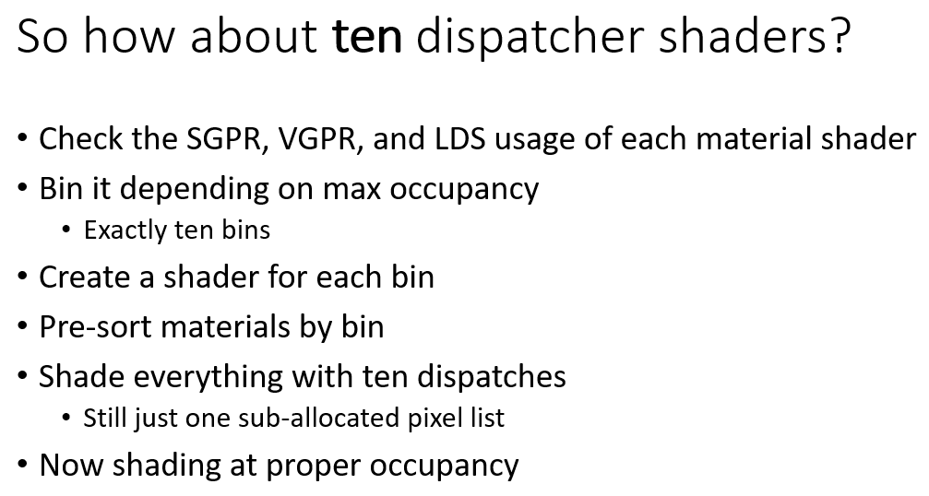

Improving Occupancy via Software?
Per IHV…
Per architecture…
Per SKU…
Per driver/compiler…
From “A deferred material rendering system” by Tomasz Stachowiak, 2017
Notes:
Mixing code with different occupancy hurts performance… so let’s not mix occupancy!
Tom notes that there aren’t actually that many different possible occupancies, so why not just bin our invocations appropriately and do one dispatch per bin?
This is actually a potentially viable solution on a console, but unfortunately the occupancy of a given shader depends on the IHV… and architecture… potentially the SKU… and definitely the given driver version and associated shader compiler.
Thus it’s impractical to do this in a portable way.
There’s also some additional overhead from the binning pass that we’d like to avoid.

Slide 16
Improving Occupancy via Hardware
Dynamic resource allocation/freeing inside warps?
  Some potential here, but can get complicated quickly for the scheduler
Compile everything for good occupancy
  Let caches handle the dynamic variation via spill to L1$?
GPU caches are typically small relative to register files
  Generally a poor idea to rely on them to help manage dynamic working set
  … but improvements are starting to emerge!
Notes:
Going forward, we really need some improvements from hardware in this area.
There’s a variety of ways to accomplish this.
One option is to allow shaders to more dynamically allocate and free registers and other resources while running.
There’s definitely potential here, but it can get complicated for the warp scheduler to ensure good utilization without deadlocks.
Another option is to forcibly compile all of our shaders with limited resource counts that ensure good occupancy and rely on caches to handle the variation.
The problem with this is that GPU caches are typically very small relative to register files, and thus relying on them to help manage the dynamic working set of a shader is generally a poor plan.
That said, things are starting to improve on this front.

Slide 17
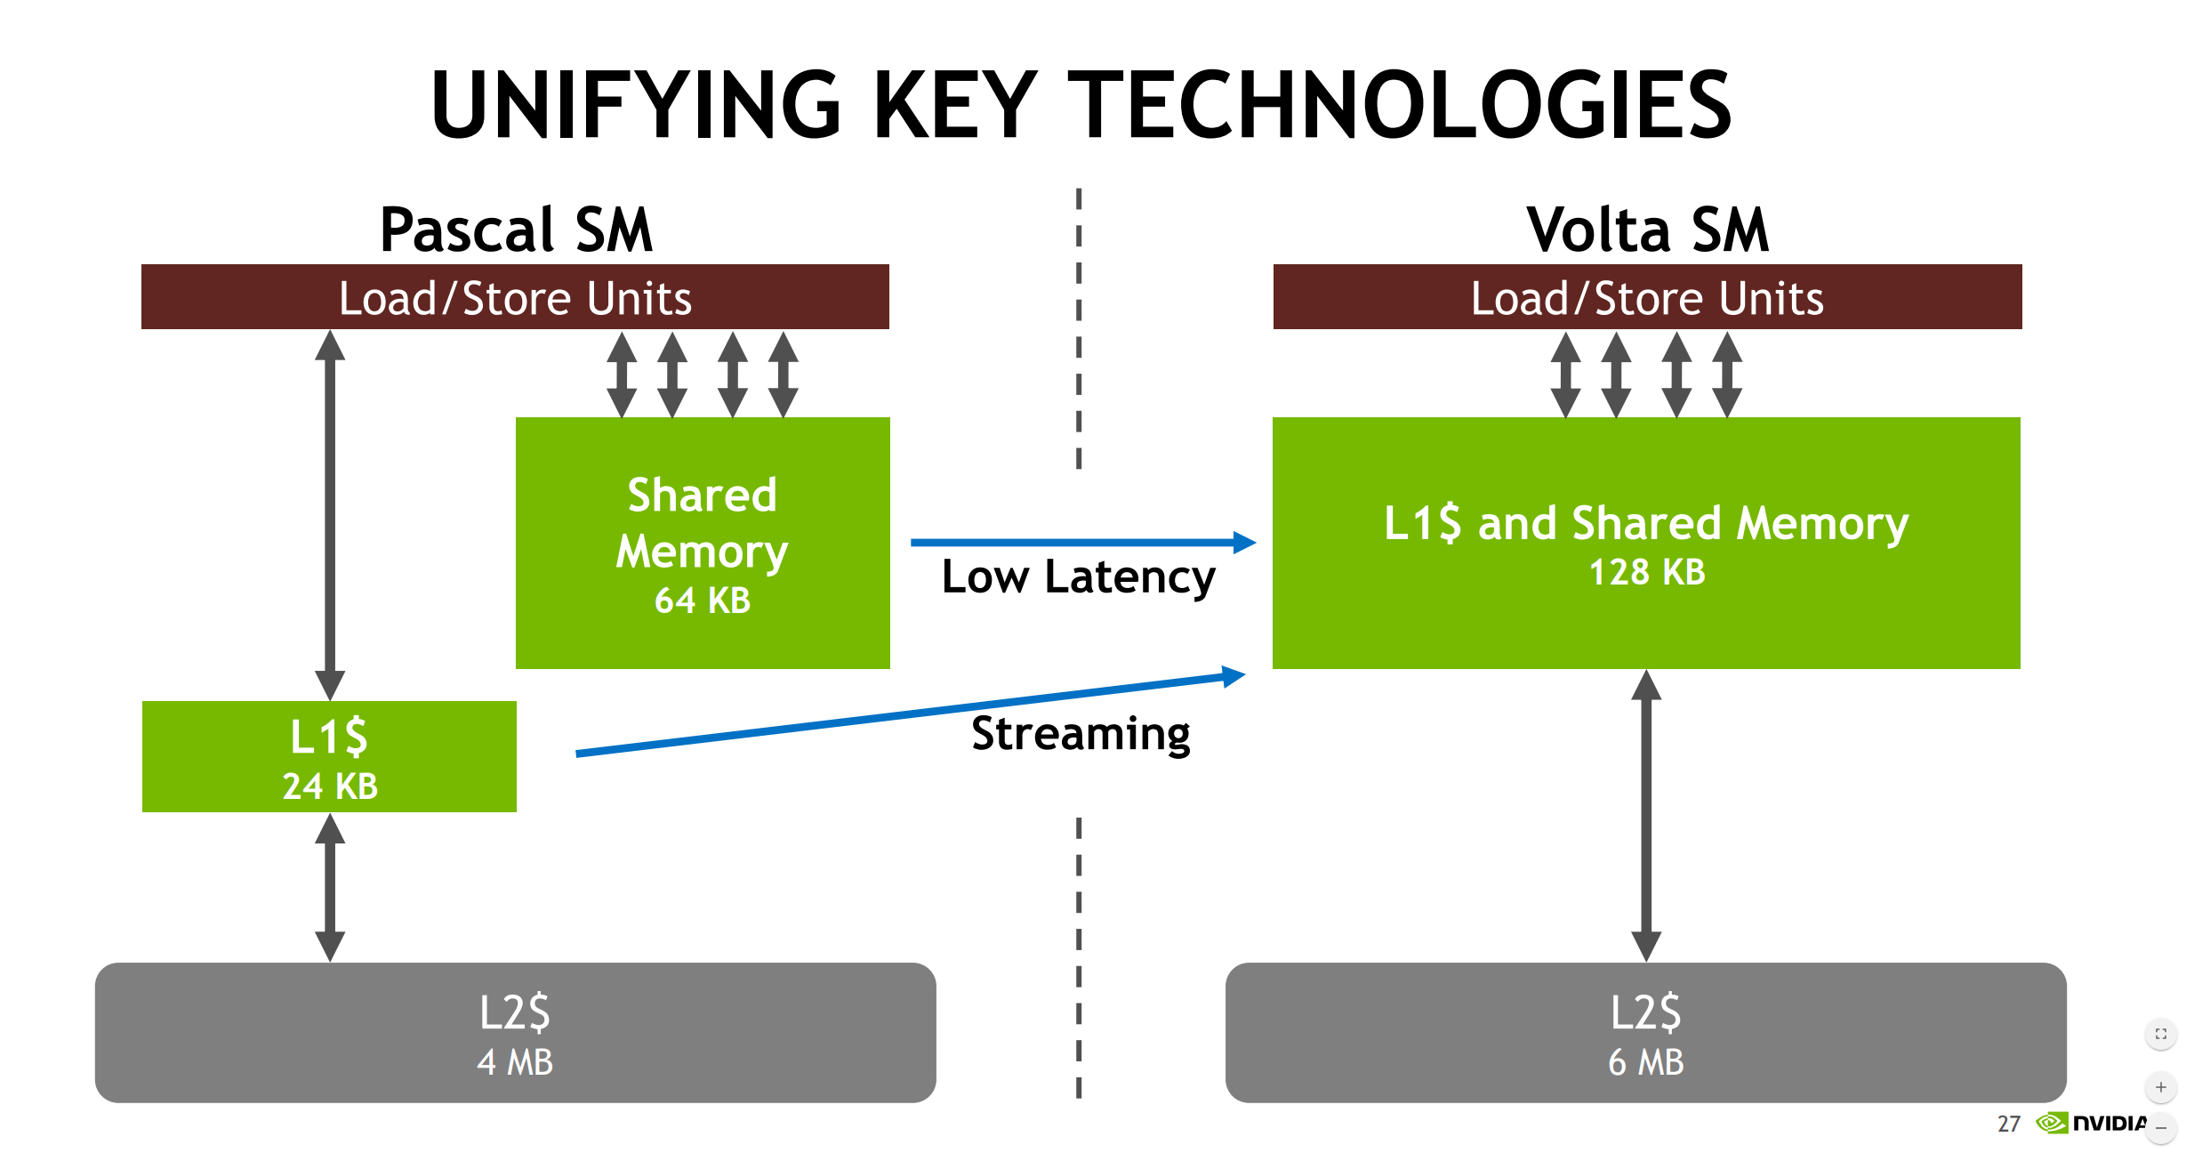
From “Inside Volta” by Olivier Giroux and Luke Durant, GTC 2017
Notes:
In NVIDIA’s recently announced Volta architecture, they have merged their shared memory and L1$.
The new block of memory is now about half the size of the register file, which is starting to get interesting in terms of handling those rare but expensive shader paths.

Slide 18
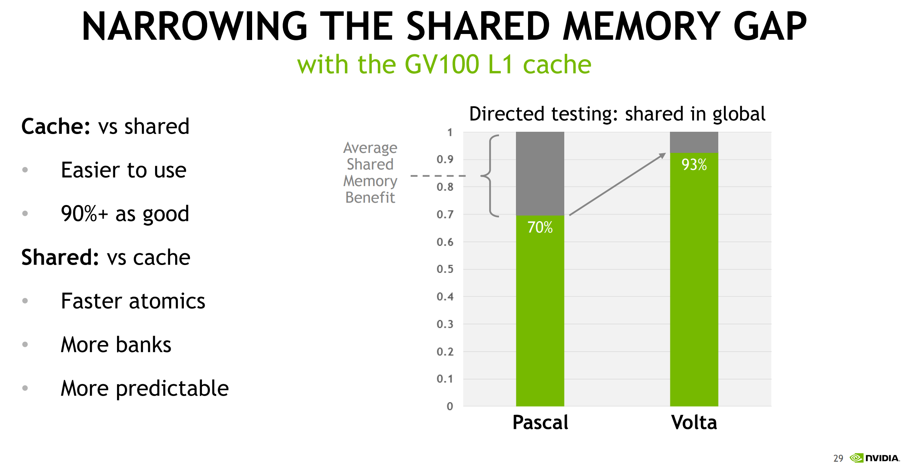
From “Inside Volta” by Olivier Giroux and Luke Durant, GTC 2017
Notes:
They also demonstrated that code that increasingly you only need to explicitly use shared memory if you are doing heavily banked gather/scatter or atomics.
This is a benefit both in terms of occupancy, but also in terms of some other issues with the compute model that we’ll talk about shortly.

Slide 19
Visibility Buffer Takeaways
Hardware needs improvements
  More dynamic resource allocation and scheduling
  Less sensitive to “worst case” statically reachable code
  NVIDIA Volta appears to be a step in the right direction
Enables software improvements
  Dynamic dispatch
  Separate compilation
  Compose and reusable shader code
Notes:
The takeaway here is that we need some hardware improvements in this area.
Volta appears to be a step in the right direction, but it is by no means the only way to improve things.
If we’re going to write increasingly complex code we need tools like dynamic dispatch and separate compilation, and we can’t continue to be crippled by the worst case reachable path through a shader or function call.

Slide 20
Case Study:
Hierarchical Structures
Notes:
Next, let’s look at another case study that comes up commonly in rendering: hierarchical data structures and algorithms.

Slide 21
Hierarchical Structures
Hierarchical acceleration structures are a good tool for “smarter” rendering
  Mipmaps, quadtrees, octrees, bounding volume/interval hierarchies, …
Constructing these structures is inherently nested parallel
  Data propagated bottom-up, top-down or both
  Conventionally created on the CPU and consumed by the GPU
Several reasons we want to construct these structures on the GPU as well
  Latency: input data may be generated by rendering
  FLOPS are significantly higher on the GPU on some platforms
Notes:
If we want to do more “smarter” rendering, hierarchical acceleration structures are a great tool to have.
They already show up all over the place in graphics: mipmaps, octrees and BVH’s are all examples.
While using these structures is fairly straightforward, constructing them is inherently nested parallel.
Data needs to be propagated up the tree, down the tree or sometimes both in sequence.
These structures are conventionally constructed on the CPU and then consumed by the GPU.
Going forward there are several reasons that we want to construct them on the GPU as well.
The most important is latency: often we generate data on the GPU and want to construct some sort of acceleration structure on the fly.
Reading the data back to the CPU and trying to cover the associated latency with other GPU work is not always possible.
Another consideration is that on current consoles the GPU has the lions share of the FLOPS budget, so certain algorithms might not run reasonably on the CPU at all.

Slide 22
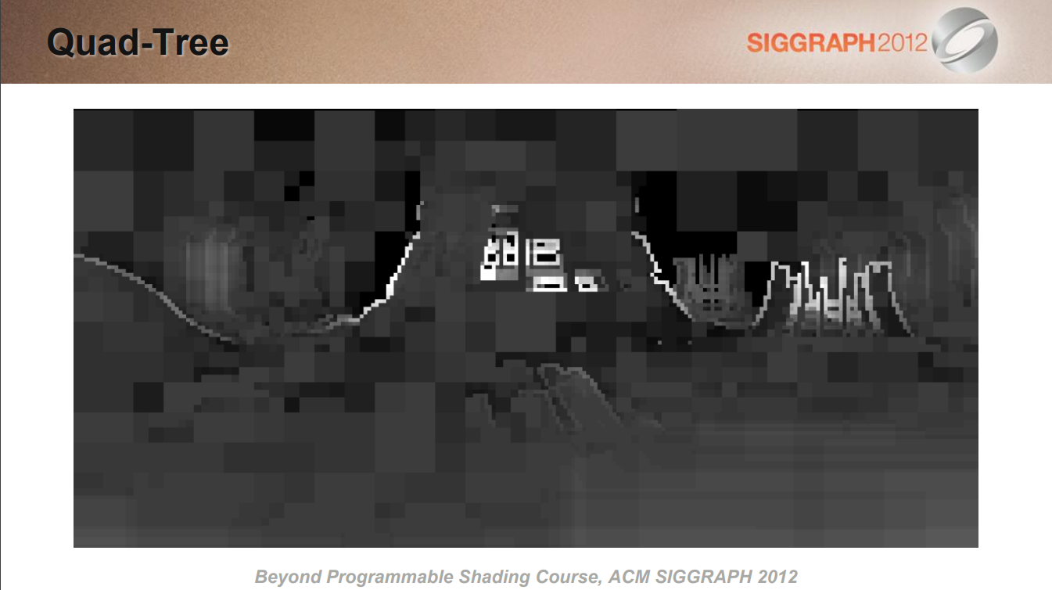
Notes:
To give a simple example, we’ve known for a little while that tiled GPU light culling algorithms are fairly inefficient.
They duplicate a lot of calculations and generally fail to take advantage of the large amounts of coherency present in the distribution of lights on the screen.
At SIGGRAPH 2012 I showed that a relatively modest CPU could outperform a high end GPU at light culling by using a simple quad tree.

Slide 23
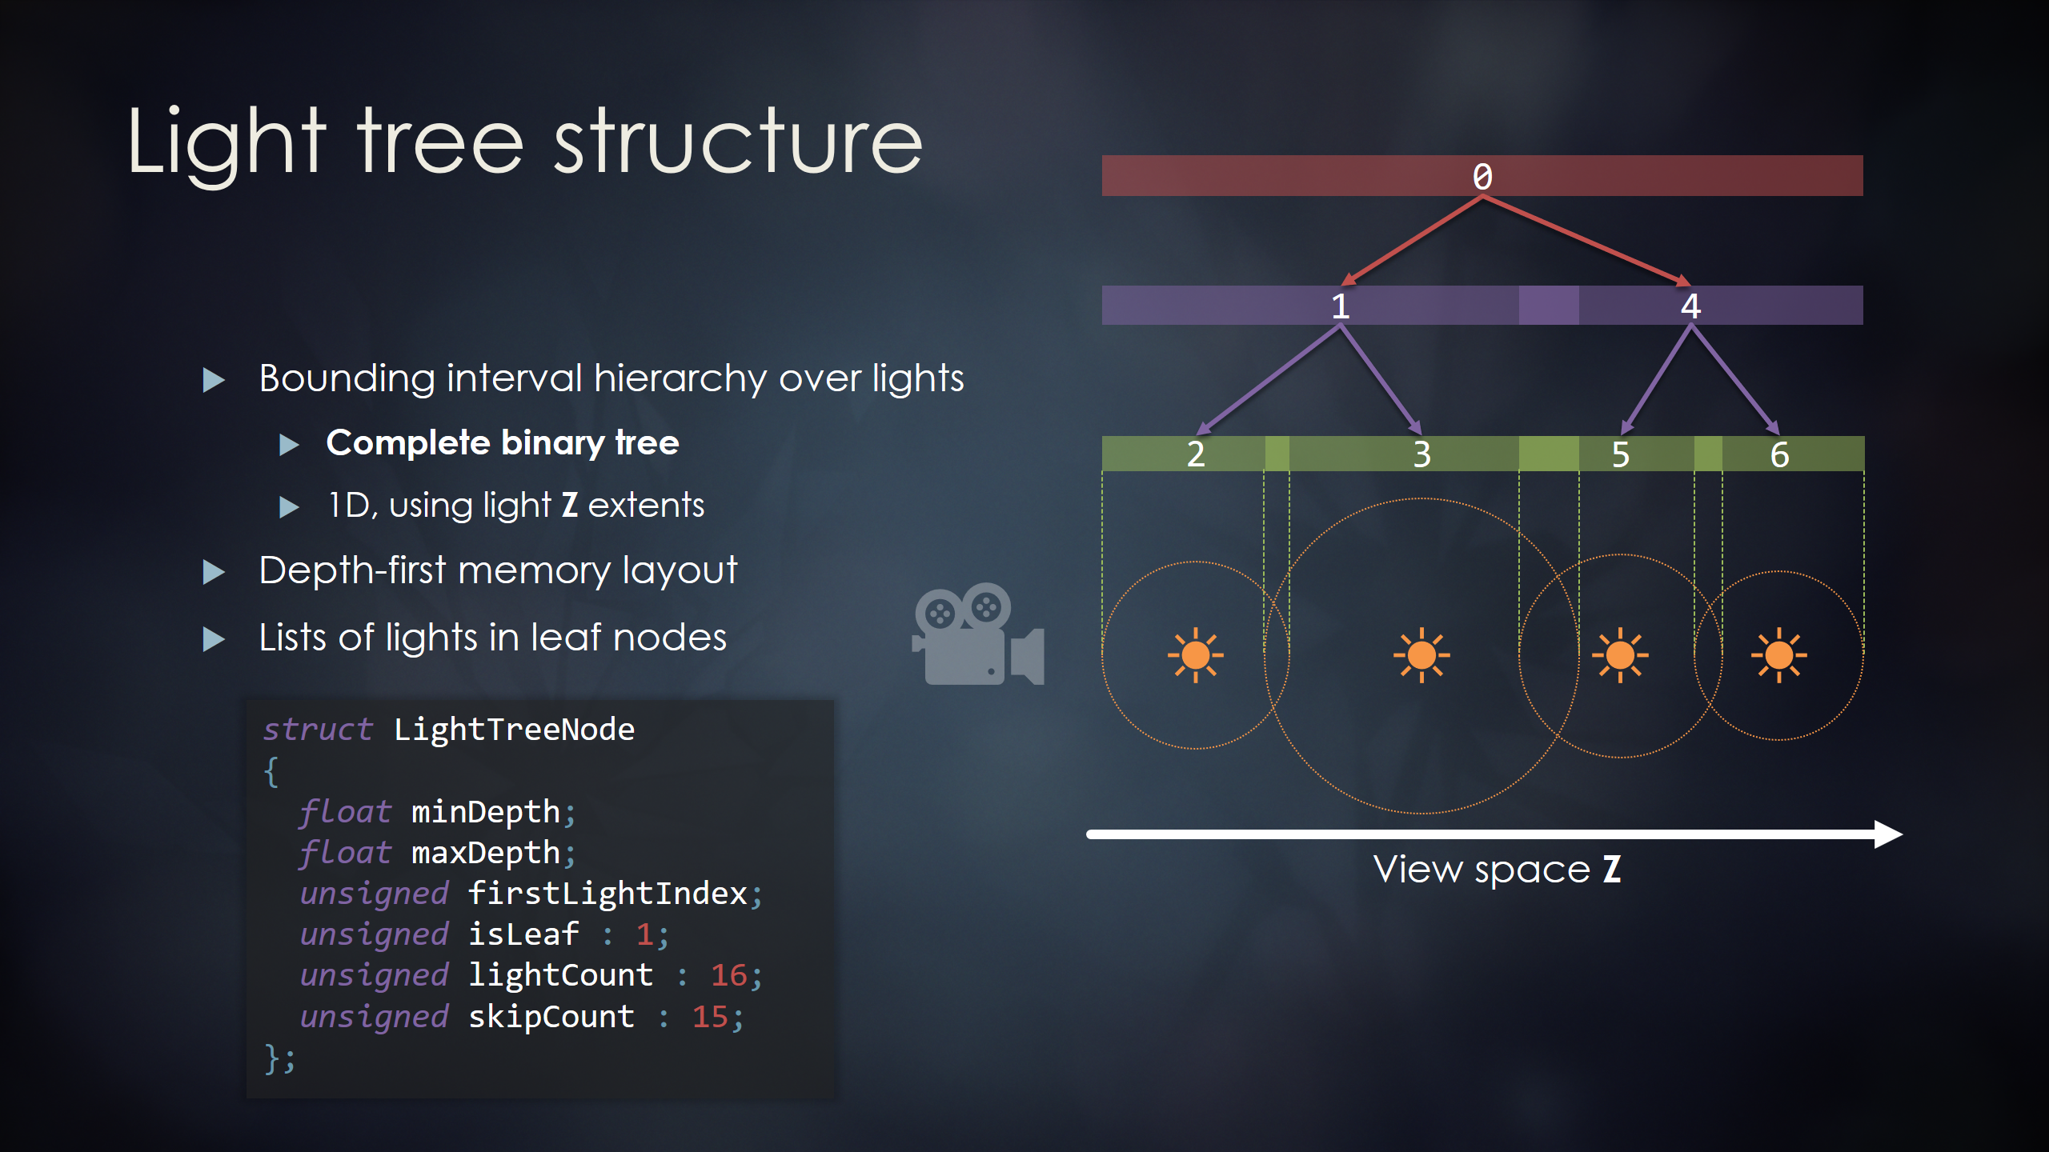
From “Tiled Light Trees” by Yuriy O’Donnell and Matthäus Chajdas, I3D 2017
Notes:
Earlier this year Yuriy and Matthäus presented “Tiled Light Trees”, which create a per-tile bounding interval hierarchy of lights to further accelerate intersection tests.
As with the previous example, the data structure is created on the CPU and consumed by the GPU.

Slide 24
Quadtree GPU Dispatch
Dispatch
128x128
Store/reload state
Dispatch
32x32
32x32
32x32
32x32
Store/reload state
Dispatch
16x16
16x16
16x16
16x16
16x16
16x16
16x16
16x16
16x16
16x16
16x16
16x16
16x16
16x16
16x16
16x16
Notes:
Let’s look at how we might express these algorithms via GPU compute.
A key component of tree algorithms is that the width of parallelism changes as we travel up and down the tree.
This is true whether we’re doing a more bottom up reduction style algorithm or a top-down recursion as shown here.
In either case, to change the number of threads running on the GPU we currently only have one option: issuing a new dispatch.
Between dispatches we actually need to save and reload any live state from main memory, which carries some overhead.
Some algorithms need to return back up the tree as well, creating even more state that we need to save and restore.
Furthermore since we don’t know the dynamic control flow path of the reduction on the CPU, we either have to dispatch the “worst case” number of threads and terminate them early, or do an indirect dispatch on the GPU.
The latter generally requires an additional analysis pass between each dispatch which introduces even more overhead.

Slide 25
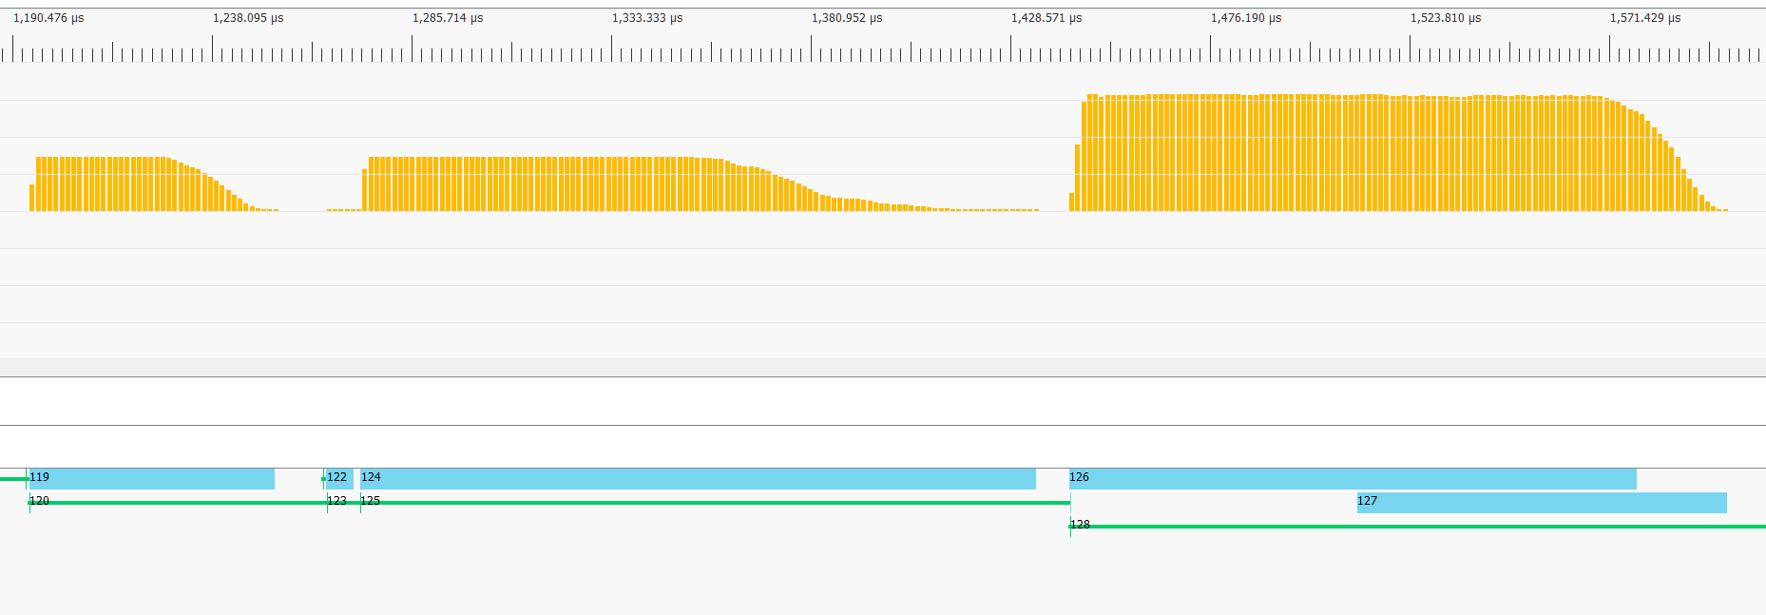
GPU Dispatch Inefficiency
Idle GPU: bad!
Idle GPU: bad!
“Opportunity” for async compute! ☺
From AMD’s Radeon GPU Profiler
Notes:
These problems manifest as poor GPU performance.
Dispatches higher in the quadtree do not fill the machine at all as there simply isn’t enough work.
More seriously, between dispatches the machine has to drain and spin back up which results in lots of wasted cycles.
Recently I’ve learned to put a positive spin on this and call these gaps “opportunities for async compute”.
Indeed concurrent compute work can help, but doesn’t excuse the underlying inefficiency.
Ultimately the synchronization here is too coarse-grained for the real dependencies.
We’re effectively forced to specify that every node in one level depends on every node in the previous level, which is obviously over-constrained.

Slide 26
Quadtree GPU Block Reduction
#define BLOCK_SIZE 16
groupshared TileData tiles[BLOCK_SIZE][BLOCK_SIZE];
groupshared float4 output[BLOCK_SIZE][BLOCK_SIZE];
float4 TileFlat(uint2 tid, TileData initialData)
{
bool alive = true;
...
for (int level = MAX_LEVELS; level > 0; --level)
{
if (alive && all(tid.xy < (1 << level)))
{
...
if (isBaseCase(tileData))
{
output[tid] = baseCase(tileData);
alive = false;
}
...
}
GroupMemoryBarrierWithGroupSync();
}
return output[tid];
}
Baked into kernel
Optimal sizes are highly GPU dependent
May not align with optimal sizes for data
Potential occupancy issues
Some algorithms need a full TileData stack
Notes:
Unfortunately, dispatch is only one part of the problem.
Let’s take a quick look at the kernel code itself that we execute for each node.
To iterate within a block we have to write code that looks something like this.
Since we need to pass data from one iteration to the next via shared memory, we need a barrier in the loop.
This in turn requires that we track threads that have hit the base case manually since we are not allowed to diverge at all around a barrier.
There are a number of problems with this style of code.
First, our block size is baked into the kernel which means we need to recompile if we want to vary it.
That’s particularly annoying since the optimal block sizes are highly depending on the specific GPU, and may not line up nicely with the optimal data structure granularity.
Along with any shared memory use also comes occupancy concerns, which are even worse in algorithms that need a full stack.

Slide 27
Quadtree GPU Block Reduction
#define BLOCK_SIZE 16
groupshared TileData tiles[BLOCK_SIZE][BLOCK_SIZE];
groupshared float4 output[BLOCK_SIZE][BLOCK_SIZE];
float4 TileFlat(uint2 tid, TileData initialData)
{
bool alive = true;
...
for (int level = MAX_LEVELS; level > 0; --level)
{
if (alive && all(tid.xy < (1 << level)))
{
...
if (isBaseCase(tileData))
{
output[tid] = baseCase(tileData);
alive = false;
}
...
}
GroupMemoryBarrierWithGroupSync();
}
return output[tid];
}
Lots of GPU threads doing useless work
Can’t terminate early
Can’t re-pack threads
Notes:
Being forced to only have barriers in converged code means that we’re going to waste a lot of cycles doing useless work.
All threads – whether they are needed by the current level or not – have to execute the loop, branch and control logic just to stay in sync with the rest of the group.
Even if they will no longer do any useful work, we can’t terminate or otherwise repack threads.
Thus they just continue to waste time and hardware waves doing useless work until the entire thread group is complete.

Slide 28
Quadtree GPU Block Reduction
#define BLOCK_SIZE 16
groupshared TileData tiles[BLOCK_SIZE][BLOCK_SIZE];
groupshared float4 output[BLOCK_SIZE][BLOCK_SIZE];
float4 TileFlat(uint2 tid, TileData initialData)
{
bool alive = true;
...
for (int level = MAX_LEVELS; level > 0; --level)
{
if (alive && all(tid.xy < (1 << level)))
{
...
if (isBaseCase(tileData))
{
output[tid] = baseCase(tileData);
alive = false;
}
...
}
GroupMemoryBarrierWithGroupSync();
}
return output[tid];
}
Base and subdivide cases can’t do thread sync
Can’t (efficiently) use shared memory
Breaks nesting abstraction
Notes:
Using shared memory and synchronization also breaks nesting.
The base and subdivide cases are unable to make any real use of shared memory or barriers themselves since they aren’t at the outer-most scope.
Similarly this code can’t easily be called as part of another algorithm.

Slide 29
Improving Performance
Notes:
So how do we avoid all of this inefficiency in practice?

Slide 30
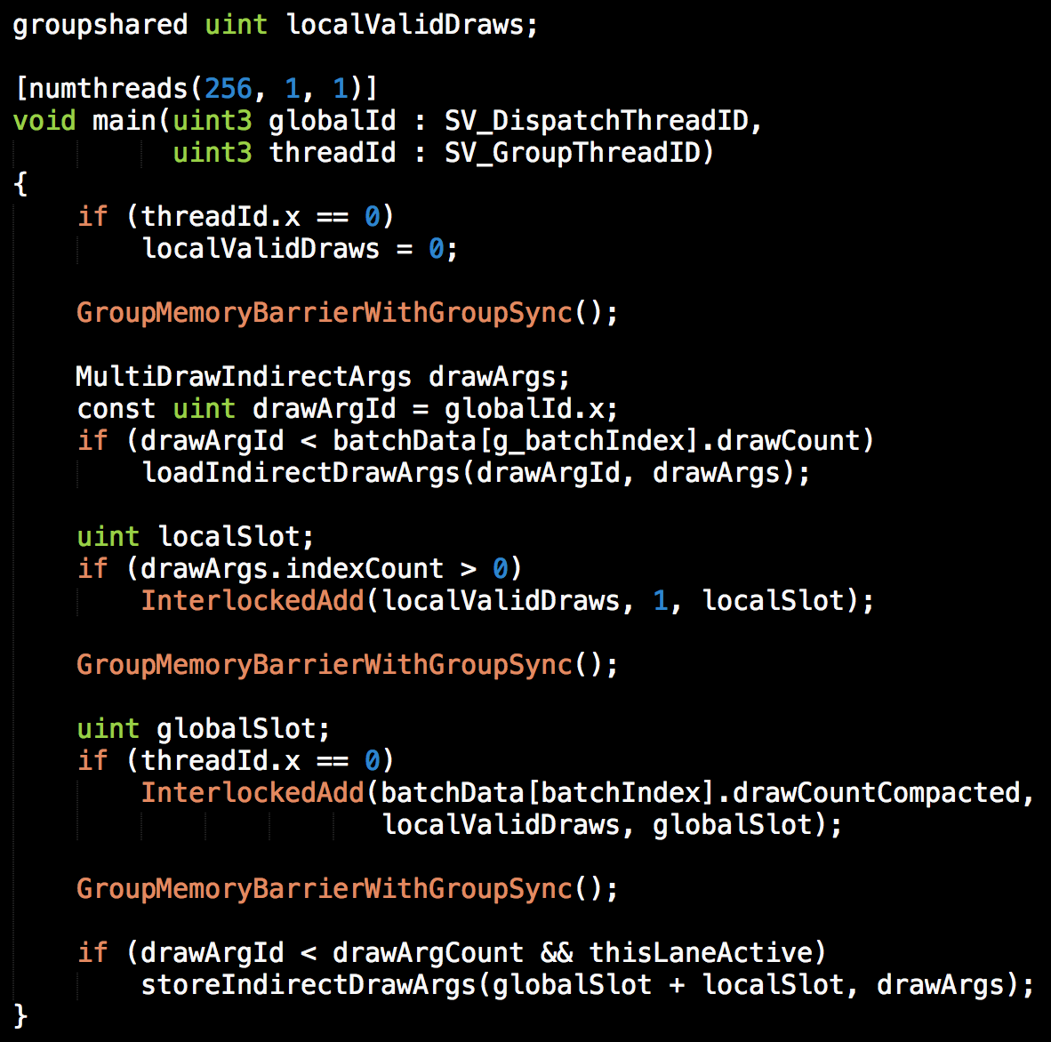
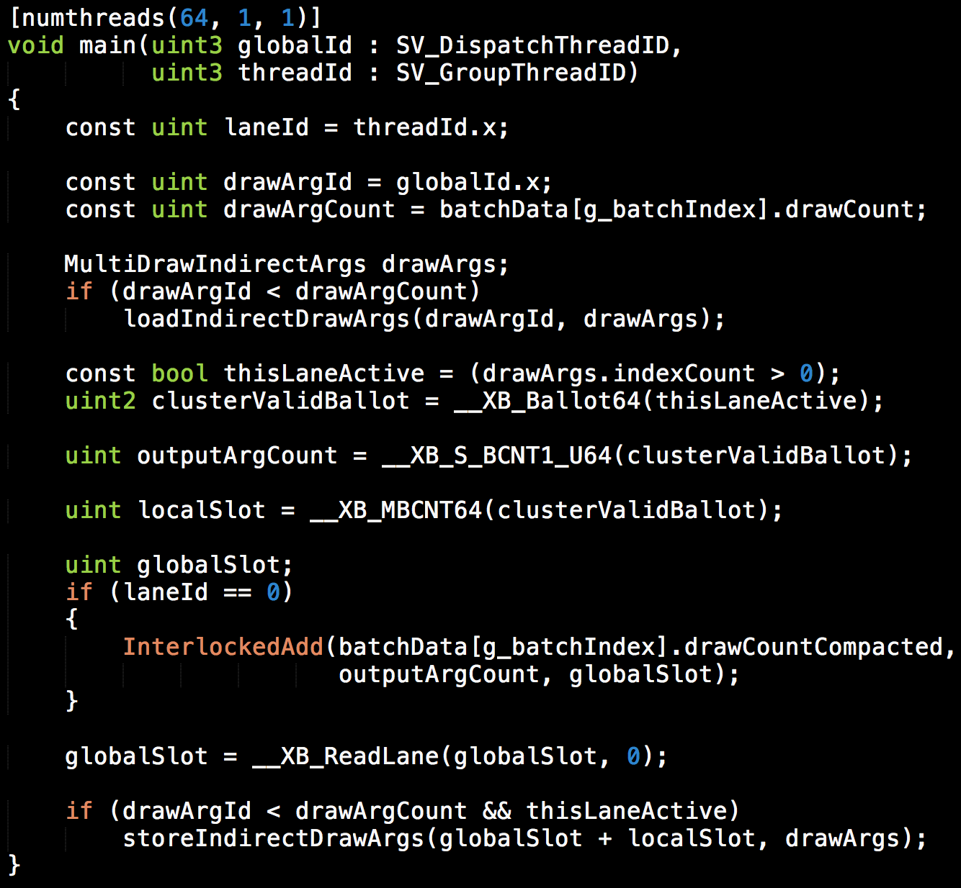

Writing
Compute Shaders
Fast
/** DO NOT CHANGE!! **/
Remove barriers
(numthreads = hardware warp size)
Remove smem and atomics
Replace with register swizzling
i.e. bypass the warp width abstraction
Write code directly for GPU warps
From “Optimizing the Graphics Pipeline with Compute” by Graham Wihlidal, GDC 2016
Notes:
Here’s an example compute shader written in a fairly portable style. Now what if we actually want to make this run fast?
Luckily, Graham showed us how to do this at GDC last year, but you’ll find the same sort of thing in optimized compute code.
Setting numthreads to the hardware warp size ensures that branching on threadId is only wasting SIMD lanes, not entire hardware warps, occupancy, etc.
By removing shared memory use we no longer need barriers.
Since we’re only running one warp per group, we can use warp operations and swizzling instead to share data.
This is actually a relatively simply example since the kernel itself is agnostic to the group size.
In most cases changing the thread group size to match the hardware instead of the data also implies adding loops and bounds checks everywhere as well.
What we’re really doing here is bypassing the compute shader execution model abstraction and instead writing code directly to the warps of the GPU.
This is all well and good when we’re writing code for a specific console, but what if we want to write fast compute shaders in a more portable way?

Slide 31
Writing Fast and Portable Compute Shaders
… is just not possible right now in the compute languages we have
  SIMD widths vary, sometimes even between kernels on the same hardware
  Reliance on brittle compiler “optimization” steps to not fall off the fast path
  Warp synchronous programming is not spec compliant [Perelygin 2017]
  No legal way to “wait” for another thread outside your group [Foley 2013]
Performance delta can be 10x or more
  Too large to accept compatible “fallback”
Is the SIMD width abstraction doing more harm than good?
Notes:
Unfortunately writing fast compute shaders that are also portable just isn’t really possible right now.
First, hardware SIMD widths vary, sometimes even between different kernels running on the same piece of hardware.
Second, getting the “fast path” with no barriers and appropriate use of scalar and vector operations relies on a number of somewhat brittle compiler optimizations steps.
Beyond these practical issues, writing warp synchronous code and omitting barriers is not spec compliant, even if it happens to work on the specific driver and hardware in your dev box.
Similarly, there’s no legal way for any warp to ever wait for another one outside of barriers, so any sort of “locks” or producer/consumer patterns are not allowed.
If writing the portable version was giving up 10 or 20% performance we’d probably just suck it up and write two paths, but in a lot of cases it can be an order of magnitude slower which is unworkable.
Given these realities, it’s worth asking if the current compute models – and in particularly their abstraction over SIMD widths – is actually doing more harm than good at this point.

Slide 32
More Explicit SIMD Model?
// No “numthreads”: this is called once per warp always
void kernel(float *data)
{
// Operations and memory at this scope are scalar, as you’d expect
int x = 0;
float4 array[128];
// Does not have to match hardware SIMD size: compiler will add a loop in the kernel as needed
parallel_foreach(int i: 0 .. N)
{
// This gets compiled to SIMD – this is like a regular shader in this scope
float d = data[i] + data[i + N];
// All the usual GPU per-lane control flow stuff works normally
if (d > 0.0f)
data[i] = d;
// Parallel for’s can be nested; various options on which scope/axis to compile to SIMD
parallel_foreach(int j: 0 .. M) { ... }
}
// Another parallel/SIMD loop with different dimensions; no explicit sync needed
parallel_foreach(int i: 0 .. X) { ... }
}
Notes:
Along these lines, one direction to go for games is to make SIMD a bit more explicit instead of implicit.
If we give up on the SIMD width abstraction, as well as shared memory , groups and barriers we can easily come up with much cleaner and portable syntax.
Borrowing a bit from ISPC, you can create a pretty clean language based on nested parallel foreach statements.
The code here is just an example – it doesn’t have to be this exact syntax or semantics, but the point is we should really be exploring some of these avenues given the issues with the current compute execution models.

Slide 33

Quadtree Recursion on the GPU?
void TileRecurse(int level, TileData tileData)
{
if (level == 0 || isBaseCase(tileData))
return baseCase(tileData);
else
{
// Subdivide and recurse
TileData subtileData[4];
computeSubtileData(level, tileData, subtileData);
--level;
spawn TileRecurse(level, subtileData[0]);
spawn TileRecurse(level, subtileData[1]);
spawn TileRecurse(level, subtileData[2]);
spawn TileRecurse(level, subtileData[3]);
}
}
*
error X3500: 'TileRecurse': recursive functions not allowed in cs_5_1
* exception: CUDA dynamic parallelism
Notes:
In terms of dispatch, let’s think about how we might want to express the algorithm in a more direct manner.
I’ve borrowed a Cilk-like syntax for spawning recursive work here, but you can easily substitute TBB, PPL or a home grown work stealing task scheduler to your liking.
The key point her is that this *style* of code is fine for a massively data-parallel processor like GPU.
Unfortunately, if you try to write this in HLSL you’re going to get a rude awakening.

Slide 34
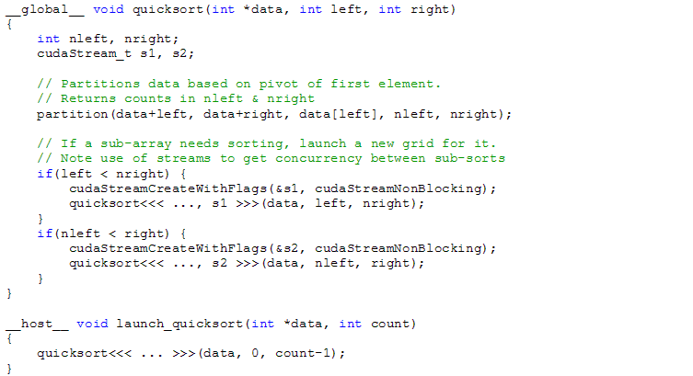
CUDA Dynamic Parallelism
From “How Tesla K20 Speeds Quicksort, a Familiar Comp-Sci Code”, Blog Post, Link
Notes:
But… you actually can write something similar to this code in CUDA, which is pretty awesome.

Slide 35
CUDA Dynamic Parallelism
CUDA does support recursion including fork and join!
  CUDA also supports separate compilation
Performance issues remain
  Mostly syntactic sugar for spilling, indirect dispatch, reload
  Not really targeted at games and real-time rendering
Definitely an improvement on the semantic front
  Get similar capabilities into HLSL and implementations improve over time?
  Chicken and egg problem with game performance (ex. geometry shaders)

Slide 36
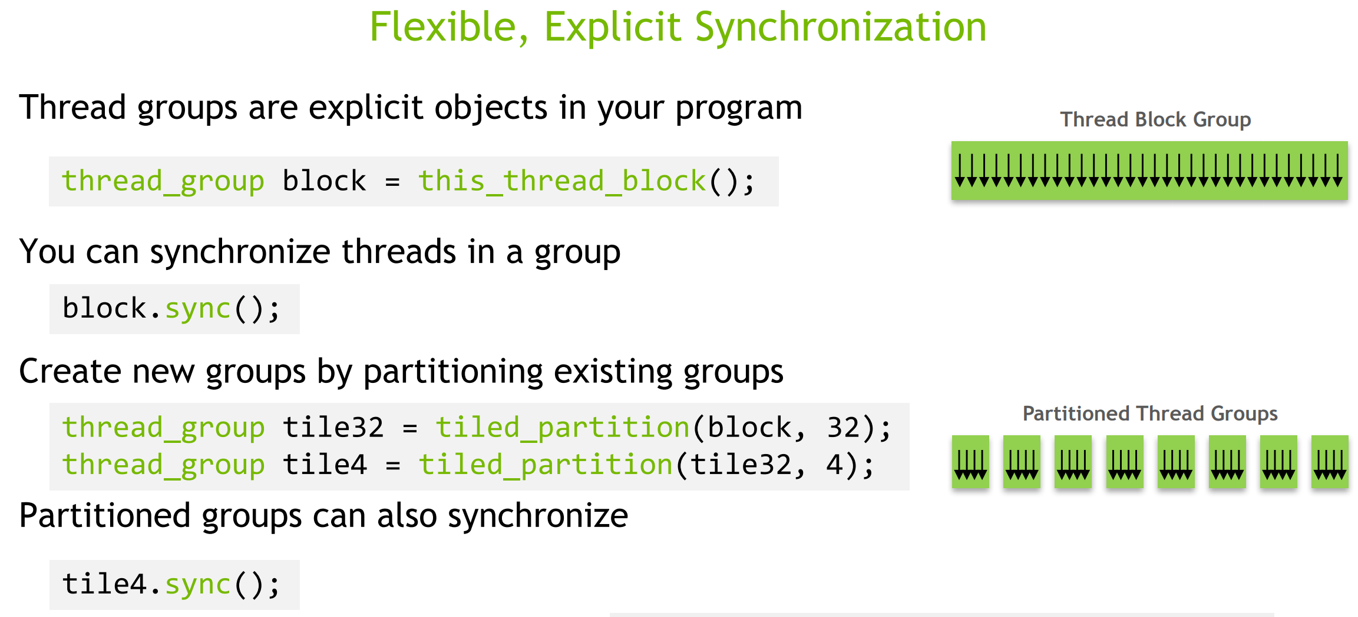
CUDA Cooperative Groups
From “CUDA 9 and Beyond” by Mark Harris, GTC 2017
Notes:
CUDA cooperative groups are another interesting direction for improvements.
They attack the composability and warp width abstraction problem by generalizing thread groups into an explicated nested-parallel style primitive that can be subdivided, synchronized and share data safely.
This allows writing reusable code that is relatively independent of the calling context, both in terms of the nature of the cooperating threads, but also in terms of any dynamic control flow at the call site.
The abstraction extends beyond warps and thread groups to cooperation across the whole GPU, or even between multiple GPUs.
While the syntax may or may not be a good fit for graphics, the fundamental hardware capabilities that it is exposing are really required for writing fast, portable compute code in the future.

Slide 37
Hierarchical Structures Takeaways
Nested parallelism and trees are key components of many algorithms
  We need an efficient, portable way to express these
Current compute languages are not particularly suitable
  Only way to write efficient code is to defeat the abstractions
We need new languages and language features
  Map/reduce? Fork/join?
  CUDA cooperative groups?
  ISPC [Pharr 2012]? BSGP [TOG 2008]? Halide [Ragan-Kelly 2013]?
Good opportunity for academia and industry collaboration!

Slide 38
Code Compatibility and Reuse
Notes:
In addition to the larger items, there’s a bunch of smaller items that inhibit our ability to write reusable code that we should just fix ASAP.

Slide 39
Compute Language Basics
C-like, unless there’s a compelling reason to deviate
  Including all the regular C types… 8/16/32/64-bit
Buffers
  Structured buffers
  “Byte address buffers” (really dword + two extra 0 bits for fun!)
  Constant buffers, texture buffers, typed buffers, …
REAL pointers please!
  We’ve already taken on all of the “negative” aspects with root buffers (DX12)
  Now give us the positives

Slide 40
Compute Language Basics
Resource binding and shader interface mess
  Even just between DX12 and Vulkan this is a giant headache
Get rid of “signature” and “layout” glue
  Replace with regular structures and positional binding (i.e. “function calls”)
  Pointers for buffers, bindless for textures
DX12 global heap is an acceptable solution for bindless
  Must be able to store references to textures in our own data structures
  Ideal would be to standardize a descriptor size (or even format!)

Slide 41
Compute Language Basics
Avoid/remove weird features that end up as legacy pain
  UAV counters
  Be very careful with shader “extensions”
Mature JIT compilation setup
  DXIL/SPIR-V make this both better and worse…
  Shader compiler/driver cannot be allowed to emit compilation errors (!!)
  We cannot have random errors on end user machines
Notes:
UAV counters and their weird semantics in DirectX are a perfect example of a feature that might have felt like a good idea at the time when an IHV had some shiny new hardware, but the semantics are strange, and now we’ll have to replicate them long after the underlying hardware has changed.

Slide 42
Compute Language Essentials
CPU/GPU interoperation and synchronization
  Low latency, bi-directional submission, signaling and atomics
  … in user space
Shared data structures
  Consistent structure layouts and alignment between CPU/GPU

Slide 43
Call to Action

Slide 44

Compute for Graphics
Notes:
This is a common meme, but it’s an appropriate one.
We’ve convinced ourselves that the compute ecosystem is workable, as long as we just work around a bunch of minor things.
But in the back of our minds when we’re rewriting an optimized reduction for the 100th time, we’re at least vaguely aware that things might not actually be fine.
Hopefully most of us are ready to admit there are problems, as we all have a part in fixing this.

Slide 45
Call to Action
Hardware vendors
  More dynamic resource allocation and scheduling
  Less sensitive to “worst case” statically reachable code
  Dynamic warp sorting and repacking
  Unified compression and format conversions on all memory paths
Operating system vendors
  GPUs as first class citizens (like another “core” in the system)
  Fast, user-space dispatch and signaling
  Shared virtual memory
Notes:
Whether or not we make heavy use of shared virtual memory, it needs to be supported for orthogonality.

Slide 46
Call to Action
Standards bodies
  Be willing to make breaking changes to compute execution models
  Forgo some low level performance (optionally) for better algorithmic expression
  Resist being bullied by hardware vendors ☺
Academics and language designers
  Innovate on new efficient, composable, and robust parallel languages
  Work with industry on requirements and pain points
Game developers
  Let people know that the status quo is not fine
  Help the people who are working to improve it!

Slide 47
Conclusion
Recently industry did explicit graphics APIs
  Data-parallel intermediate languages (DXIL, SPIR-V)
Next problem to solve is compute
  Want to take real-time graphics further
  Ex. 8k @ 90Hz stereo VR with high quality lighting, shading and anti-aliasing
  Need to render “smarter”
Requires industry-wide cooperation!
Notes:
Recently the industry did a large shift towards more explicit graphics APIs with data-parallel intermediate languages.
I hope I’ve convinced you that the next big problem for the industry to solve in this area is compute.
We really want to take real-time graphics further, and realistically we’re not going to get to stuff like 8k VR rendering with brute force algorithms.
We’re also not going to get anywhere by finger pointing about whose responsibility it is to fix this.
We all need to work together.

Slide 48
Acknowledgements
Aaron Lefohn (@aaronlefohn)
Alex Fry (@TheFryster)
Colin Barré Brisebois (@ZigguratVertigo)
Dave Oldcorn
Graham Wihlidal (@gwihlidal)
Jasper Bekkers (@JasperBekkers)
Jefferson Montgomery (@jdmo3)
Johan Andersson (@repi)
Matt Pharr (@mattpharr)
Natalya Tatarchuk (@mirror2mask)
Neil Henning (@sheredom)
Tim Foley (@TangentVector)
Timothy Lottes (@TimothyLottes)
Tomasz Stachowiak (@h3r2tic)
Yuriy O'Donnell (@YuriyODonnell)

Slide 49
References
Brodman, James et al. Writing Scalable SIMD Programs with ISPC, WPMVP 2014, Link Web Site
Burns, Christopher and Hunt, Warren, The Visibility Buffer: A Cache-Friendly Approach to Deferred Shading, JCGT 2013, Link
Foley, Tim, A Digression on Divergence, Blog Post in 2013, Link
Giroux, Olivier and Durant, Luke, Inside Volta, GTC 2017, Link
Haar, Ulrich and Aaltonen, Sebastian, GPU-Driven Rendering Pipelines, Advances in Real-Time Rendering 2015, Link
Harris, Mark, CUDA 9 and Beyond, GTC 2017, Link
Hou, Qiming et al. BSGP: Bulk-Synchronous GPU Programming, TOG 2008, Link
Jones, Stephen, Introduction to Dynamic Parallelism, GTC 2012, Link
O’Donnell, Yuriy and Chajdas, Matthäus, Tiled Light Trees, I3D 2017, Link
Perelygin, Kyrylo and Lin, Yuan, Cooperative Groups, GTC 2017, Link
Pharr, Matt and Mark, William, ISPC: A SPMD Compiler for High-Performance SIMD Programming, InPar 2012, Link
Ragan-Kelly, Jonathan et al. Halide: A Language and Compiler for Optimizing Parallelism, Locality and Recomputation in Image Processing Pipelines, PLDI 2013, Link Web Site
Stachowiak, Tomasz, A Deferred Material Rendering System, Blog Post 2015, Link
Wihlidal, Graham, 4K Checkerboard in Battlefield 1 and Mass Effect Andromeda, GDC 2017, Link
Wihlidal, Graham, Optimizing the Graphics Pipeline with Compute, GDC 2016, Link

